Slide 1
WVU Medicine Pain Conference, May 27, 2022
Neuromodulation therapies for the treatment of
Migraine
Umer Najib, MD, FAAN, FAHS
Associate Professor of Neurology
Rockefeller Neuroscience Institute
West Virginia University
Department of Neurology

Slide 2
Relevant Disclosures
I will talk about on- and off-label application of devices
PI on clinical trials – Teva, Lilly, Electrocore, Theranica.

Slide 3
Objectives
Describe Neuromodulation
Identify when to consider Neuromodulation and/or Interventional procedures in the treatment of Migraine
Outline common types of Neuromodulation used in Migraine treatment
Review the literature supporting Neuromodulation in Migraine treatment

Slide 4
Neuromodulation
International Neuromodulation Society:
  ‘the alteration of nerve activity through targeted delivery of a stimulus, such as electrical stimulation or chemical agents, to specific neurological sites in the body’.
In migraine treatment:
  “invasive or noninvasive manipulation of central or peripheral pain pathways with electrical current for the purpose of functional modification of the nociceptive system”
Notes:
In the realm of the treatment of headache disorders, electrical neuromodulation refers to ……

Slide 5
Management of Migraine
Abortive treatment
  NSAIDs
  Triptans
  Ergotamine
  Ditans
  Gepants
Preventive treatment
  Antidepressants
  Anticonvulsants
  Beta Blockers
  CGRP MAB
  OnabotulinumtoxinA
Neuromodulation – both abortive and preventive treatment
Notes:
Neuromodulation typically used in refractory cases, in addition to pharmacological therapy. Neuromodulation is potentially useful in both acute and preventive treatment.

Slide 6
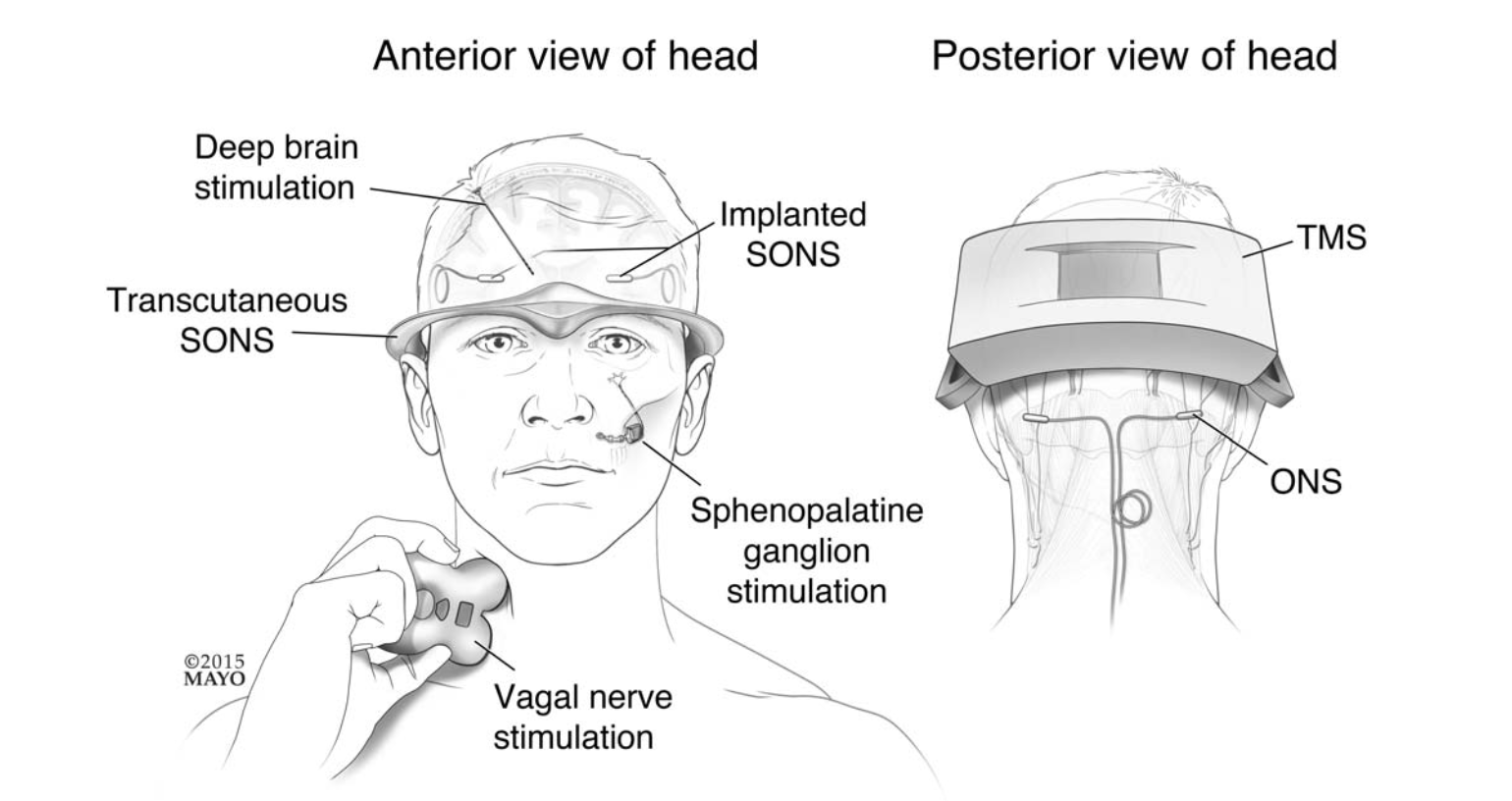
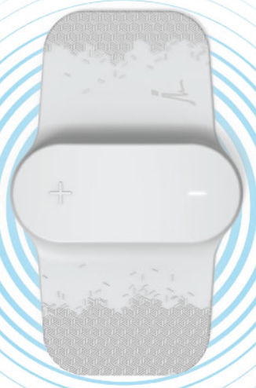
Neuromodulation in Headache Disorders
REN
Schwedt TJ, Vargas B. Pain Med. 2015 Sep;16(9):1827-34

Slide 7
Neuromodulation in Headache Disorders
REN
Schwedt TJ, Vargas B. Pain Med. 2015 Sep;16(9):1827-34

Slide 8
Neuromodulation in Migraine
Noninvasive
  Transcranial Magnetic Stimulation (TMS)
  External Trigeminal Nerve Stimulation (eTNS)
  Noninvasive vagus nerve stimulation (nVNS)
  Peripheral electrical stimulation (PES) or Remote electrical neuromodulation (REN)
Invasive
  Occipital nerve stimulation (ONS)

Slide 9
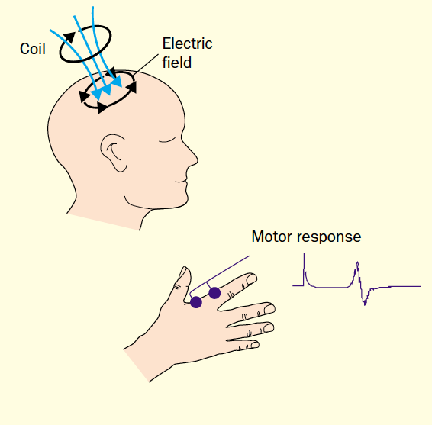
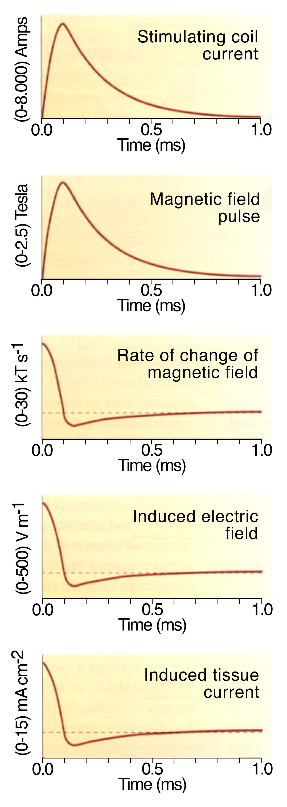
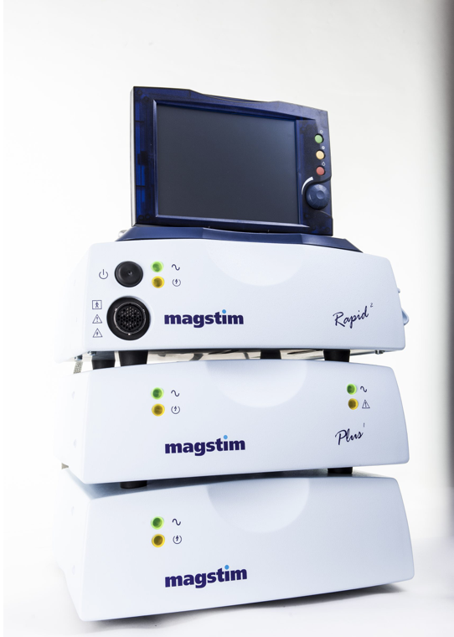
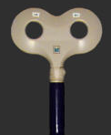
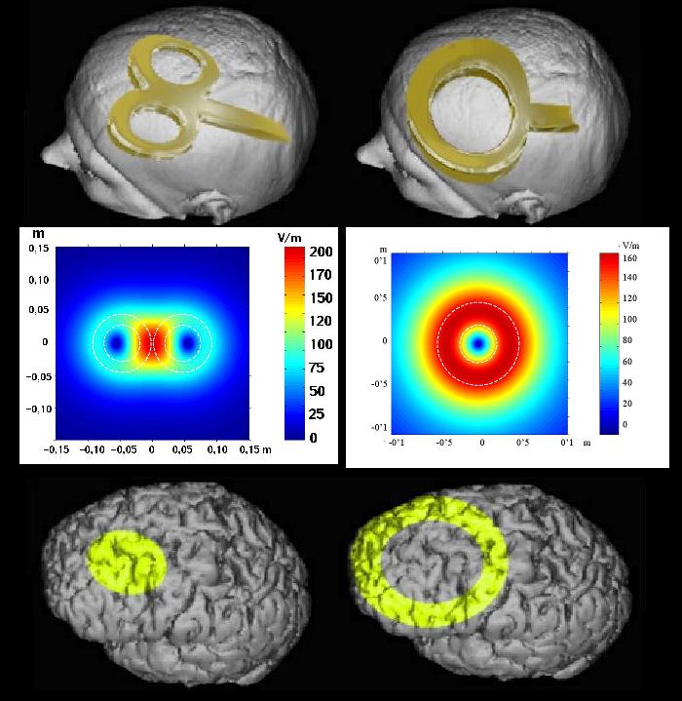
Transcranial Magnetic Stimulation (TMS)

Slide 10
TMS
Diagnostic Applications
Central Motor Conduction
Motor Cortical Output Mapping
Cortical Reactivity
Cortical Plasticity
  Metaplasticity
  Functional Connectivity
    Cortico-cortical
    Cortico-subcortical
  Intra-cortical E/I Balance
Therapeutic Applications
Medication Refractory Depression
  Lancet 1995
  FDA Approval, Neuronetics, 2008
Migraine
  Lancet 2010
  FDA approval, Spring TMS/eNeura, 2013 for Migraine
Stroke/Neurorehabilitation
Alzheimer’s disease
Parkinson’s disease
Epilepsy
….

Slide 11
TMS
Diagnostic Applications
Central Motor Conduction
Motor Cortical Output Mapping
Cortical Reactivity
Cortical Plasticity
  Metaplasticity
  Functional Connectivity
    Cortico-cortical
    Cortico-subcortical
  Intra-cortical E/I Balance
Therapeutic Applications
Medication Refractory Depression
  Lancet 1995
  FDA Approval, Neuronetics, 2008
Migraine
  Lancet 2010
  FDA approval, Spring TMS/eNeura, 2013 for Migraine
Stroke/Neurorehabilitation
Alzheimer’s disease
Parkinson’s disease
Epilepsy
….

Slide 12
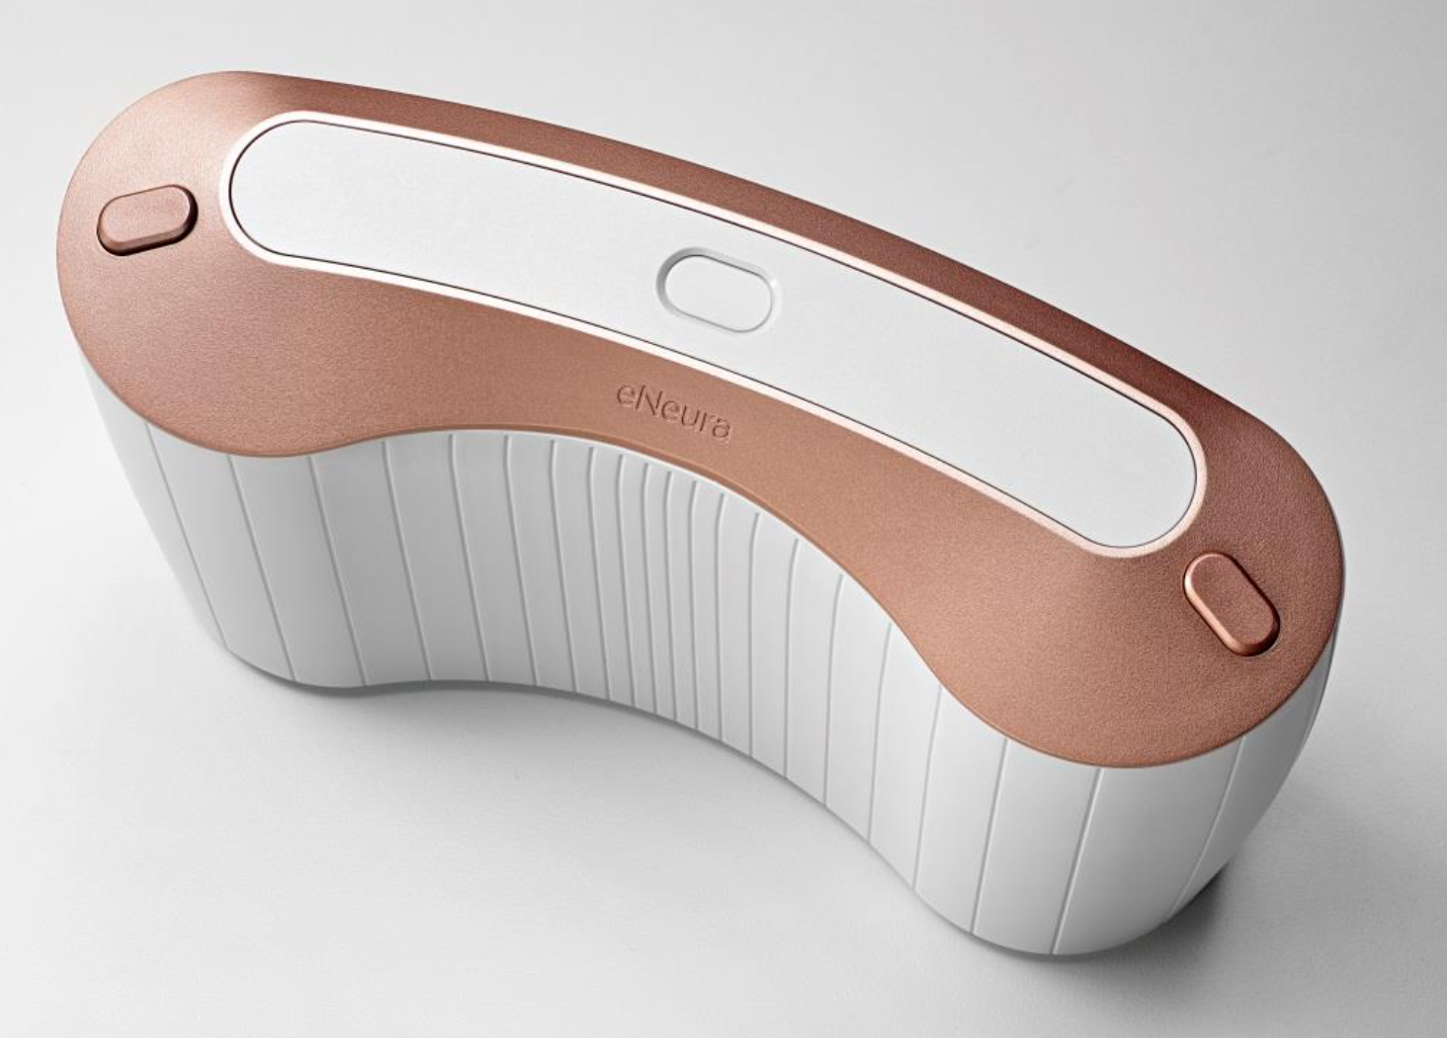
TMS in Migraine
Noninvasive
Abortive and preventive treatment
Type of studies:
  Randomized sham-controlled trial (abortive)
  Open-label studies (preventive)
Stimulation related adverse events
  Tingling, tinnitus
  Lightheadedness
FDA approval: Acute & preventive treatment in adults and adolescents > age 12 years
Notes:
FDA approval, Spring TMS, 2013 for Migraine w/ aura
2017: preventive treatment added to indications
USE:
Prevention
Treat with 4 pulses each morning and evening 2 consecutive pulses
Wait 15 minutes
Repeat the 2 consecutive pulses
Acute
3 sequential pulses (early) at the onset of migraine pain Wait 15 minutes
If needed, treat with additional 3 pulses
Wait 15 minutes
If needed, treat with additional 3 pulses

Slide 13
TMS in Migraine - MOA
Disruption of cortical spreading depression (CSD)
Modulation of thalamic nociceptive circuit activity via downregulation of thalamocortical neurons
Holland et al. Cephalalgia. 2009;29(Suppl 1):22.
Andreou et al. Headache. 2010;50(Suppl 1):58.
Notes:
MOA: disruption of cortical spreading depression (CSD) and modulation of thalamic nociceptive circuit activity via down- regulation of thalamocortical neurons

Slide 14
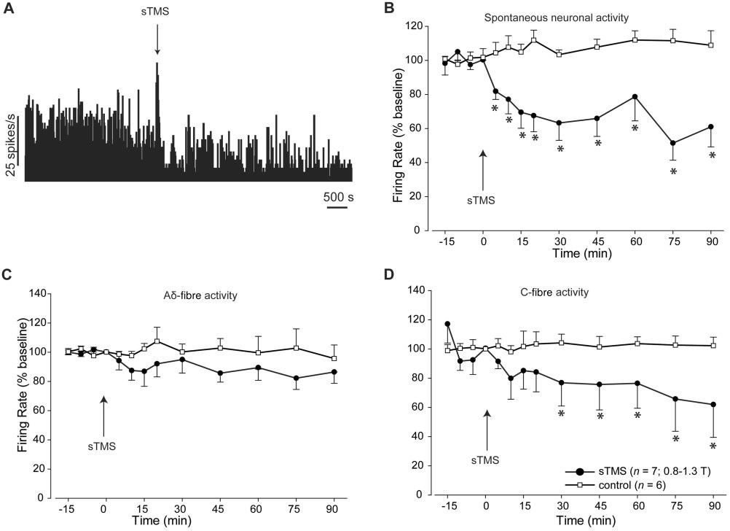
TMS in Migraine - MOA
Thalamocortical modulation - sTMS preclinical model
Andreou et al., Brain 2016

Slide 15
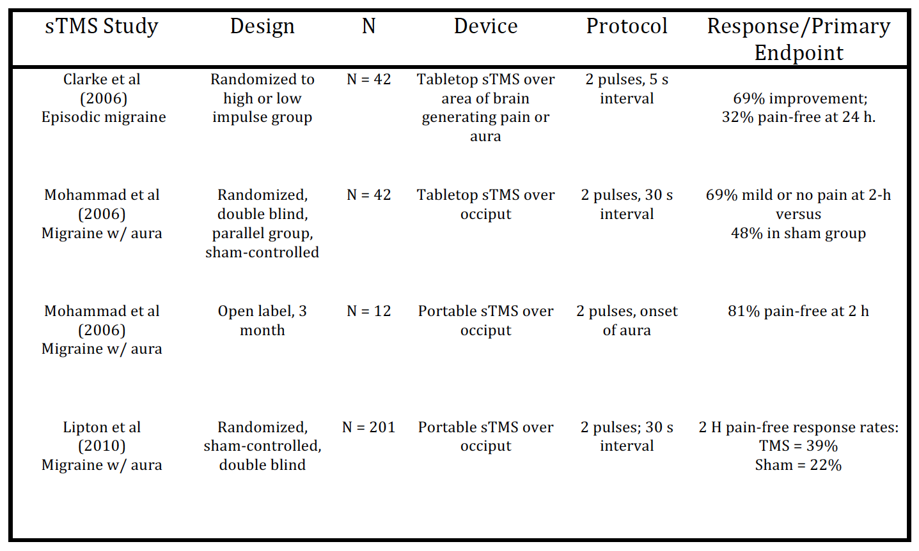
TMS for Migraine (abortive)

Slide 16
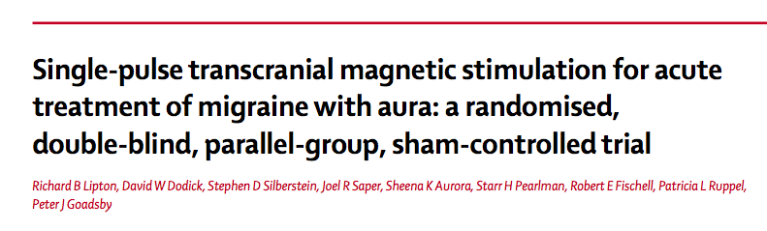
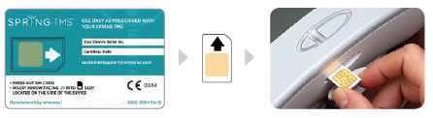
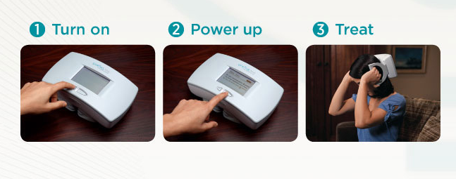
TMS for Migraine (abortive)
  FDA approval, Spring TMS, 2013 for abortive treatment of MA
Lipton et al., Lancet Neurol 2010
Notes:
FDA approval, Spring TMS, 2013 for Migraine w/ aura
2017: preventive treatment added to indications

Slide 17
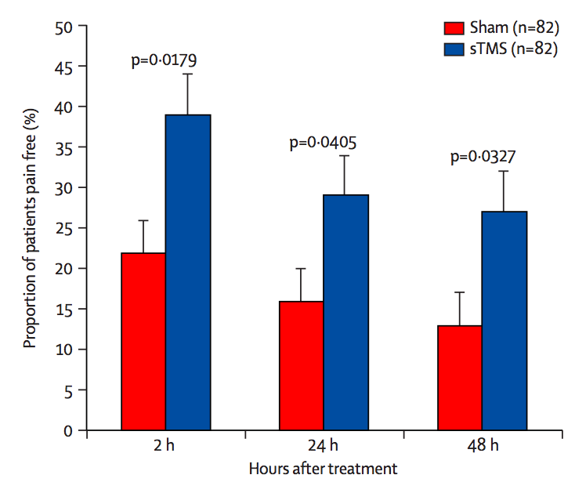
TMS in Migraine (abortive)
Lipton et al., Lancet Neurol 2010
Notes:
sTMS (n=82) or sham stimulation (n=82; modified intention-to-treat analysis set).
Pain-free at 2 h: sTMS 39% vs sham stimulation 22%

Slide 18
TMS in Migraine (prophylaxis)
sTMS Open Label Study: Pulsed BID and PRN

Slide 19
TMS in Migraine (prophylaxis)
ESPOUSE Study
Starling AJ et al. Cephalalgia. 2018 May;38(6):1038-1048
Notes:
N=132
In this study, a performance goal, a statistically derived placebo response, was used as the comparator
The primary endpoint was the mean reduction from baseline in headache days compared to the performance goal.
Treatment Protocol: 4 pulses twice a day

Slide 20
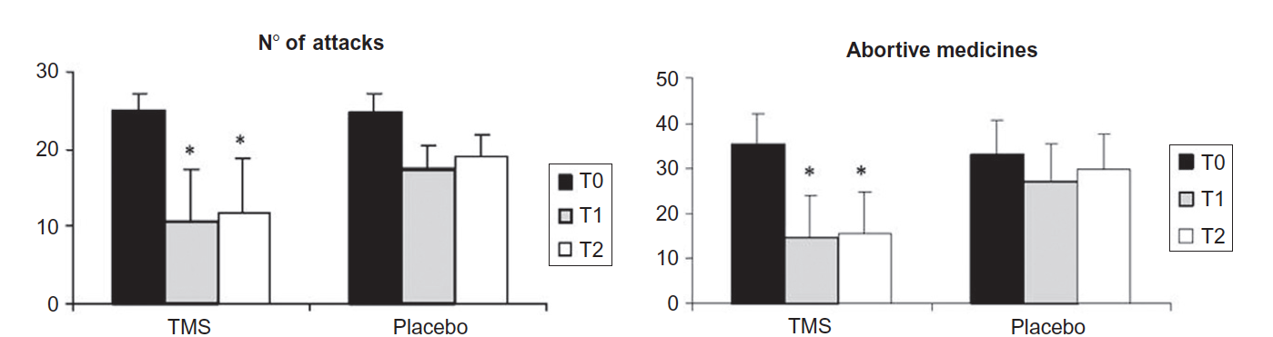
rTMS for Migraine (prophylaxis)
High frequency rTMS (excitatory) to DLPFC as preventive treatment for migraine (n: 11)
  Results: reduction in migraine attacks, drug consumption, headache index
Brighina et al., J Neurol Sci 2004
Notes:
T0: before TMS
T1: during TMS treatment phase
T2: 1 month post
Protocol: 12 stimulation sessions 10 trains of 40 TMS pulses, separated by a 30-second pause, delivered at 20 Hz frequency and 90% MT intensity

Slide 21
rTMS for Migraine (prophylaxis)
rTMS vs botulinum toxin in chronic migraine prophylaxis
N = 29
rTMS = 10 Hz, 12 sessions
Target = M1
Shehata et al., J Pain Res 2016

Slide 22
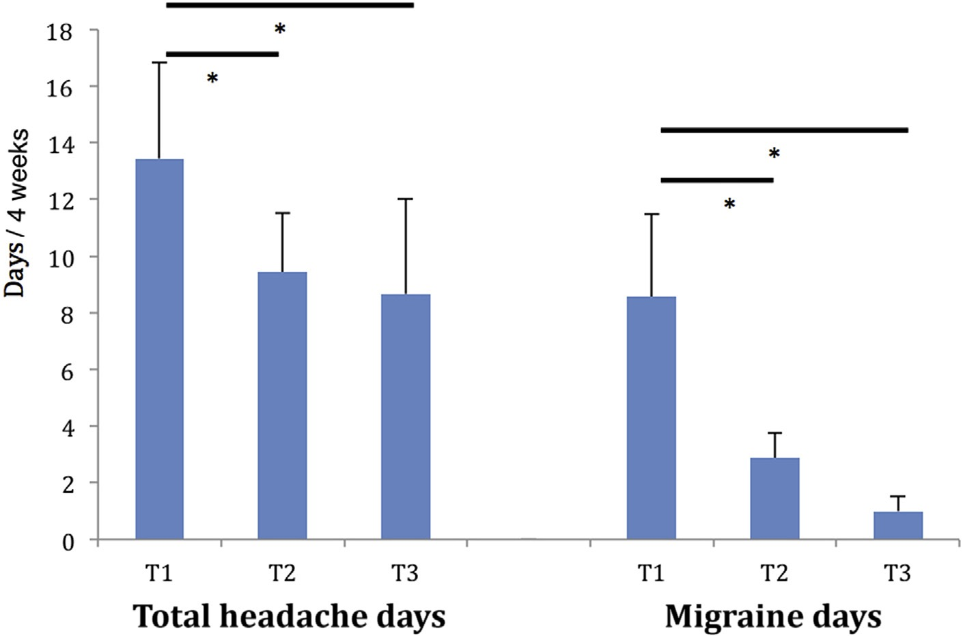
cTBS for Migraine (prophylaxis)
N = 9
cTBS = 20 sessions (4 wks)
Target = M1
T1 = baseline
T2 = during stimulation
T3 = 4 weeks post stimulation
Chen et al., JCMA 2016
Notes:
T1= baseline
T2= during stimulation
T3= 4 weeks after stimulation.

Slide 23
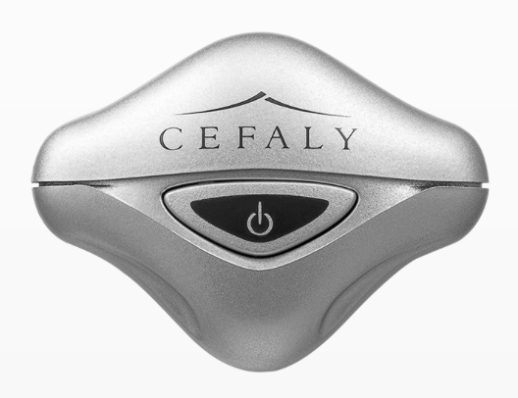
External Trigeminal Nerve Stimulation (eTNS)
Noninvasive
Preventive and abortive treatment
Type of studies:
  Randomized, sham-controlled trial (prevention)
  Open-label studies (abortive)
Stimulation related adverse events
  Paresthesia
  Sleep-wake disturbances
FDA approval: Acute & preventive treatment in adults age 18 and up
Notes:
FDA approval for preventive treatment: 2014
2017: acute treatment added to indications
USE:
Acute - 1 hour; prevention – 20 min daily

Slide 24
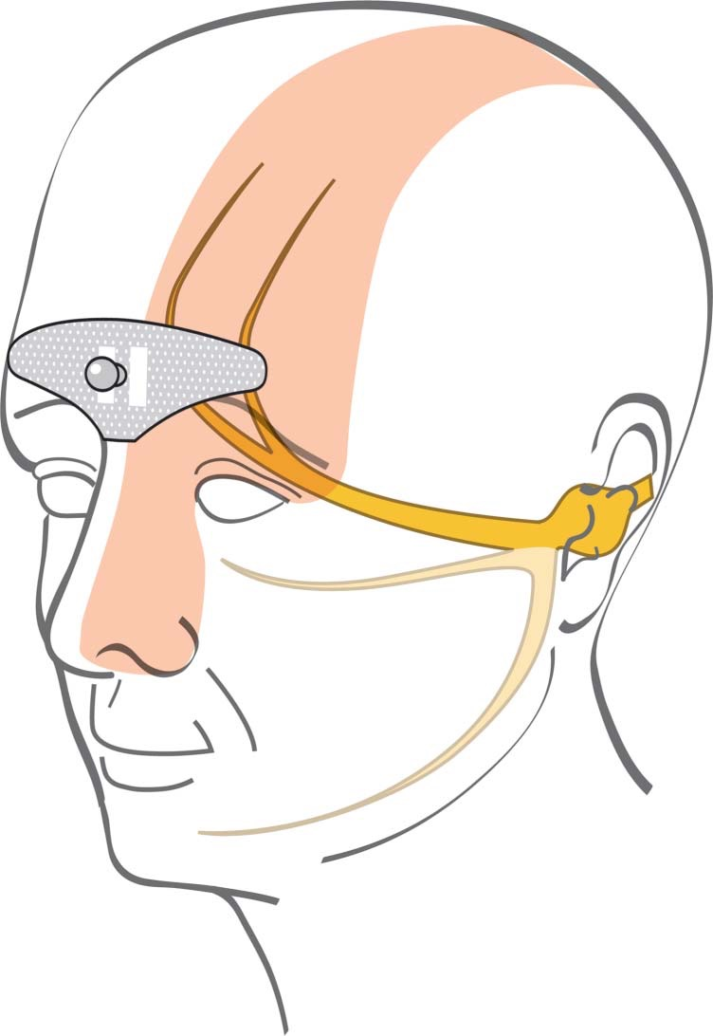
eTNS - MOA
Stimulation of bilateral supratrochlear and supraorbital nerves

Slide 25
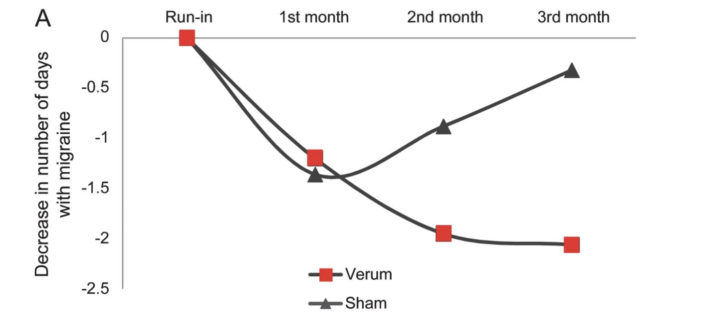
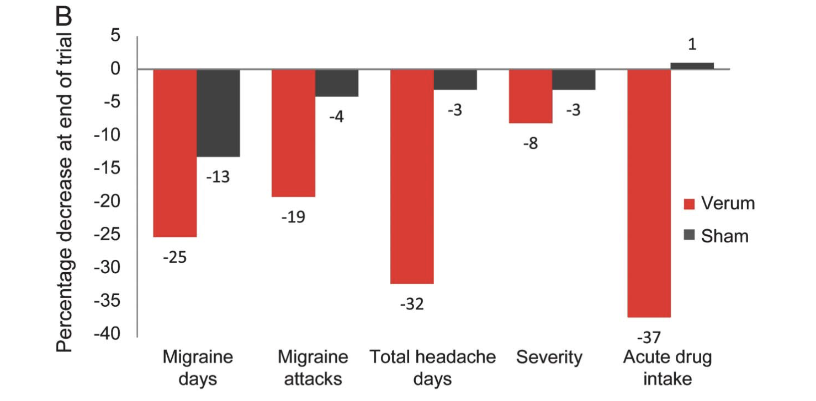
eTNS (prophylaxis)
Schoenen J, et al. Neurology. 2013;80:697-704.

Slide 26
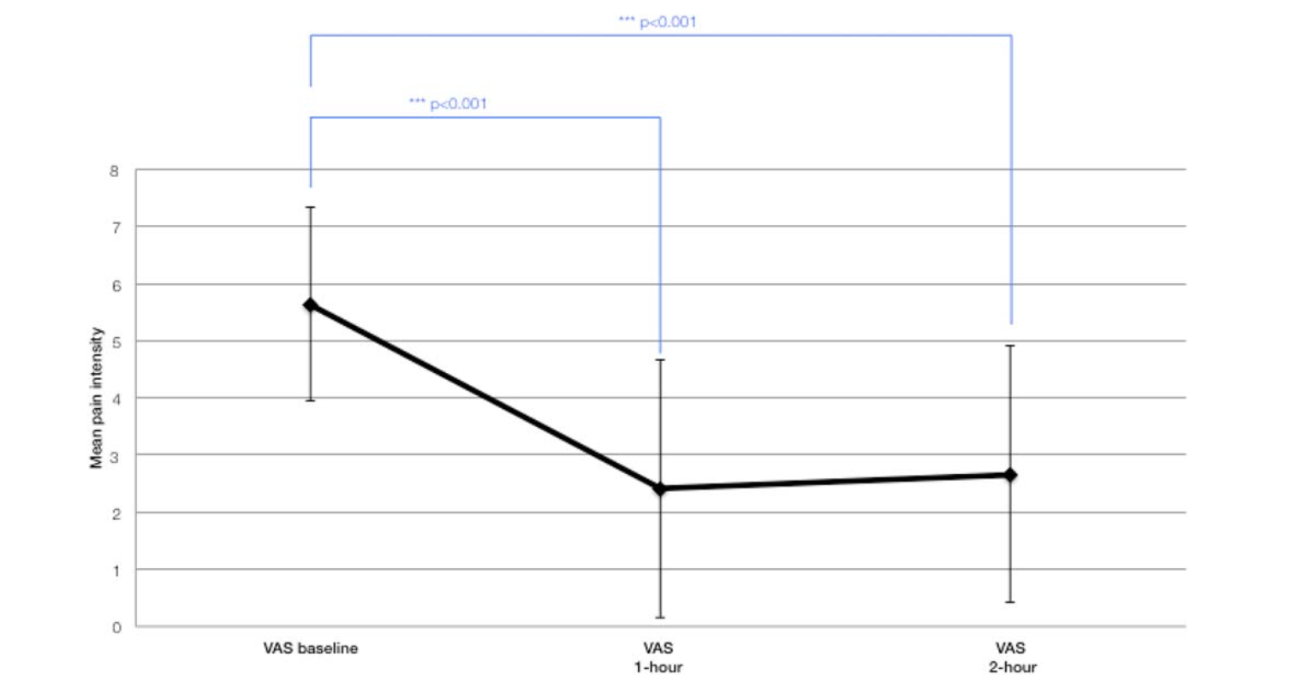
eTNS (abortive)
Chou DE, et al. Neuromodulation. 2017;20:678-683
Notes:
On average, pain intensity was reduced from 5.63 to 2.42 after one hour of treatment and to 2.66 at two hours.
N: 30
Primary outcome was the mean change in pain intensity after the one-hour treatment, compared to baseline.

Slide 27
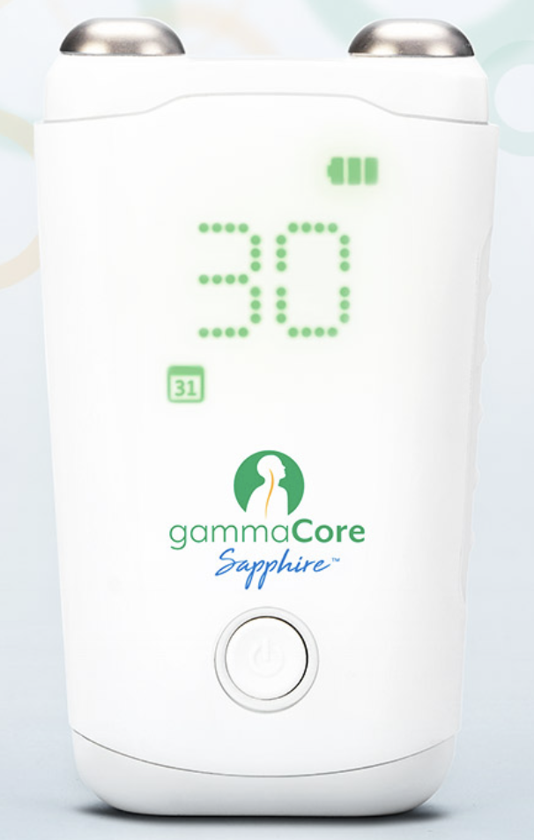
Noninvasive vagus nerve stimulation (nVNS)
Noninvasive
Abortive and preventive treatment
Type of studies:
  Randomized, sham-controlled trials
  Open-label studies
Stimulation related adverse events
  Lip/face pulling/twitching
  Dizziness, neck pain
  Burning/tingling/soreness
FDA approval: Acute and preventive treatment in adults age 18 and up
Notes:
Electrical impulses transcutaneously to the cervical branch of the vagus nerve
low-voltage electrical signal comprising a 5-kHz sine wave burst lasting for 1 millisecond (five sine waves, each lasting 200 microseconds), with such bursts repeated once every 40 milliseconds (25 Hz), generating a 24-V peak voltage and 60-mA peak output current; users could adjust the stimulation amplitude
- ACT 1: Sham device–associated pain may have also produced a diffuse noxious inhibitory control (DNIC) effect, a phenomenon in which the application of a noxious electrical stimulus to remote body regions inhibits dorsal horn activity and attenuates the original pain. Potential place- bo and DNIC effects in the sham group may have reduced the magnitude of the therapeutic benefit associated with nVNS treatment.
- In ACT 1:
Burning/tingling/soreness (more in sham)
Skin irritation/redness (only in sham)
Dysgeusia (only in sham)
FDA approval for acute cluster treatment in April 2017. Label expanded to acute migraine treatment in Jan 2018.
Premium 2 ongoing for migraine prevention

Slide 28
nVNS - MOA
Preclinical data: inhibits the trigeminovascular pathway and suppresses extracellular glutamate in the central nervous system.
  Affects multiple areas such as nucleus tractus solitarius, trigeminal nucleus caudalis, spinal trigeminal nucleus, dorsal raphe nuclei, hypothalamus, locus coeruleus, and periaqueductal grey.
Modulates the susceptibility to cortical spreading depression.
Notes:
affects multiple areas involved in pain transmission and in migraine pathophysiology

Slide 29
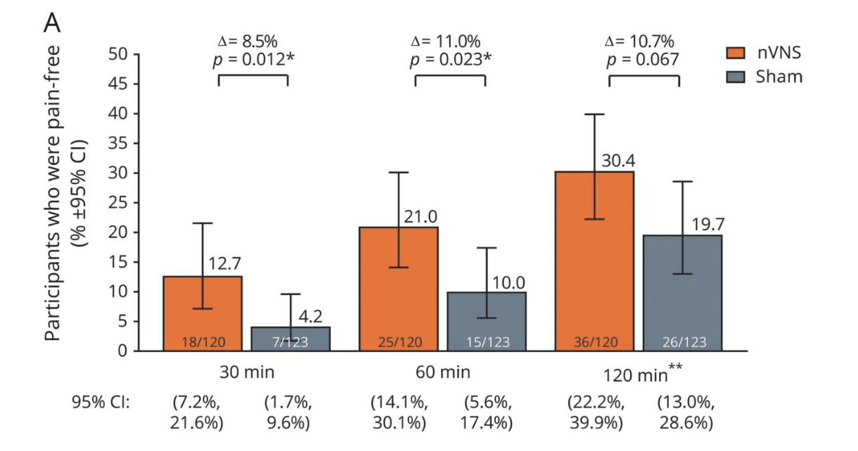
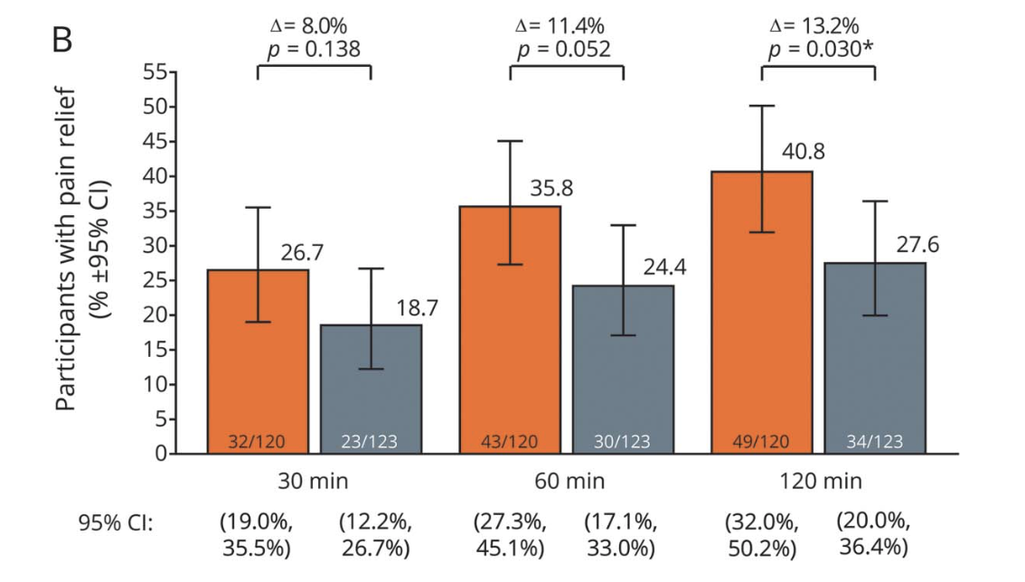
nVNS
PRESTO Study
Tassorelli C, et al. PRESTO study. Neurology. 2018;91:e364-e373.
Notes:
- Primary endpoint was the proportion of participants who were pain- free without using rescue medication at 120 minutes

Slide 30
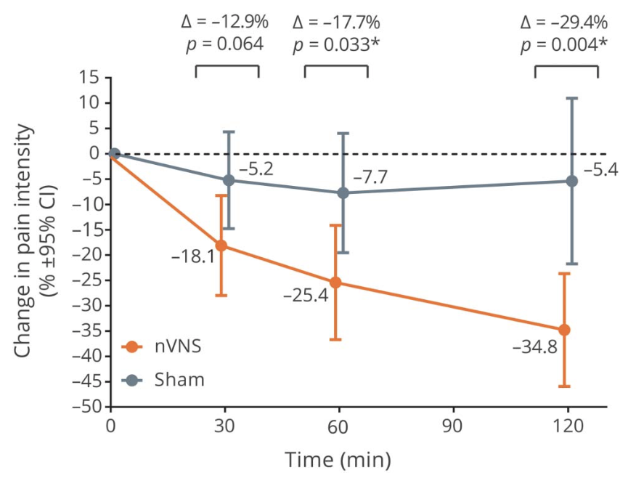
nVNS
PRESTO Study
Mean percentage pain score reductions
Tassorelli C, et al. PRESTO study. Neurology. 2018;91:e364-e373.

Slide 31
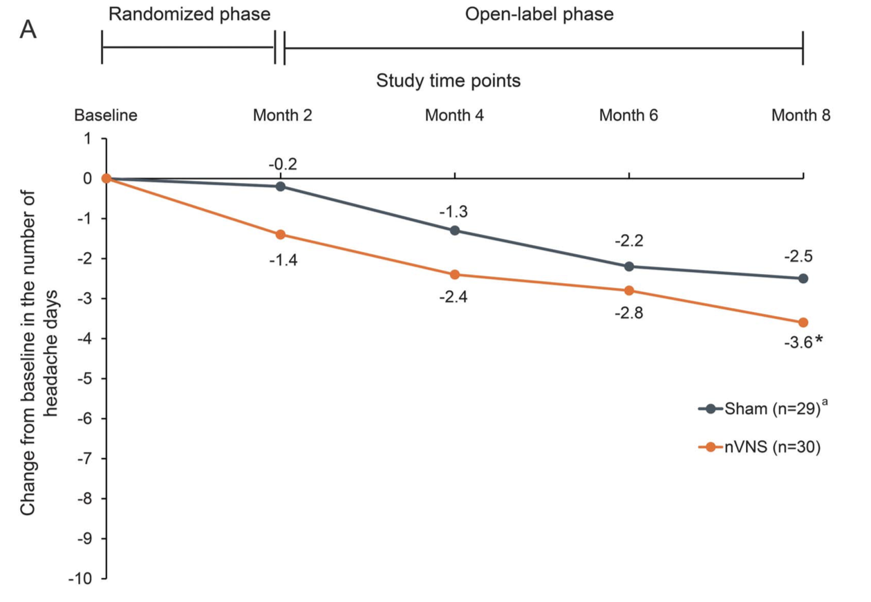
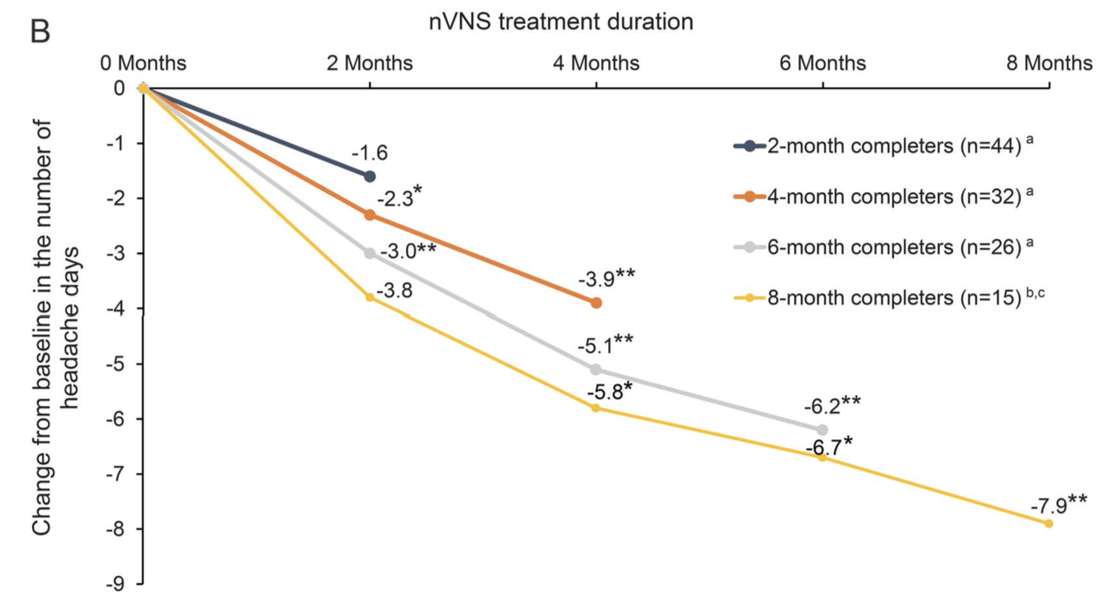
nVNS
EVENT Study
Silberstein SD, et al. EVENT study. Neurology. 2016 Aug 2;87(5):529-38.
Notes:
N:59

Slide 32
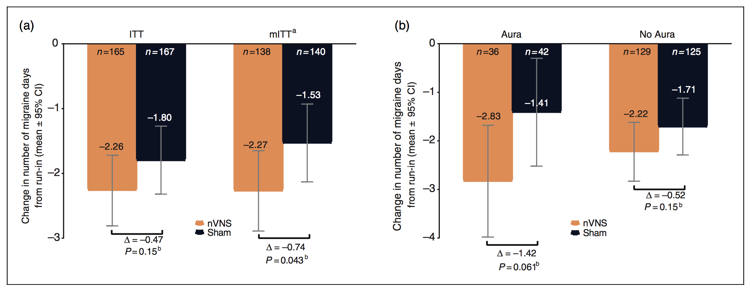
nVNS
PREMIUM Trial
Diener HC, et al. PRIMIUM Trial. Cephalalgia. 2019 Oct;39(12):1475-1487.
Notes:
Preventive nVNS treatment in episodic migraine was not superior to sham stimulation in the ITT popu-lation. The ‘‘sham’’ device inadvertently provided a level of active vagus nerve stimulation. Post hoc analysis showed significant effects of nVNS in treatment-adherent patients.
primary efficacy outcome was the mean reduction in number of migraine days from the 4-week run-in period (baseline) to the last 4 weeks of the 12-week double-blind period.
The primary efficacy analysis set was the ‘intent-to- treat (ITT) population’, defined as enrolled patients who received 1 treatment in the double-blind period. Upon observation of suboptimal rates of adherence to the TID treatment protocol in the ITT population, a ‘modified intent-to-treat (mITT) population’ was defined as those with 67% adherence per month for evaluation in a post hoc analysis, which was not adjusted to control for type I error. The electronic database did not measure daily adherence, and the 67% per month threshold was selected on the basis of reports regarding the nVNS mechanisms of action (19), which suggest benefits lasting up to 6–8 hours, and for practical reasons (i.e. 67% is equivalent to two of the recommended three treatments per day).

Slide 33
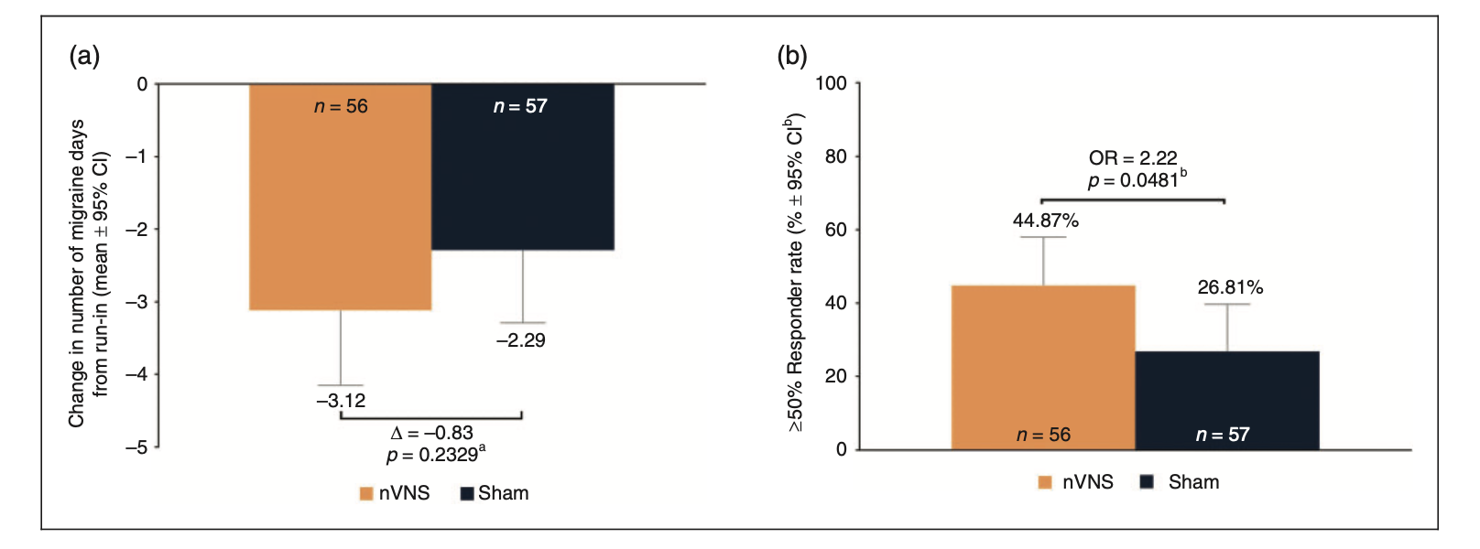
nVNS
PREMIUM II Trial
Najib, et al. PRIMIUM II Trial. Cephalalgia. 2021 Dec
Notes:
Preventive nVNS treatment in episodic migraine was not superior to sham stimulation in the ITT popu-lation. The ‘‘sham’’ device inadvertently provided a level of active vagus nerve stimulation. Post hoc analysis showed significant effects of nVNS in treatment-adherent patients.
primary efficacy outcome was the mean reduction in number of migraine days from the 4-week run-in period (baseline) to the last 4 weeks of the 12-week double-blind period.
The primary efficacy analysis set was the ‘intent-to- treat (ITT) population’, defined as enrolled patients who received 1 treatment in the double-blind period. Upon observation of suboptimal rates of adherence to the TID treatment protocol in the ITT population, a ‘modified intent-to-treat (mITT) population’ was defined as those with 67% adherence per month for evaluation in a post hoc analysis, which was not adjusted to control for type I error. The electronic database did not measure daily adherence, and the 67% per month threshold was selected on the basis of reports regarding the nVNS mechanisms of action (19), which suggest benefits lasting up to 6–8 hours, and for practical reasons (i.e. 67% is equivalent to two of the recommended three treatments per day).

Slide 34
Remote electrical neuromodulation (REN)
Noninvasive
Abortive treatment
Type of studies:
  Randomized, sham-controlled trials
Stimulation related adverse events
  Stimulation site discomfort
FDA approval: Acute treatment in adults age 18 and up
Notes:
FDA approval (De Novo classification) for acute treatment – May 2019

Slide 35
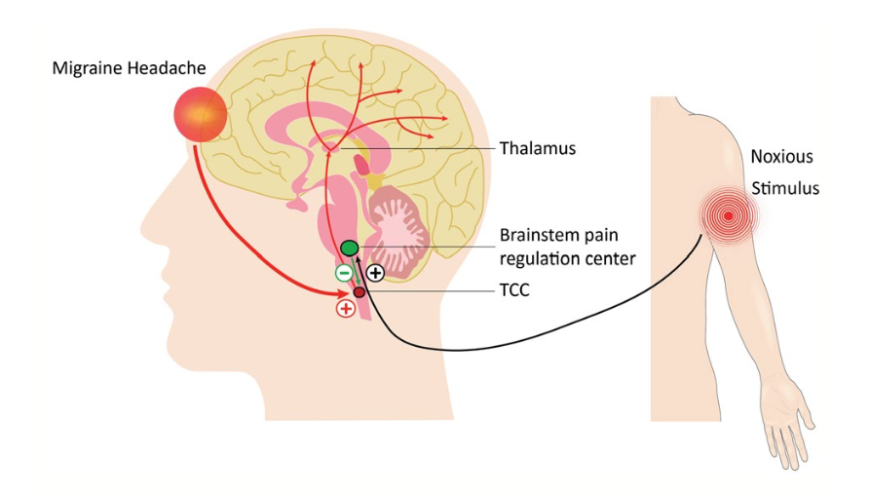
REN - MOA
Electrodes placed on the upper arm generate a non- painful electric stimulus thought to exert a generalized analgesic effect through conditioned pain modulation via activation of inhibitory pain pathways.
Yarnitsky D, et al. Headache. 2019 Sep;59(8):1240-1252.

Slide 36
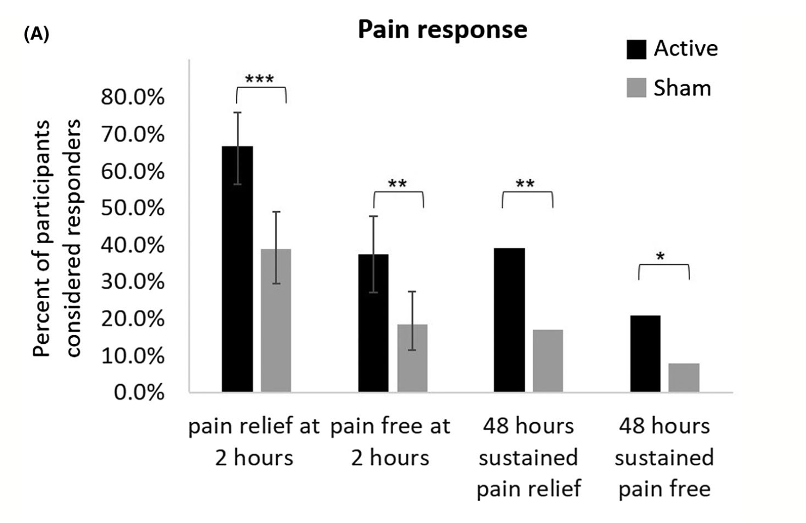
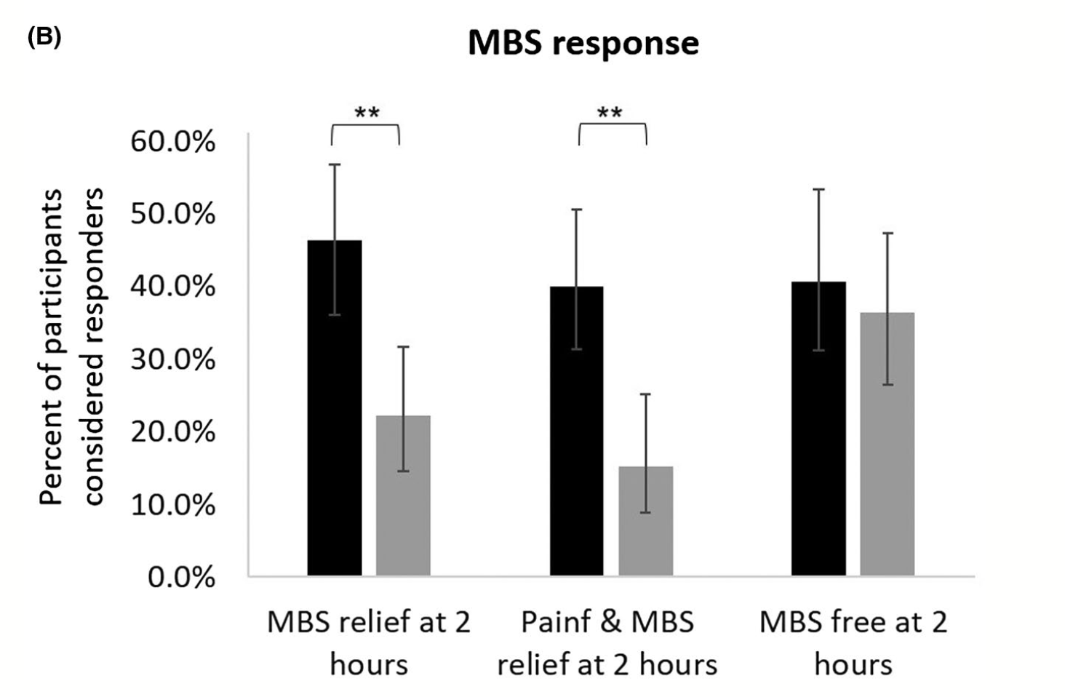
REN
Yarnitsky D, et al. Headache. 2019 Sep;59(8):1240-1252.
Notes:
Efficacy endpoints. (A) Pain response at 2 and 48 hours post-treatment. (B) MBS response at 2 hours post-treatment. The error bars represent 95% confidence intervals. ***P < .001, **P < .005, *P < .05. MBS = most bothersome symptom.
A: 66.7% vs 38.8%; 37.4% vs 18.4%.
B: 46.3% vs 22.2%
45 min stimulation. The active device produces a proprietary electrical signal comprising a modulated symmetrical biphasic square pulse with a modulated frequency of 100-120 Hz, pulse width of 400 μs (200+200), and output current up to 40 mA (adjusted by the participant)

Slide 37
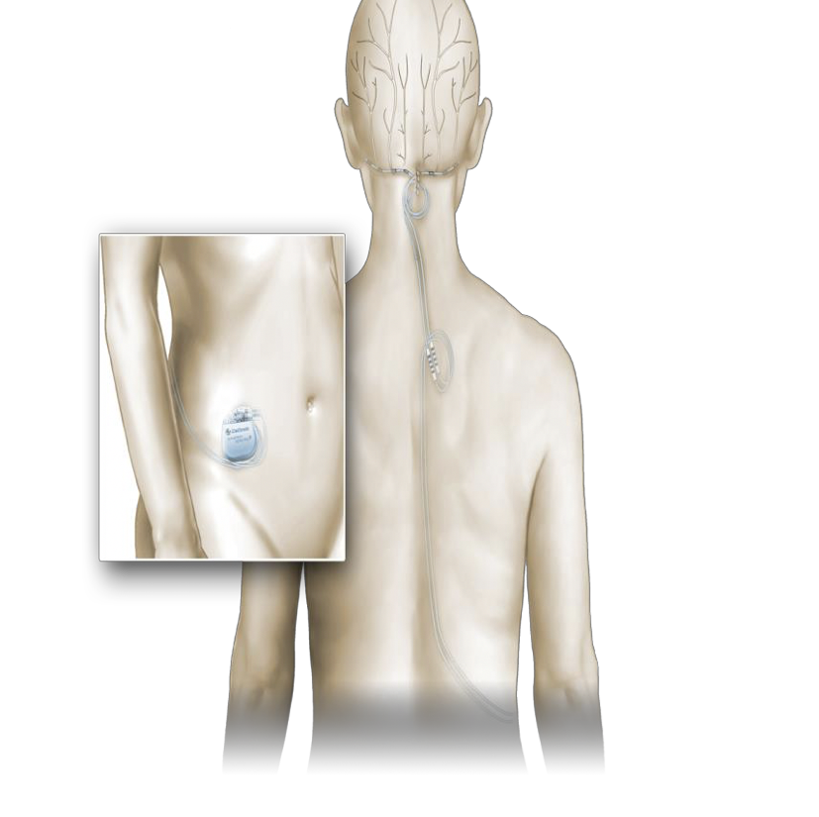
Occipital nerve stimulation (ONS)
Invasive
Preventive treatment
Type of studies:
  Randomized, sham-controlled trial*
  Open-label studies
Procedure related adverse events
  Lead migration
  Device infection
  Battery depletion
  Pain, paresthesia
  Tolerance phenomenon
FDA approval: None
* Did not meet primary end point
Notes:
- Despite a reduction in the attack frequency, invasive ONS had little or no effect on the intensity of attacks or the duration of pain (Cluster headache)
- At least two long‐term trials of up to 10 years in duration have described a tolerance phenomenon with invasive ONS, which required the adjustment of the stimulation parameters and could be related to neuroplasticity in the opioid system (Cluster headache)
- A large multicenter randomized controlled trial is currently underway to evaluate invasive ONS for prevention of cluster headache (ICON study).

Slide 38
ONS - MOA
Peripheral: stimulation of large sensory afferents that likely inhibit nociceptive activity in small fibers
Central: normalization of pain processing centers that were hypermetabolic before stimulation

Slide 39
ONS
Randomized 2:1 to active (n = 105) or sham (n = 52)
No significant difference in responders (>50% reduction)
  95% lower confidence bound (LCB) of -0.06; p = 0.55.
Significant difference in the percentage of patients that achieved a 30% reduction (p = 0.01).
Significant difference in reduction of number of headache days (Active Group = 6.1, baseline = 22.4; Control Group = 3.0, baseline = 20.1; p = 0.008), migraine-related disability (p = 0.001) and direct reports of pain relief (p = 0.001).
Silberstein SD, et al. Cephalalgia. 2012;32:1165-1179.
Notes:
Primary end point: difference in the percentage of responders
Responders (defined as patients that achieved a ≥50% reduction in mean daily visual analog scale scores) in each group at 12 weeks.

Slide 40
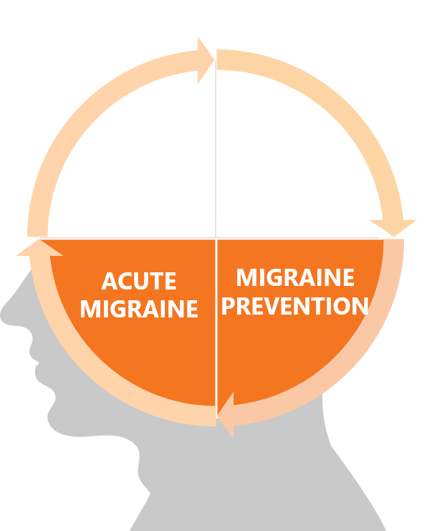
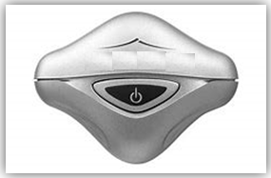
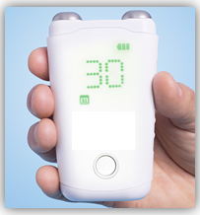
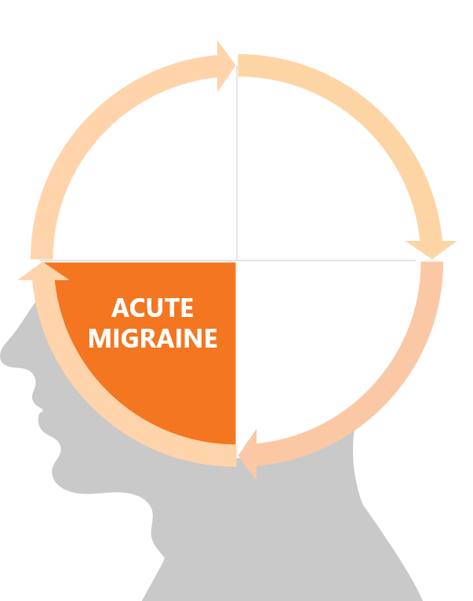
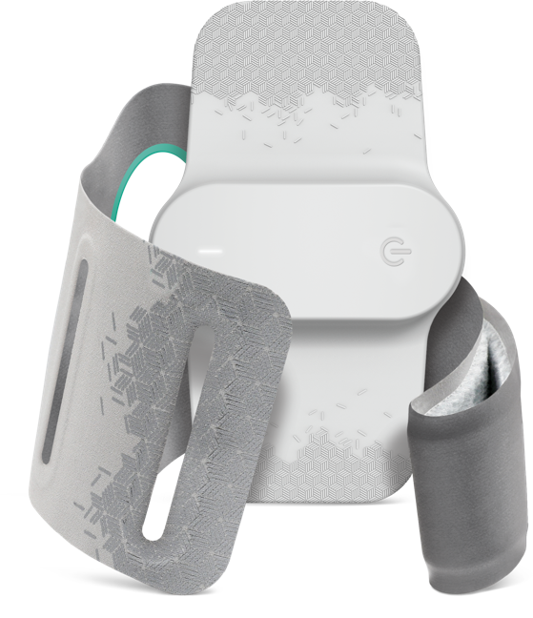
Summary – Noninvasive
Cluster
Prevention
External Trigeminal Nerve Stimulation(eTNS)
Non-invasive Vagus Nerve Stimulator (nVNS)
Remote Electrical Neuromodulation (REN)
Single pulse Transcranial Magnetic Stimulation(sTMS)

Slide 41

Summary – Noninvasive: Prevention (MWA)
Cluster
Prevention
External Trigeminal Nerve Stimulation(eTNS)
Non-invasive Vagus Nerve Stimulator (nVNS)
Remote Electrical Neuromodulation (REN)
Single pulse Transcranial Magnetic Stimulation(sTMS)

Slide 42
Summary – Noninvasive: Prevention (MWOA)
Cluster
Prevention
External Trigeminal Nerve Stimulation(eTNS)
Non-invasive Vagus Nerve Stimulator (nVNS)
Remote Electrical Neuromodulation (REN)
Single pulse Transcranial Magnetic Stimulation(sTMS)

Slide 43
Summary – Noninvasive: Acute (MWA)
Cluster
Prevention
External Trigeminal Nerve Stimulation(eTNS)
Non-invasive Vagus Nerve Stimulator (nVNS)
Remote Electrical Neuromodulation (REN)
Single pulse Transcranial Magnetic Stimulation(sTMS)

Slide 44
Summary – Noninvasive: Acute (MWOA)
Cluster
Prevention
External Trigeminal Nerve Stimulation(eTNS)
Non-invasive Vagus Nerve Stimulator (nVNS)
Remote Electrical Neuromodulation (REN)
Single pulse Transcranial Magnetic Stimulation(sTMS)

Slide 45

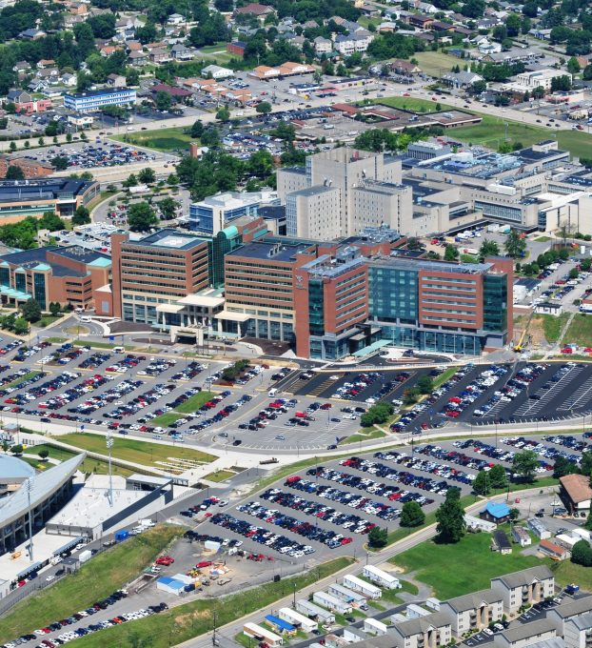

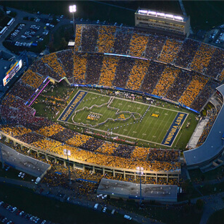

Thank you

