Slide 1
Jeffrey Hamilton, Christopher Skaggs
Diversion Investigators
Tactical Diversion Squad, Clarksburg Resident Office

Slide 2
Disclaimers
The contents of this document do not have the force and effect of law and are not meant to bind the public or DEA in any way. This document is intended only to provide clarity to the public regarding existing requirements under the law or agency policies.
Notes:
Review Disclaimers

Slide 3
I have no financial relationship to disclose.

Slide 4
The presentation is for educational purposes. Materials, images, or sounds authored or created by parties other than DEA may be subject to copyright and are used herein in accordance with the fair use provision of Title 17 United States Code Section 107. DEA’s use of these materials does not authorize persons outside of DEA to further distribute or use copyrighted materials.

Slide 5
Objectives
Who We Are
Discuss Primary Threats facing WV and the Nation
Discuss the mission of the Diversion Control Division of the DEA
West Virginia and General Registration Information
Practitioner vs. Pharmacist Prescription responsibilities
Diversion and commonly Diverted Substances
Methods of Diversion and DEA Authority
Prescriptions, Pills, Resources
Overdoses and Drug Statistics
One Pill Can Kill Campaign
Questions

Slide 6
United States Federal District Court
Northern District of West Virginia

Slide 7
Primary Threats
The primary threats in the Northern District of West Virginia are:
Fake Prescription Products
Methamphetamine
Prescription Drugs
Opioids, Stimulants (Adderall/Ritalin etc.), MAT abuse
Heroin/Fentanyl
Source cities include: Atlanta, Baltimore, Chicago, Cleveland, Columbus, Detroit and Pittsburgh.
High purity methamphetamine is sourced out of Mexico.

Slide 8
Methamphetamine
Mexican Drug Trafficking Organizations have become the primary manufacturers and distributors of meth. Domestic clandestine laboratory operators, most commonly seen as one-pot cooks in West Virginia, produce, distribute and consume meth, but usually on a smaller scale.
Meth is made with diverted products such as Pseudoephedrine, acetone, anhydrous ammonia (fertilizer), ether, red phosphorus and lithium. Examples include: Coleman fuel, paint thinner, liquid draino and Red Devil Lye.
Chronic meth abusers exhibit violent behavior, anxiety, confusion, insomnia, and psychotic features including paranoia, aggression, visual and auditory hallucinations, mood disturbances, and delusions.

Slide 9
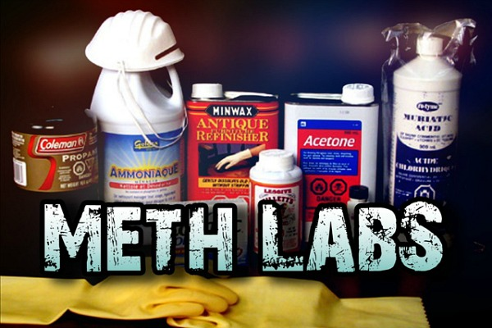
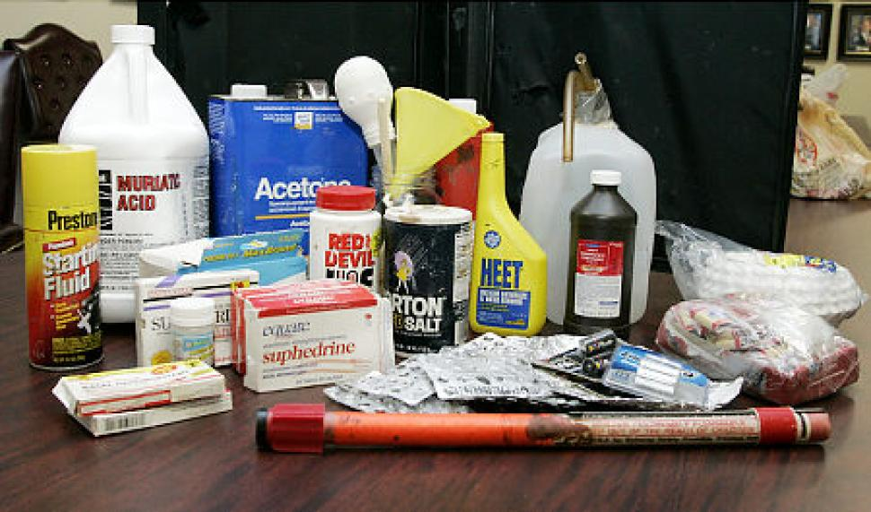
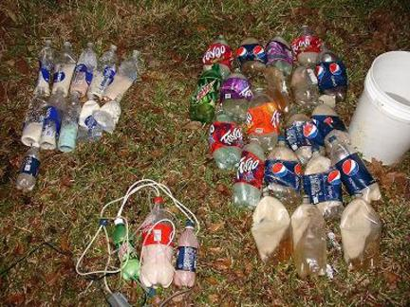
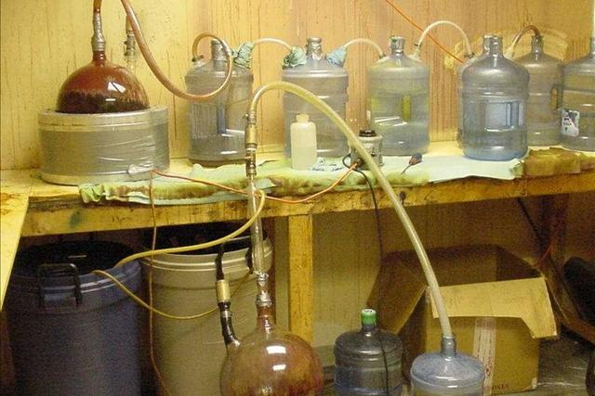
Manufacture open source photos
Ingredients include: pseudoephedrine, lithium, iodine, red phosphorous, among others.

Slide 10
Mission of the Diversion Control Division
The mission of the Office of Diversion Control is to prevent, detect, and investigate the diversion of pharmaceutical controlled substances and listed chemicals from legitimate channels of distribution
while…
ensuring an adequate and uninterrupted supply of controlled substances to meet legitimate medical, commercial, and scientific needs.
Notes:
* Assist the pharmaceutical industry in the compliance of federal law and regulations;

Slide 11
Closed System of Distribution
Manufacturers
Importers
Exporters
Distributors
NTPs
Pharmacies
Researchers
Practitioners
Hospitals
Notes:
Closed system of distribution: follow and account for the flow of chemicals and controlled substances (importation, manufacturing, distributors, exportation ) to the end user

Slide 12
Closed System of Distribution Cont.
The DEA is responsible for:
The oversight of the system
The integrity of the system
The protection of the public health and safety
Title 21 CFR Section 1301.11(a):
Every person who manufactures, distributes, dispenses, imports, or exports any controlled substance or who proposes to engage in the manufacture, distribution, dispensing, importation or exportation of any controlled substance shall obtain a registration…

Slide 13
DEA Regulated Entities
Activity | Amount
PRACTITIONER | 6678
MLP-NURSE PRACTITIONER | 1910
MLP-PHYSICIAN ASSISTANT | 912
RETAIL PHARMACY | 292
CHAIN PHARMACY | 250
PRACTITIONER-DW/30 | 242
MLP-AMBULANCE SERVICE | 142
MLP-OPTOMETRIST | 139
MLP-NURSE PRACTITIONER-DW/100 | 139
HOSPITAL/CLINIC | 132
MLP-NURSE PRACTITIONER-DW/30 | 127
PRACTITIONER-DW/100 | 122
PRACTITIONER-DW/275 | 116
RESEARCHER (II-V) | 91
MLP-NURSE PRACTITIONER-DW/275 | 66
MLP-PHYSICIAN ASSISTANT-DW/100 | 40
MLP-PHYSICIAN ASSISTANT-DW/30 | 35
CANINE HANDLER | 34
MLP-ANIMAL SHELTER | 25
HOSP/CLINIC-VA | 14
PRACTITIONER-DW/30SW | 12
MLP-PHYSICIAN ASSISTANT-DW/275 | 11
MAINT & DETOX | 9
MLP-NURSE PRACTITIONER-DW/30SW | 8
ANALYTICAL LAB | 7
AUTOMATED DISPENSING SYSTEM | 6
HOSP/CLINIC FED | 6
TEACHING INSTITUTION | 6
CHEMPACK/SNS DISTRIBUTOR | 5
RESEARCHER (I) | 5
M/O PHARMACY | 3
MLP-PHYSICIAN ASSISTANT-DW/30SW | 3
CHEMICAL DISTRIBUTOR | 3
CENTRAL FILL PHARMACY | 2
MLP-MILITARY | 2
DISTRIBUTOR | 2
CHEMICAL MANUFACTURER | 2
CHEMICAL IMPORTER | 2
CHEMICAL EXPORTER | 2
HOSP/CLINIC NG | 1
MILITARY-PRACTITIONER | 1
MILITARY PRACTITIONER-DW/30 | 1
MANUFACTURER | 1
IMPORTER (C I,II) | 1
EXPORTER | 1
SUBTOTAL | 11608
WV DEA Registrants
Total: 11,608
Practitioner, 6678
Nurse Practitioner, 1910
Physician Assistant, 912
Retail Pharmacy, 292
Chain Pharmacy, 250

Slide 14
Separate Registrations for Separate Locations
An office used by a practitioner (who is registered at another location in the same state in which he or she practices) where controlled substances are prescribed but neither administered nor otherwise dispensed as a regular part of the professional practice of the practitioner at such office, and where no supplies of controlled substances are maintained 21 CFR § 1301.012(b)
One registration per state

Slide 15
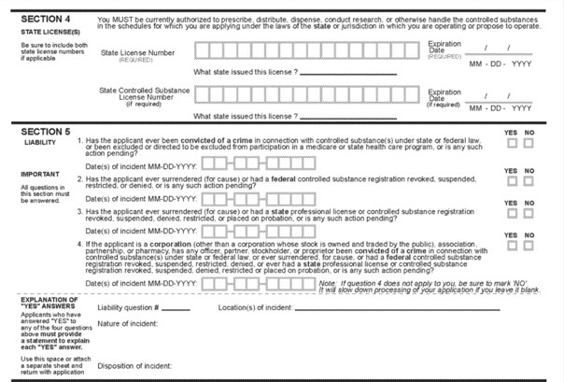
Registration Points of Emphasis
Place of practice is your registrant address, not a PO Box
Providers email (YOURS!) not the office assistant
Renewals or address changes – Please don’t wait until the last minute
caveat): Once you DO renew prior to expiration date, your DEA is still valid until approved. It’s the act of renewing that matters
Fee exempt: put the credential coordinator or supervisor (if you don’t know, ask around)
All these lead could lead to delay on renewals/new applications
Valid phone number to be reached
Liability Questions

Slide 16
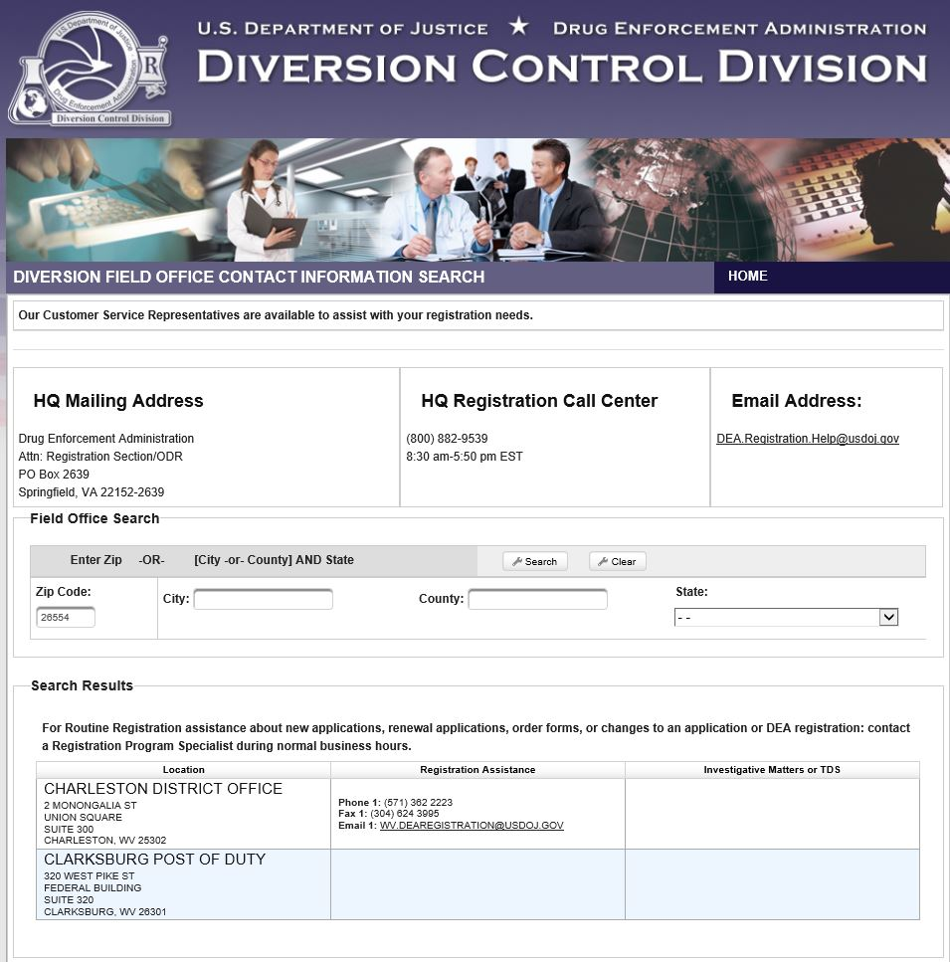
WV DEA Registration Contact Information
WV.DEAREGISTRATION@USDOJ.GOV, 571-362-2223

Slide 17
What is Controlled Substance Diversion?

Slide 18
Definition
The unlawful channeling of regulated pharmaceuticals from legal sources to the illicit marketplace, to include transferring drugs to people they were not prescribed to by a physician.

Slide 19
Commonly Diverted Controlled Substances

Slide 20
The United States is in the midst of an opioid epidemic—drug overdoses are up thirty percent over the last year alone and taking more than 250 lives every day. The majority of opioid addictions in America start with prescription pills found in medicine cabinets at home.

Slide 21
According to a report published by the Substance Abuse and Mental Health Services Administration (SAMHSA), a majority of people who misused a prescription medication obtained the medicine from a family member or friend.
The Centers for Disease Control and Prevention reported that last year, more than 93,000 people died of drug overdoses in the United States, marking the largest number of drug-related deaths ever recorded in a year. Opioid-related deaths accounted for 75 percent of all overdose deaths in 2020.
Notes:
CDC indicated 93,000 deaths is almost 30% higher than the year before

Slide 22
Criminal drug networks are exploiting the opioid crisis by making and falsely marketing deadly, fake pills as legitimate prescriptions, which are now flooding U.S. communities.

Slide 23
Methods of Diversion

Slide 24
Methods of Diversion (Employee/Staff)*
Employee pilferage
Pretends to dispose of drugs
Replaces medication with placebos
Orders inventory without DEA Registrant’s knowledge
Sets up break-ins, burglaries, or armed robberies
* This list is not all-inclusive.
Notes:
Steal prescription pads
Steal from inventory and adjusts numbers
Calls in fake prescriptions
Falsifies verifications when pharmacies call the office
Uses number of retired practitioner/takes advantage of older practitioner

Slide 25
Methods of Diversion (Public)*
Friends & Relatives
Medicine Cabinets
Street Dealers
Robberies & Theft
Wounds inflicted to self or family members
* This list is not all-inclusive.

Slide 26
Motivation for Diversion
Money – Financial Gain
Fear
Blackmail
Sexual Favors
Addiction – Supply Family Member
Personal Use – Self Abuse

Slide 27
DEA’s Authority

Slide 28
Letter of Admonition (LOA)
Memorandum of Agreement (MOA)
Order to Show Cause
Immediate Suspension Order
Penalties
Civil and Criminal
Notes:
Different Actions Diversion Investigators Take:
Investigations: Review records, conduct audits, check security, discuss findings
These are administrative Actions
Civil/Criminal Actions: Criminal prosecution, civil litigation and fines, Suspension and Revocation of DEA Registration

Slide 29
Prescriptions, Pills, Resources

Slide 30
Prescriptions: Practitioners/Pharmacists 21 CFR section 1306.04
Practitioners
Persons entitled to issue prescriptions.
A prescription for a controlled substance may be issued only by an individual practitioner who is:
authorized to prescribe controlled substances by the jurisdiction in which he is licensed to practice his profession and
either registered or exempted from registration pursuant to Secs. 1301.22(c) and 1301.23 of this chapter.
A prescription issued by an individual practitioner may be communicated to a pharmacist by an employee or agent of the individual practitioner.
A prescription for a controlled substance: must be issued for a LEGITIMATE MEDICAL PURPOSE by an individual practitioner acting in the USUAL COURSE OF HIS/HER PROFESSIONAL PRACTICE.
Pharmacists
Corresponding Responsibility
A pharmacist has a legal corresponding responsibility to ensure that prescriptions are legitimate.
When a prescription is presented by a patient or demanded to be filled for a patient by a doctor’s office, a pharmacist is NOT obligated to fill the prescription.
The responsibility for the proper prescribing and dispending of controlled substances is upon the prescribing practitioner, but a corresponding responsibility rests with the pharmacist who fills the prescription.

Slide 31
Fentanyl

Slide 32
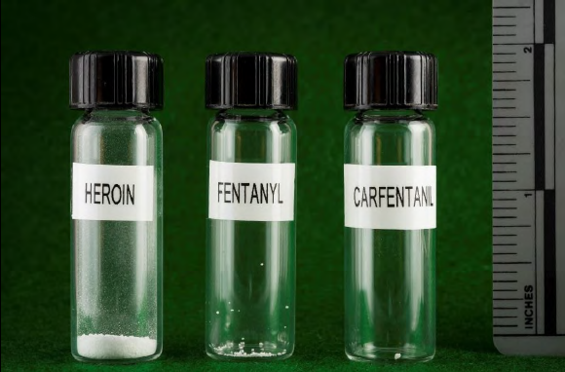
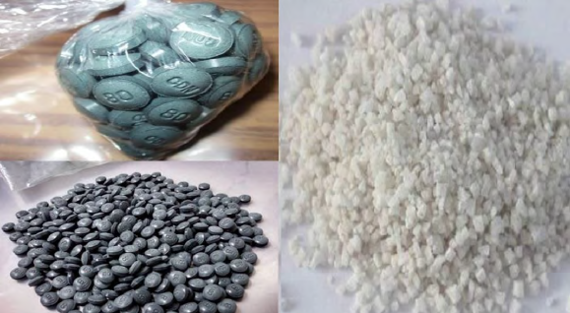
Know the Facts
50 – 100 x more potent than morphine and 30 – 50 x more potent than heroin.
Ingesting small doses at 0.25 mg can be fatal (about the amount of ¼ of a sweet and low packet)
Commonly produced clandestinely by drug trafficking organizations who are mixing it with heroin
It can be absorbed through the skin and accidental inhalation of airborne powder can occur.
BE EXTREMELY VIGILANT IN PROTECTING YOURSELF WHEN YOU SUSPECT FENTANYL IS INVOLVED IN AN OVERDOSE.

Slide 33
Statistics

Slide 34
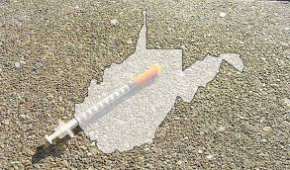
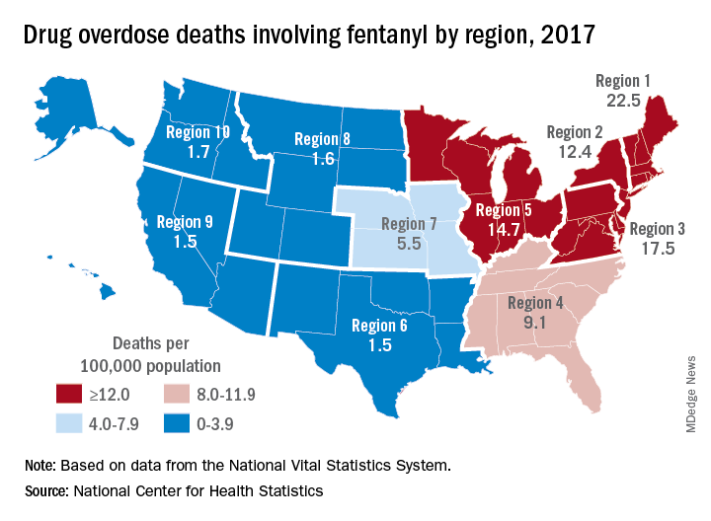
Statistics: WV Price/Gram and National Average/Gram National Vital Statistics System: National Center for Health Statistics
West Virginia
Cocaine - $7.66
Fentanyl – No data
Heroin/Opiates - $16.68
Opiates (Pharmaceutical) - $7.35
Methamphetamine/Amphetamine - $9.80
National Averages
Cocaine - $21.40
Fentanyl - $20.11
Heroin/Opiates - $21.91
Opiates (Pharmaceutical) - $22.77
Methamphetamine/Amphetamine - $11.50

Slide 35
Waves of Opioid Overdose Deaths cdc.gov, Understanding the opioid epidemic
From 1999–2019, almost 500,000 people died from an overdose involving any opioid, including prescription and illicit opioids.
The first wave began with increased prescribing of opioids in the 1990s, with overdose deaths involving prescription opioids(natural and semi-synthetic opioids and methadone) increasing since at least 1999.
The second wave began in 2010, with rapid increases in overdose deaths involving heroin.
The third wave began in 2013, with significant increases in overdose deaths involving synthetic opioids, particularly those involving illicitly manufactured fentanyl. The market for illicitly manufactured fentanyl continues to change, and it can be found in combination with heroin, counterfeit pills, and cocaine.

Slide 36
Drug-Involved Overdose Deaths nida.nih.gov

Slide 37
OD Deaths involving Prescription Opioids nida.nih.gov

Slide 38
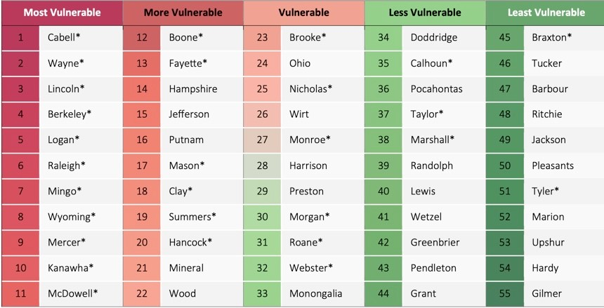
County-level Vulnerability to Overdose Deaths in West Virginia WV Department of Health & Human Resources Bureau for Public Health

Slide 39
Pandemic Affects on OD Deaths www.cdc.gov
. 2022 Feb 18;1-12. doi: 10.1007/s11524-022-00610-0
. 2022 Feb 18;1-12. doi: 10.1007/s11524-022-00610-0
. 2022 Feb 18;1-12. doi: 10.1007/s11524-022-00610-0
Over 81,000 drug overdose deaths occurred in the United States in the 12 months ending in May 2020, the highest number of overdose deaths ever recorded in a 12-month period, according to recent provisional data from the Centers for Disease Control and Prevention (CDC).
While overdose deaths were already increasing in the months preceding the 2019 novel coronavirus disease (COVID-19) pandemic, the latest numbers suggest an acceleration of overdose deaths during the pandemic. “The disruption to daily life due to the COVID-19 pandemic has hit those with substance use disorder hard,” said CDC Director Robert Redfield, M.D. “As we continue the fight to end this pandemic, it’s important to not lose sight of different groups being affected in other ways. We need to take care of people suffering from unintended consequences.”
Synthetic opioids (primarily illicitly manufactured fentanyl) appear to be the primary driver of the increases in overdose deaths, increasing 38.4 percent from the 12-month period leading up to June 2019 compared with the 12-month period leading up to May 2020. During this time period:
• 37 of the 38 U.S. jurisdictions with available synthetic opioid data reported increases in synthetic
opioid-involved overdose deaths.
• 18 of these jurisdictions reported increases greater than 50 percent.
• 10 western states reported over a 98 percent increase in synthetic opioid-involved deaths.
Overdose deaths involving cocaine also increased by 26.5 percent. Based upon earlier research, these deaths are likely linked to co-use or contamination of cocaine with illicitly manufactured fentanyl or heroin. Overdose deaths involving psychostimulants, such as methamphetamine, increased by 34.8 percent. The number of deaths involving psychostimulants now exceeds the number of cocaine-involved deaths.“The increase in overdose deaths is concerning.” said Deb Houry, M.D., M.P.H., director of CDC’s National Center for Injury Prevention and Control. “CDC’s Injury Center continues to help and support communities responding to the evolving overdose crisis. Our priority is to do everything we can to equip people on the ground to save lives in their communities.”

Slide 40
Overdose Indicators
Slow or shallow breathing
(dangerously slow)
Slow heartbeat
Severe sleepiness
Cold, clammy skin
Trouble walking or talking
Feeling faint, dizzy, or confused
weak muscles
Unresponsiveness
Pinpoint pupils
Bluish tint to nails and lips
Very low Blood Pressure
Visuals…….

Slide 41
One Pill Can Kill Campaign

Slide 42
One Pill Can Kill
This Year, DEA issued a Public Safety Alert and launched the One Pill Can Kill public awareness campaign to warn Americans of a surge in deadly, fake prescription pills driven by drug traffickers seeking to exploit the U.S. opioid epidemic and prescription pill misuse.

Slide 43
One Pill Can Kill
Criminal drug networks are shipping chemicals from China to Mexico where they are converted to dangerous substances like fentanyl and methamphetamine and then pressed into pills.
The end result—deadly, fake prescription pills—are what these criminal drug networks make and market to prey on Americans for profit. These fake, deadly pills are widely available and deadlier than ever.

Slide 44
One Pill Can Kill
Fake pills are designed to appear nearly identical to legitimate prescriptions such as Oxycontin®, Percocet®, Vicodin®, Adderall®, Xanax® and other medicines.
Criminal drug networks are selling these pills through social media, e-commerce, the dark web and existing distribution networks.

Slide 45
One Pill Can Kill
Along with the alert came a warning that the only safe medications are ones prescribed by a trusted medical professional and dispensed by a licensed pharmacist. Any pills that do not meet this standard are unsafe and potentially deadly.
Notes:
In just two months, the DEA and law enforcement seized more than 1.8 million fake pills that included fentanyl. Today, DEA lab testing reveals that about 4 out of every 10 of these fentanyl-laced pills are potentially deadly.

Slide 46
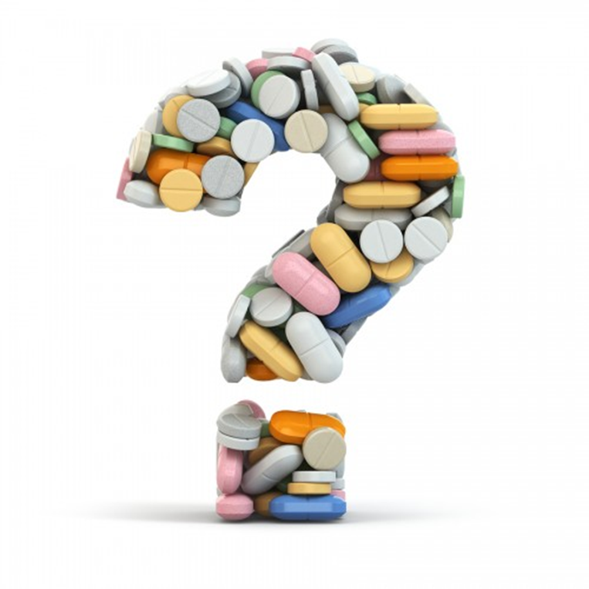
Questions?

