Slide 1
Exercise as a Prescription
Julianne Speeney, M.S., CES, CSS
Exercise Physiologist
WVU Medicine - Center for Integrative Pain Management
1075 Van Voorhis Road
Morgantown, WV 26505

Slide 2
I declare no conflict of interest and no financial disclosures.

Slide 3
Objectives
Introduce exercise therapy prescription versus a physical fitness prescription
Describe the benefits and role of employing exercise as an adjunct to a treatment plan
Describe the role of physical activity and exercise in rehabilitation
Describe the purpose and elements of a structural screening exam and program formation
Principles of Exercise Prescription
Describe key elements of exercise prescription
Multidisciplinary comprehensive pain management exercise therapy

Slide 4
Introduction to Exercise Therapy
Physical Fitness – Ability of the body’s systems to function efficiently and effectively.
Individuals who are “physically fit” have the ability to:
  “carry out daily tasks with vigor and alertness, without undue fatigue, and with ample energy to enjoy leisure-time pursuits and to meet unforeseen emergencies.”
Physical Fitness has 2 sides:
  Health-Related Fitness
  Performance Skill Related Fitness

Slide 5
Physical Fitness
Health-Related Fitness
  Body composition
  Cardiorespiratory endurance
  Flexibility
  Muscular endurance
    ability of a muscle or muscle group to exert force repeatedly or over a period of time.
  Muscular strength
    ability of a muscle or a muscle group to exert a single force against a resistance.
Performance/Skill Related Fitness
  Agility
  Balance
  Coordination
  Speed
  Reaction Time
  Power

Slide 6
Components of Physical Fitness:
Elements of Physical Activity and Exercise
Physical Activity
Bodily movement of skeletal muscles
Results in energy expenditure
Varying of energy expenditure (kilocalories)
Certainly associated with Physical Fitness
Exercise Therapy
All elements list in Physical Activity including the following:
  Planned, structured, and repetitive bodily movements
  The improvement and maintenance of a person’s physical fitness level in an objective manner

Slide 7
Benefits/Role of Exercise Therapies
Therapuetic Exercise Benefits
  Enable ambulation
  Release contracted muscle, tendons, and fascia
  Mobilize joints
  Improve circulation
  Reduce rigidity
  Improve balance
  Promote relaxation
  Improve muscular strength/maximal voluntary contractile force
  Improve exercise performance and functional capacity
Additional Benefits: Cardiac, Mental Health (depression, anxiety) Musculoskeletal, Pain Medicine, Lymphedema, endocrinology, cancer, endocrine, etc.
Goal of exercise is to always achieve and maintain an optimal level of function
Notes:
Additional important reasons for prescribing exercise:
Psychological benefits, i.e. encouragement and optimism
Natural biochemical high – diminishing or breaking cycle of chronic pain
Cardio-vascular health
Weight management
Facilitates integration of body-mind-spirit

Slide 8
Benefits/Role. . . (cont.)
Physical exercise - interrelationship of altered function to the body structure
  skeletal, arthrodial and myofascial structures and their related vascular, lymphatic and nervous elements.
  Prefaces the use of therapeutic exercise and makes the exercise more effective
  Prescribed exercise can reinforces the functional correction or maintenance of the patient’s current status
Adjunct therapy to patient treatment plan
Notes:
Physical exercise has profound benefits now supported by research due to the interrelationship of altered function to the related components of a patient’s body framework (skeletal, arthrodial and myofascial structures and their related vascular, lymphatic and nervous elements.)
Sets the stage for therapeutic exercise and makes the exercise more effective
Prescribed exercise then reinforces the functional correction or maintenance of the patient’s current framework.
Adjunct therapy to patient treatment plan
References to consider:
Dr. Kappler’s section V Introduction, Foundations for Osteopathic Manipulation, 2nd ed.
Dr. Philip Greenman, Principles of Manual Medicine, 3rd ed. D.O.
Professor emeritus of Michigan State University

Slide 9

Conservative Treatment Guidelines
Notes:
11 common recommendations for the care of musculoskeletal pain conditions.
1.Care should be patient centered; it responds to the individual context of the patient, employs effective communication and shares decision-making.
2. Screen patients to identify those with a higher likelihood of serious pathology/red flag conditions.
3. Assess psychosocial factors.
4. Radiological imaging is discouraged unless:
Serious pathology is suspected.
There is an unsatisfactory response to conservative care or unexplained progression of signs and symptoms.
It is likely to change management.
5. Do a physical examination, including neurological screening tests, assessment of mobility and/or muscle strength.
6. Evaluate patient progress, including the use of outcome measures.
7. Provide education/information about their condition and management options.
8. Provide management addressing physical activity and/or exercise.
9. Apply manual therapy only as an adjunct to other evidence-based treatments.
10. Unless specifically indicated (e.g. red flag condition), offer evidence-informed non-surgical care prior to surgery.
11. Facilitate continuation or resumption of work.

Slide 10
Well Rounded Exercise Programming
Effects of various exercises on various systems of the body.
Relationship of energy metabolism to performance.
Effects of environmental factors on performance.
Effects of individual differences.
Effectiveness of various rehabilitation programs.
Ergogenic aids and exercise.
  (pharmaceuticals, injections, etc.)
Education with Patients
Health and therapeutic effects associated with exercise.
Effects of nutrition on performance.
Notes:
Areas of focus during a patient’s Evaluation

Slide 11
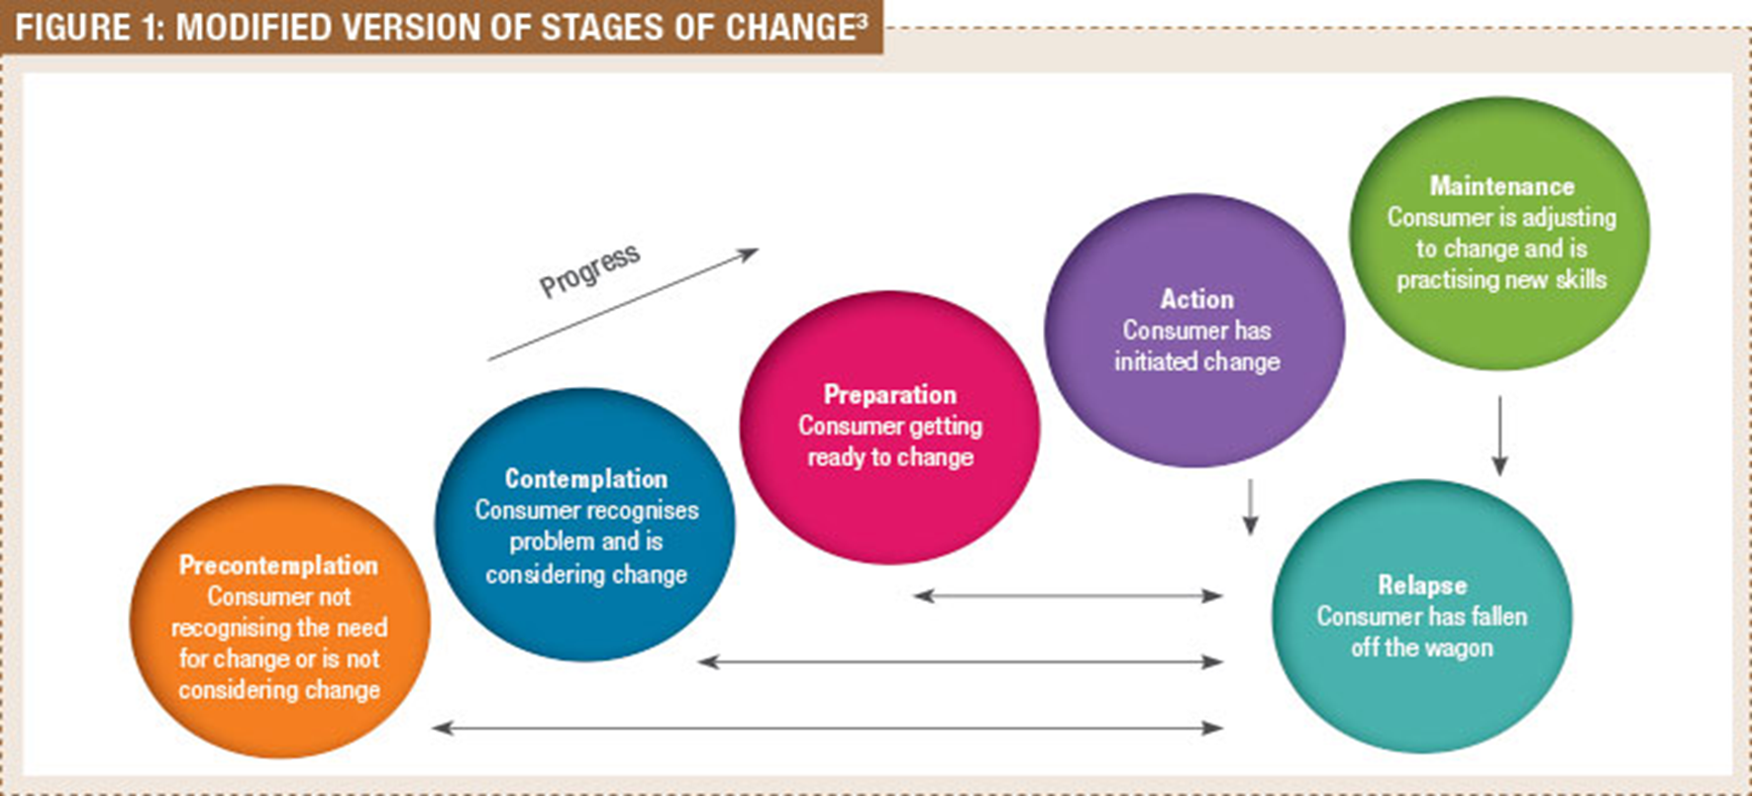
Stages of Change

Slide 12
Screening Element
Guiding Question
  Is there a significant musculoskeletal component to the patient’s pain?
Looking at postural and functional imbalances
  Gait
  Observation of related stature and posture
  Active/Passive ROM
  Dynamic Assessments
Somatic Dysfunction and Muscle Firing Patterns
  Vladimir Janda
    Dysfunction of Postural versus Dynamic muscles
Notes:
If we allow our structural screening exam to lead us into our regional or segmental diagnosis, we will be more apt to see a particular somatic dysfunction in relation to the whole, integrated body system - paraphrased from Dr. Hugh Ettlinger
Vladimir Janda, physiatrist from Czech Republic Studied muscle function and found characteristic “normal” patterns of neuromuscular activation and common patterns of dysfunction/abnormal activation. Evaluated muscle function based on tone, sequence or patterns of muscle activation, and bilateral symmetry/asymmetry of muscle activation.
Guiding Question
Is there a significant musculoskeletal component to the patient’s pain?
Looking at postural and functional imbalances
Gait analysis
Observation of related anatomical landmarks, antero-posterior and lateral curves
Active/Passive ROM
Dynamic Assessments
Somatic Dysfunction and Muscle Firing Patterns
Vladimir Janda
Dysfunction of Postural versus Dynamic muscles

Slide 13
Screening Elements. . . (cont.)
Postural Muscles
  Iliopsoas
  Rectus femoris
  Piriformis
  Adductors
  Tensor fascia lata
  Levator scapula
  Upper trapezius
  Pectorals
Dynamic Muscles
  Gluteus medius and maximus
  Supraspinatus
  Deltoids
  Infraspinatus
  Rhomboids
  Lower trapezius
  Serratus anterior
Dysfunctional Characteristics
Become hypertonic, facilitated, or contracted
Become hypotonic, inhibited, weakened
Notes:
IMPORTANT to Exercise Prescription:
Accurate and effective prescription
To prevent further injury
If a patient has significant imbalance in firing patterns, continued activity, or increased focal activity may serve to exacerbate the problem and dysfunction.

Slide 14
Example of Typical Muscle Firing Pattern Dysfunctions
Prone Hip Extension
Normal
Hamstrings
Gluteus maximus
Contralateral lower lumbar erector spinae
Ipsilateral lower lumbar erector spinae
Most Common Variation
Hamstrings
Upper lumbar and low thoracic erectors
Inhibited gluteus maximus

Slide 15
Example of Typical Muscle Firing Pattern Dysfunctions
Seated Shoulder ABD
Normal
Supraspinatus
Deltoid
Infraspinatus
Mid/Low Trapezius
Contralateral Quadratus lumborum
Ipsilateral lower lumbar erector spinae
Most Common Variation
Levator Scapulae
Upper Trapezius
Quadratus lumborum (early)
Notes:
Very similar to Upper Crossed and Lower Crossed Syndrome patterns

Slide 16
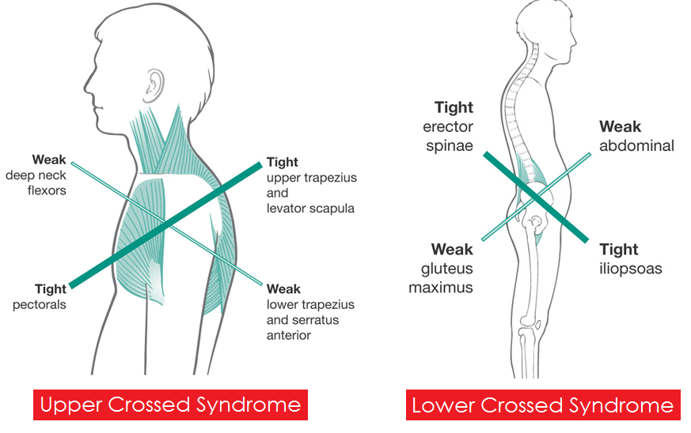

Slide 17
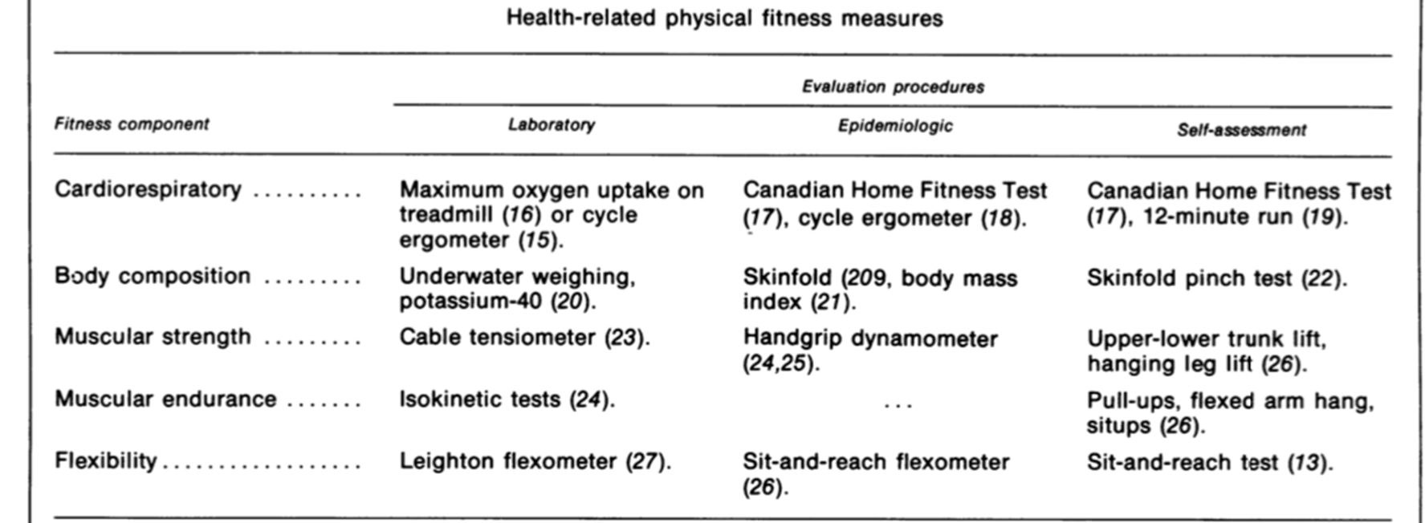
Typical Assessments of Physical Fitness

Slide 18
Additional Tests to Assess Function
Static Postural Assessments
Static Check Point ASMT
  Upper Cross Syndrome
  Lower Cross Syndrome
  Pronation Distortion
Dynamic Assessments
BERG
  Balance, Coordination, Cognition
6 Minute Walk Test
  Muscular Endurance, Gait
Timed Up & Go
  Balance Coordination, Cognition
Manual Muscle Testing
  Muscular Strength
Upper Extremity Transitional ASMT
  Mobility, Flexibility, Muscular Imbalance
Pushing/Pulling ASMT
  Muscular Strength
Overhead & Single-Leg Squat
Muscular Imbalances & Compensations
Endurance/Strength/Coordination/Mobility

Slide 19
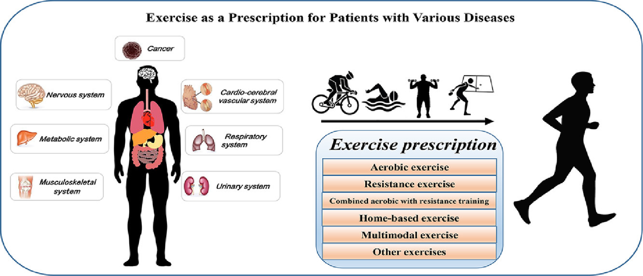
Exercise Prescription
Notes:
Greenman writes in his chapter on Exercise Principles, “the goal for an exercise program is to maintain the enhanced functional capacity of the musculoskeletal system that has been achieved by appropriate manual medicine intervention” (Greenman, 498).
Once the structural screening, somatic dysfunction diagnosis, and asymmetries of muscle firing have been assessed, manipulative treatment begins restoring balance to the system, the patient is then be ready to begin a progression into an exercise program.

Slide 20
Corrective Exercise Continuum

Slide 21
Types of Exercise
Isometric Exercises
  Muscle exerts force against an immovable object
  Static contraction (plank, holding a weight, etc.)
Isotonic Exercises
  Force is generated while the muscle is changing in length
  Concentric and eccentric contractions (bicep curl, push-up, squats)
Isokinetic Exercises
  Contractions are performed at a constant velocity (stationary bike, full range control)
    Aerobic/Anaerobic
Notes:
Focus on Isokinetic – first and foremost, then Isometrics, then Isotonic.

Slide 22
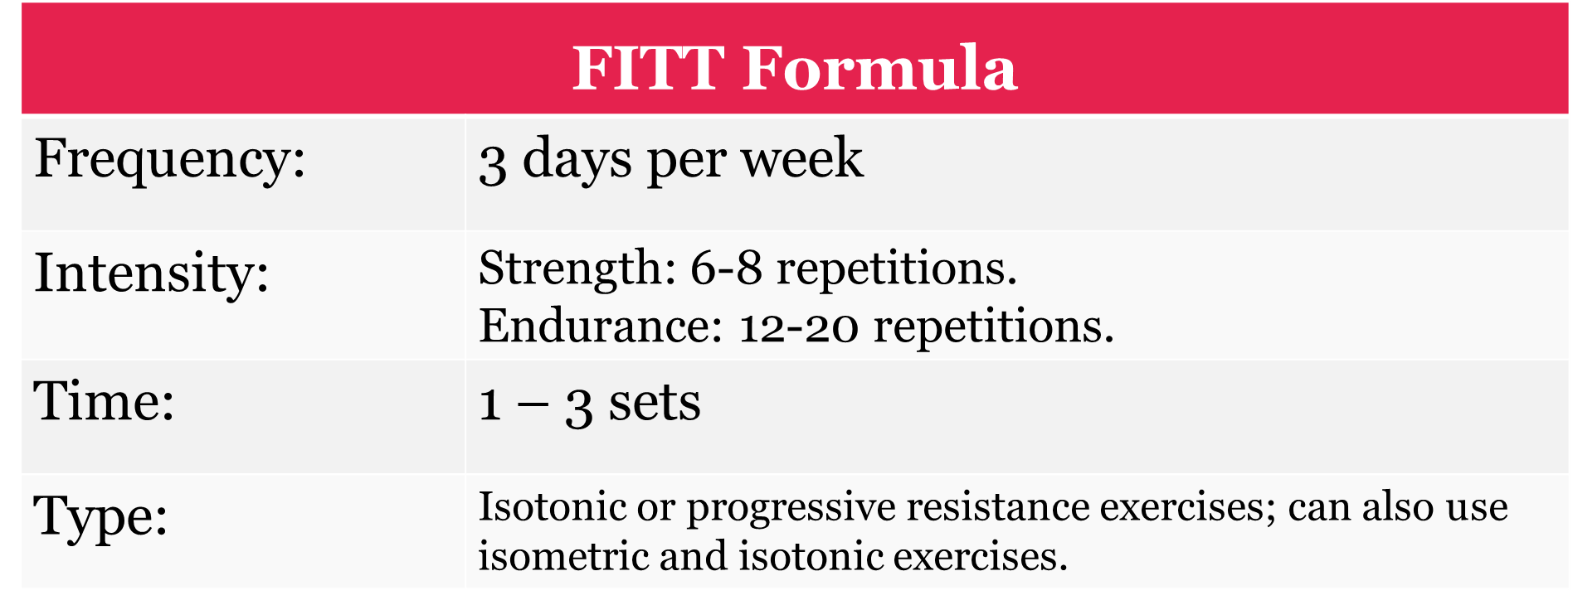
Muscular Strength and Endurance
Overload is key!
To gain - an increased workload must be placed on
the body.

Slide 23
Flexibility Techniques
Ballistic Stretching
  Momentum generated from repeated bouncing to stretch.
Static Stretching
  Slowly moving into a stretching position and holding for a certain period of time (10-30 seconds; 5 times).
Contract-relax Technique
  Relaxing of the muscle to be stretched by contracting the opposite muscle (hamstrings/quadriceps)
Measurement of Flexibility - goniometer

Slide 24
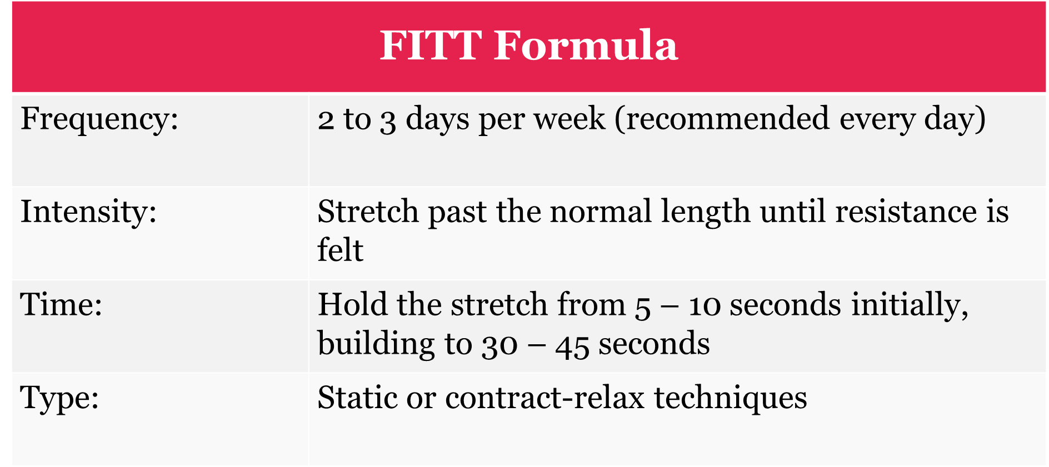
Flexibility

Slide 25
Planning a Fitness Program
Threshold of Training
  Minimal level of exercise needed to achieve desired benefits.
Target Zone
  Defines the upper limits of training and the optimal level of exercise.
Needs and goals of the individual
  Program should meet the realistic goals of the individual as well as maintain/improve function.
FITT Formula
Directly related to Exercise DOSAGE.

Slide 26
General Exercise Principles
FITT Formula- Dosage
Frequency
  Number of sessions each week (i.e., how often).
Intensity
  Degree of effort put forth during exercise (i.e., how hard).
Time
  Duration of activity (i.e., how long).
Type
  Mode of exercise being performed.
Dosage of Exercise
  Intensity
  Duration
  Frequency
  Rate of progression
Notes:
The general parameters of exercise prescription hold true for individuals who are healthy as well as those patients who have disease pathology. However, there must be some special considerations for those that have disease.
Exercise is not prescribed for these individuals until the patient has undergone a graded exercise stress test under the direction of their physician.
Intensity – how far to go or how hard to push oneself with any given exercise
Duration – how long to hold a position or sustain a prescribed exercise
Frequency – how many repetitions per set and how many sets per session or day
Discuss warning signs of “overdose”
Oral explanation and written prescription

Slide 27
Order of Prescribed Progression
Stage one: proprioceptive balance training
Stage two: stretch hypertonic muscles
Stage three: strengthen hypotonic muscles
Stage four: aerobic training
Notes:
STAGE 1:
Proprioceptive balance training is the first stage of addressing that “weak link” and restoring symmetry to muscle firing patterns and motor function control.
Improved neuromuscular firing through balance training prepares the way for stretching facilitated muscles and strengthening inhibited muscles. If during your initial screening the patient has trouble balancing on one leg (i.e. during stork test), this should prompt you to make further assessments.
Greenman suggests the following progression:
Level 1: Patient stands, with bare feet, first on one leg then the other. Compare steadiness of balance on right and left legs.
Level 2: Patient stands on one leg with arms crossed. Compare right and left.
Level 3: Patient stands on one leg with arms crossed and eyes closed. The goal is be able to stand in level three for 30 seconds. A more important and immediate goal is to restore symmetry of balance.
Stage 2:
Stretch the tight muscles identified during initial assessment or during the course of treatment.
If the physician employs muscle energy techniques, the initial steps of patient education can readily be addressed in the course of manipulation.
Identify the key muscles to be stretched -- this may change as the patient progresses with exercises and treatment.
Teach the patient how to isolate the specific muscles or muscle group to be stretched.
Stage 3:
When symmetry has been restored or improved, inhibition of the antagonist muscles will decrease. This will allow the focused strength training to be more effective.
Danger: patients often try to do more than they are truly prepared to do. The patient may not feel tired or winded from the exercises at the early stages of training, and therefore lose sight of the goal: to restore balance to the system.
As the patient pushes beyond their preparation, the first aspect to be lost will often be precision and structural/postural integrity while performing a given exercise. Alignment and correct performance of any exercise prescribed must be taught and emphasized in order to maximize the benefits and to prevent further injury.
Stage 4:
Added to the regimen only after the goals of the previous stages have been met. It is often the case that patients will come with exercise programs already in place. In these cases, unless the injury or dysfunction is preventing participation in the exercise of choice, the previous stages of proprioceptive balance training, stretching, strengthening, and integration/combination exercise will be progressively incorporated into the patient’s established routine.

Slide 28
Comprehensive Rehabilitation Programs
Goals:
  Soft tissue inflexibilities
  Improve muscle strength deficits and imbalances
  Improve endurance and power to muscle groups
  Overall goal – optimize “performance” and kinetic chain
Program should include:
  Patient education about posture, body mechanics, and proprioception
  Acute, Recovery, and Maintenance Phases

Slide 29
Therapeutic exercise
Three Main Types addressed collectively in musculoskeletal pain:
  Flexibility, Muscle Strength, and Aerobic Capacity
Specific Adaptation to Imposed Demand (SAID Principle)
  States “the body responds to given demands with specific and predictable adaptations.”
  Examples:
    Stronger muscles = strength training
    Skeletal muscle oxidative capacities = aerobic exercise
    Connective tissue elasticity = flexibility exercise

Slide 30
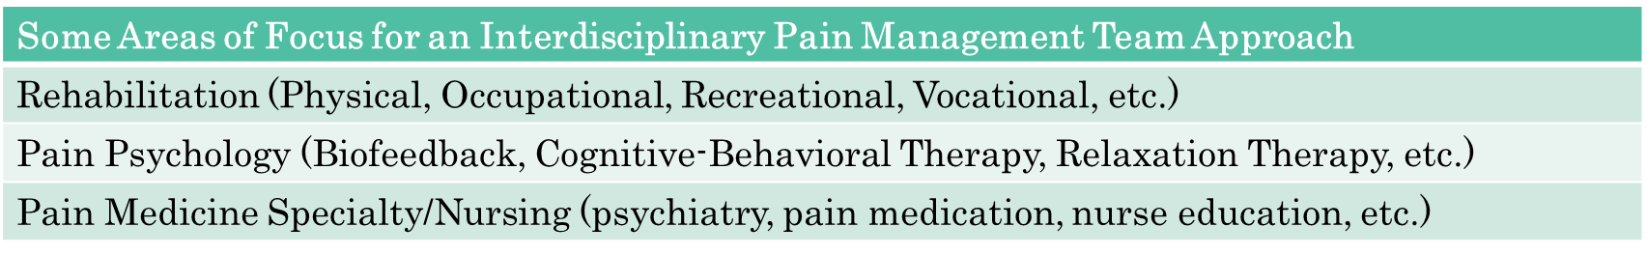
Multidisciplinary Comprehensive Pain Management
Frequency/Duration: Dependent upon level of impairment, but up to 7-8 hours per day for 3-4 weeks for most
Studies have shown: greater outcomes for 100+ hours of therapy compared to < 30 hours of treatment
The American Pain Society, The National Pain Strategy, and multiple systemic reviews support the use of a multidisciplinary and interdisciplinary approach for patients.
  Specifically for LBP
  As well as, the continuation of utilizing pain management practices.

Slide 31
Progression/Monitoring of Exercise Prescription
Re-assess exams/tests from initial evaluation visit
Repeat any outcomes tests
Borg’s Rating of Perceived Exertion Scale
Borg’s Rating Scale of Perceived Exertion
6 | No exertion at all
7 – 8 | Extremely light (very, very light)
9 – 10 | Very light (warm-up/recovery)
11 | Light (aerobic threshold)
12 – 13 | Moderate (anaerobic threshold)
14 – 15 | Hard (VO2 max)
16 – 17 | Very hard (peak lactate or lactate tolerance)
18 – 19 | Extremely hard (very, very hard; anaerobic power)
20 | Maximum (all-out effort; nothing being held in reserve)

Slide 32
Why Exercise Prescription?
NASM Corrective Exercise Values and Uses
Offers recovery workout
  Movement pattern correction, Recovery and Self-Care (adaptations)
Restores and encourages proper movement
  Technique and longevity improvement, ”wear/tear” and injury reduction
  “Return to Play” (specificity and rebalance)
3. Prepares the body for High and Low Volume to Intensity Changes
  Performance Enhancement
  Moving dynamically, walking up steps, etc.
Notes:
We are treating the entire person. Function is key
Key Principles of Osteopathic Philosophy
The body is a unit comprised of three pillars
body, mind, spirit
A person is capable of taking an active role in their care
self-healing, self-regulation, self-maintenance
Structure and Function are interrelated
Rational treatment is based on the understanding of body unity, self-regulation, and the interrelationship of structure and function

Slide 33
Resources
Benzon, H. T., Scholten, P., Press, J., Prather, H., Rivers, W., & Stanos, S. P. (2018). Physical medicine and rehabilitation approaches to pain management. In Essentials of pain medicine (4th ed., pp. 531–537). essay, Elseiver.
Benzon, H. T., & Walega, D. R. (2018). Determination of Disability. In Essentials of pain medicine (4th ed., pp. 99–102). essay, Elseiver.
Caspersen, C. J., Powell, K. E., & Christenson, G. M. (1985). Physical activity, exercise, and physical fitness: Definitions and distinctions for health-related research. Retrieved from https://www.ncbi.nlm.nih.gov/pmc/articles/PMC1424733/
Geneen, L. J., Moore, R. A., Clarke, C., Martin, D., Colvin, L. A., & Smith, B. H. (2017). Physical activity and exercise for chronic pain in adults: An overview of Cochrane Reviews. Cochrane Database of Systematic Reviews. doi:10.1002/14651858.cd011279.pub3
“Exercise Science - U.S. National Library of Medicine Collection Development Manual.” Edited by National Library of Medicine, U.S. National Library of Medicine, National Institutes of Health, 26 Nov. 2003, Retrieved from www.nlm.nih.gov/tsd/acquisitions/cdm/subjects34.html
Lavelle, J., (2015). Exercise prescription. Retrieved from https://slidetodoc.com/exercise-prescription-john-m-lavelle-do-objectives-n-2/
Lin, I., Wiles, L., Waller, R., Goucke, R., Nagree, Y., Gibberd, M., Straker, L., Maher, C. G., & O’Sullivan, P. P. (2019). What does best practice care for musculoskeletal pain look like? eleven consistent recommendations from high-quality clinical practice guidelines: Systematic review. British Journal of Sports Medicine, 54(2), 79–86. https://doi.org/10.1136/bjsports-2018-099878
McGraw-Hill Companies, Inc. (2012). Exercise Physiology and Fitness - Huntingdon College. Retrieved from http://mbamman.huntingdon.edu/SSPE110/ch07.ppt
National Academy of Sports Medicine. (2019). Retrieved from https://www.nasm.org/
National Academy of Sports Medicine. “Corrective Exercise: Maximize Client Recovery & Movement Quality.” National Academy of Sports Medicine, 2019, Retrieved from www.nasm.org/resources/downloads
West Virginia University. “Division of Exercise Physiology.” West Virginia University, West Virginia University School of Medicine, 2019, Retrieved from www.medicine.hsc.wvu.edu/ep/students/master-of-science/

