Slide 1
Minimally Invasive Spine Procedures
Corinne Stuart, DO
5/27/2022

Slide 2
Kyphoplasty
Percutaneous Interspinous Spacer
Basivertebral Nerve Ablation

Slide 3
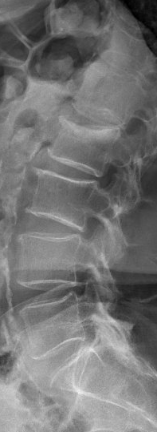
Kyphoplasty

Slide 4
Vertebral Compression Fracture (VCF)
700,000 annually in the US
Etiologies
  Osteoporosis
  Cancer
  Trauma
Quality of life
Financial implications

Slide 5
VCF Diagnosis
Presentation
Imaging

Slide 6
VCF Treatment
Conservative
  Bed rest (short course)
  OTC medications
  Prescription medications
  Bracing
Vertebral Augmentation Procedures
Surgical Intervention

Slide 7
Kyphoplasty
Indications
Contraindications
Intractable pain due to VCF that does not respond to conservative management
Patient refusal
Coagulopathy
Bony retropulsion
Infection
Allergy to bone cement
Severe fracture/unstable fracture/complete bony collapse
Tumor mass with spinal canal involvement

Slide 8
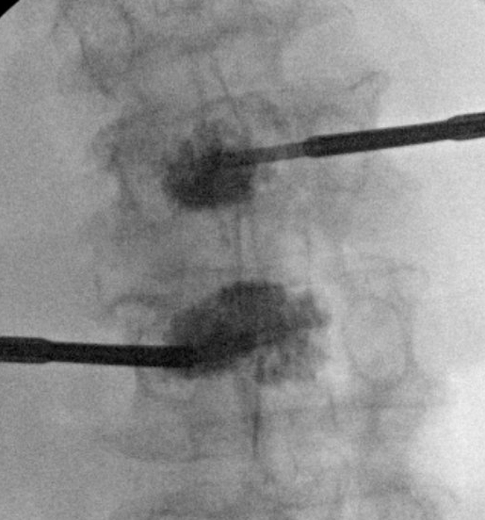
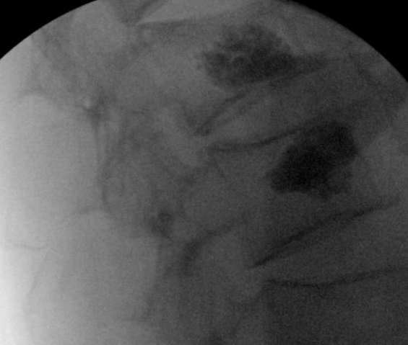
Kyphoplasty Procedure

Slide 9
Kyphoplasty
Outcomes

Slide 10
Lumbar Spinal Stenosis
400,000 in the US
  47% with mild-moderate LSS
Presentation
Treatment
  Medication
  Diet
  PT/Exercise
  LESI
  Surgical intervention

Slide 11
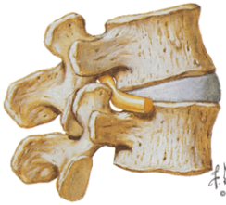
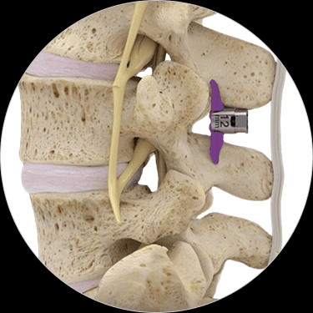
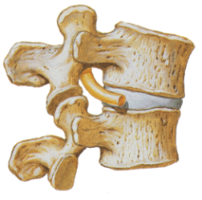
Superion® Interspinous Spacer: Mechanisms
Percutaneous Interspinous Spacer
Minimally invasive procedure which provides decompression by restriction of extension at treated segment(s).
  Canal and foraminal space for nerve decrease in extension
  Canal and foraminal space increase in flexion
Interspinous spacer

Slide 12
Percutaneous Interspinous Spacer
Indications/Prerequisites
Contraindications
Moderate spinal stenosis +/- grade 1 spondylolisthesis
Central, foraminal, lateral recess stenosis
L1-L5 levels
Failed 6 month of non-operative treatment
Allergy to titanium
Anatomy not conducive to implant
Cauda Equina Syndrome
Severe osteoporosis
Prior fusion/decompression at site of implant
Infection
BMI>40

Slide 13
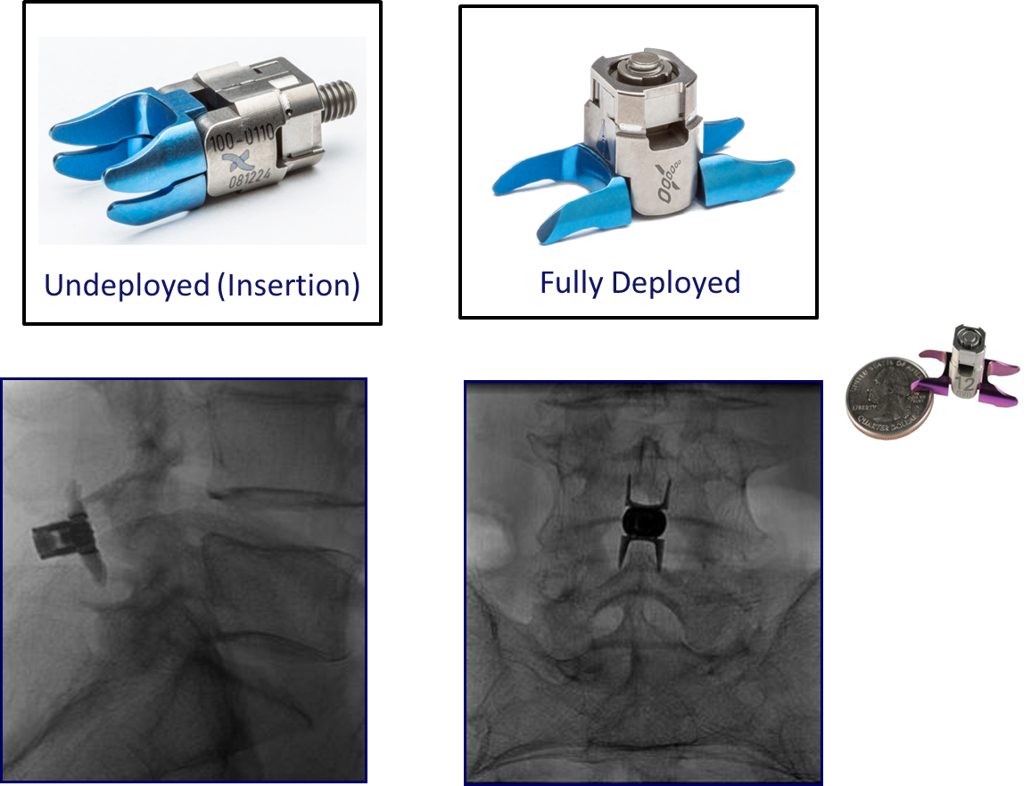
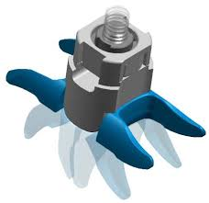
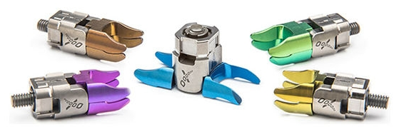
Superion® Interspinous Spacer: Design
Percutaneous Interspinous Spacer
8, 10, 12, 14,16 mm

Slide 14
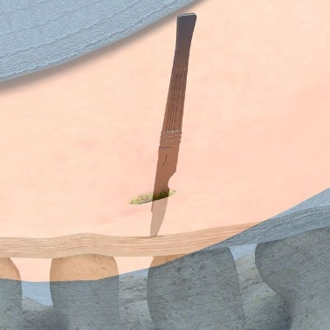
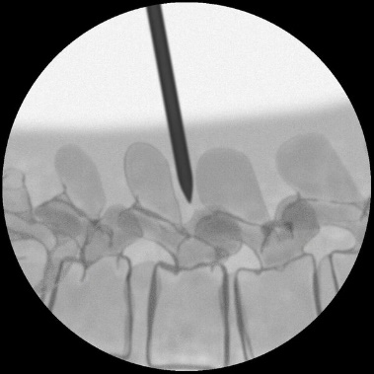
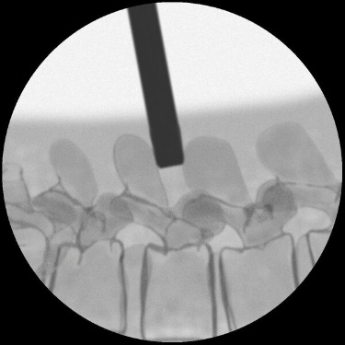


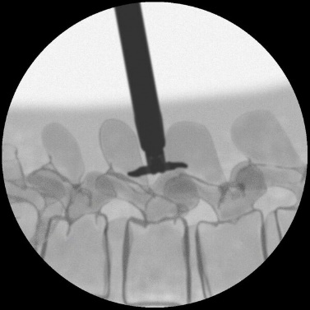
Superion® Interspinous Spacer: Surgical Steps
Percutaneous Interspinous Spacer
Skin incision
Dilator
Cannula
Space guage
Deploying device
Deploying device

Slide 15
Percutaneous Interspinous Spacer
Outcomes

Slide 16
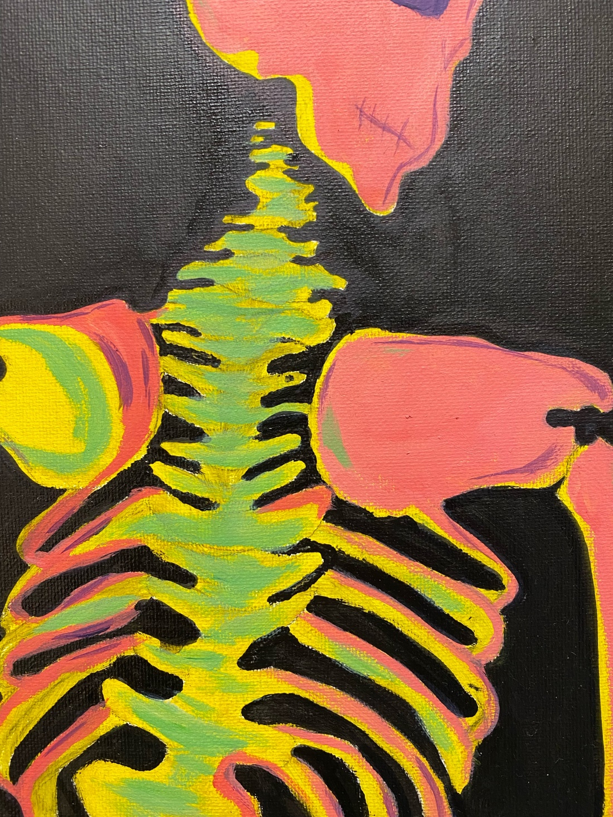
Vertebrogenic Pain

Slide 17
Intervertebral Disc
Largest avascular tissue in the body
Nutrition via cartilaginous end plates
Provides mechanical support to spine
Previously commonly understood as main pain generator

Slide 18
Disc Changes
Disc height loss due to dehydration
Alters load redistribution within IVD and EP
IVD disc material leads to increase permeability to EP bone marrow exchanging inflammatory mediators
Inflammatory cycle

Slide 19
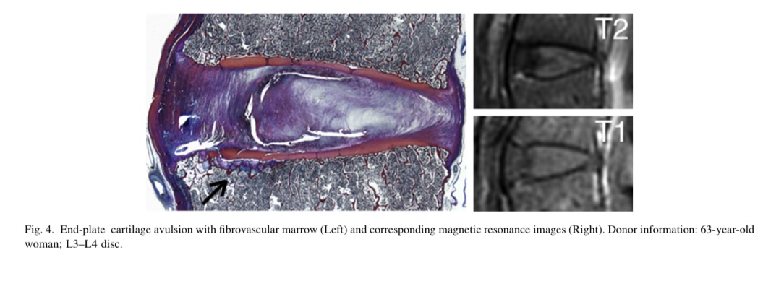
Pathophysiology of Modic Changes
Fields, AJ et al. 2014

Slide 20
Where’s the Pain Coming From?
Pain is likely from the nociceptors located on the SEP and IEP of vertebral bodies
More receptors on endplates than the disc
  Annular tear 30% neoinnervation
  Adjacent endplates 90% neoinnervation
Discectomy

Slide 21
Vertebrogenic Pain
Axial low back pain
Pain worse with position change from sitting standing, bending
Pain typically will not go past mid gluteal line
Non-radicular
Deep ache like pain sensation
Only L3–S1

Slide 22
Modic Changes
Changes visualized on MRI of the lumbar spine
  Modic I→ Inflammation, edema
  Modic II→ Fatty replacement of bone marrow
  Modic III → Prominent subchondral bony sclerosis

Slide 23
Modic Type | I | II | III
T1 weighted MRI | Hypointense | Hyperintense | Hypointense
T2 weighted MRI | Hyperintense | Hyperintense | Hypointense
Pathology of Bone Marrow | Inflammation/ edema | Fatty replacement | Sclerosis

Slide 24
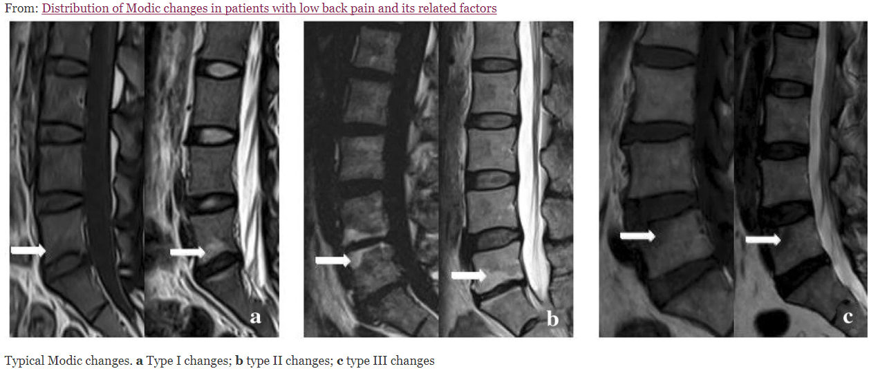
Chen, Y., Bao, J., Yan, Q. et al. Distribution of Modic changes in patients with low back pain and its related factors. Eur J Med Res 24, 34 (2019). https://doi.org/10.1186/s40001-019-0393-6

Slide 25
What is the Basivertebral Nerve?
Branch of the sinuvertebral nerve
Nerve that innervates the endplates of vertebral bodies
Enters via the posterior vertebral body via the basivertebral foramen
Arborizes in the posterior 1/3 to branch to innervate SEP and IEP

Slide 26
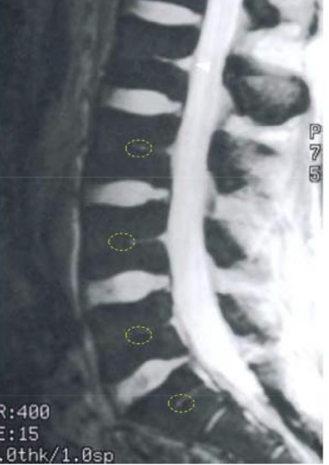
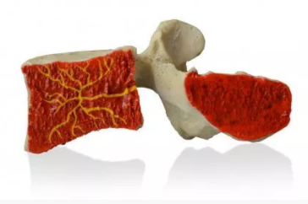

Slide 27
Basivertebral Nerve Ablation
RFA procedure
Same day surgery
No diagnostic tests
Insurance approval takes time→ up to 6 months
Pain relief may take up to 3 months before improvement is noticed

Slide 28
How is the Procedure Performed?
Transpedicular approach to gain access to place probe
The base of the trunk, prior to any branching is targeted
RFA lesioning with Bipolar probe for 15 minutes

Slide 29
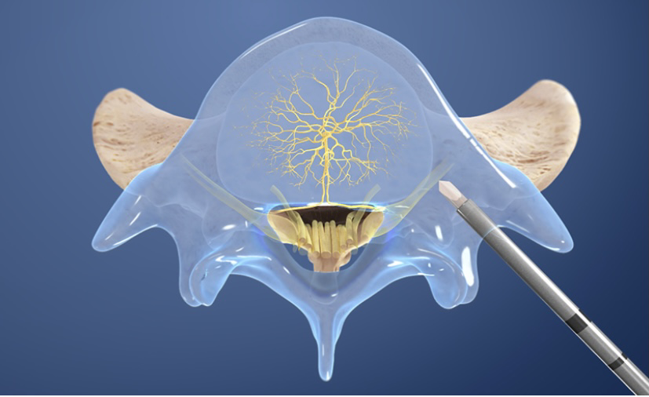
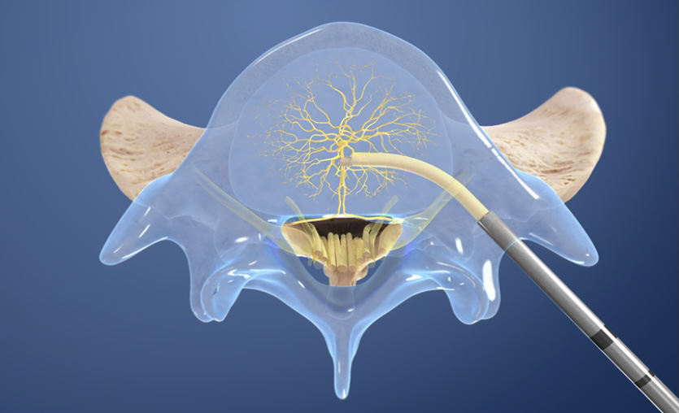
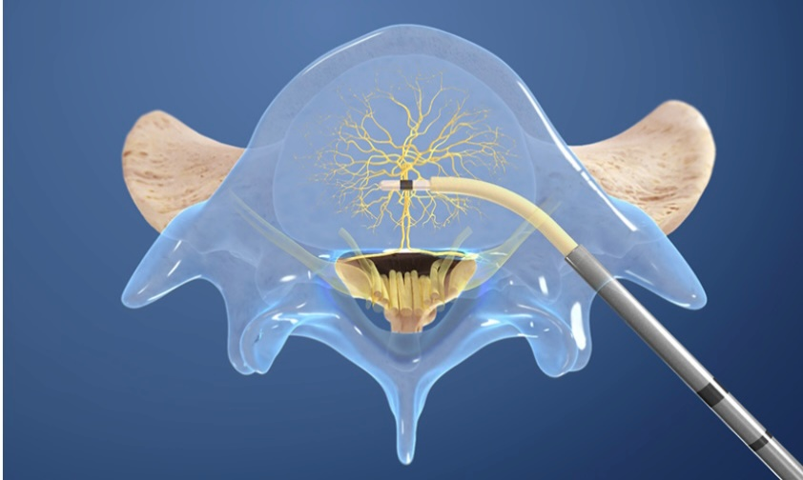
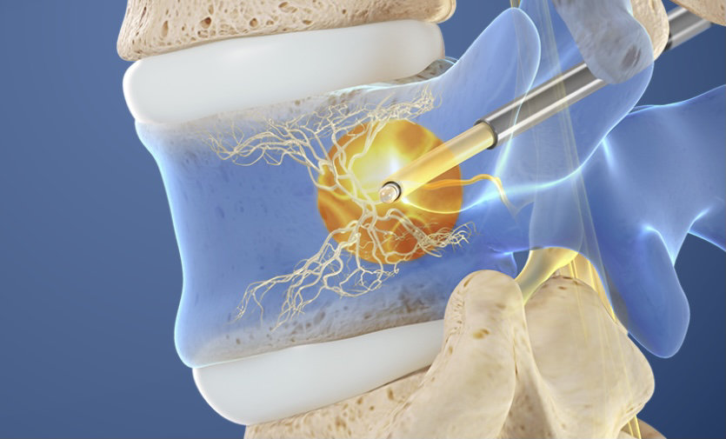
Procedure Overview
Relievant.com

Slide 30
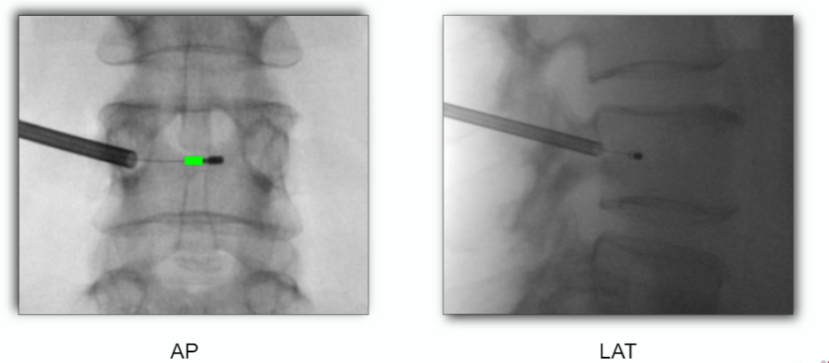
Final Probe placement

Slide 31
Basivertebral Nerve Ablation Indications
Low back pain > 6 months in duration
Low back pain that has not responded to conservative treatment > 6 months
  PT, chiropractic, medications, injections
Modic endplate changes in either L3, L4, L5, S1
  Type I or Type II

Slide 32
Basivertebral Nerve Ablation Contraindications
Severe cardiopulmonary compromise
Targeted ablation zone <10mm from sensitive structure
Active systemic infection/local infection in area of procedure
Pregnancy
Skeletally immature patient (typically <18yoa)
Electronic implants/implantable pulse generator
Situation that may result in unintended tissue damage may occur

Slide 33
Basivertebral Nerve Ablation
Relative Contraindications
Spondylolisthesis
Spondylolysis
Instability
T-score: < -2.5
BMI > 40
Radicular pain
Spinal stenosis

Slide 34
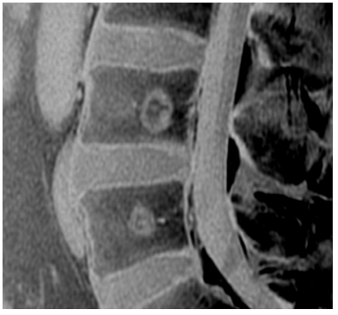

Slide 35
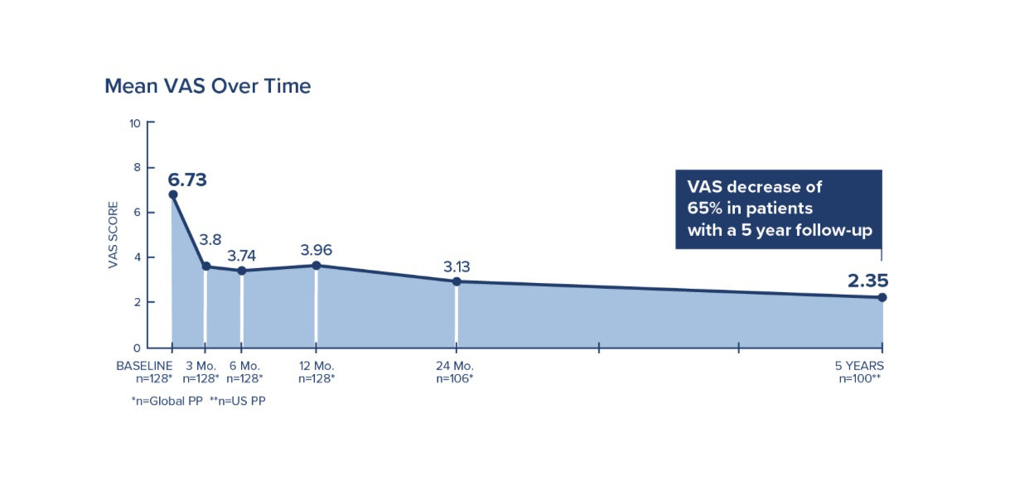
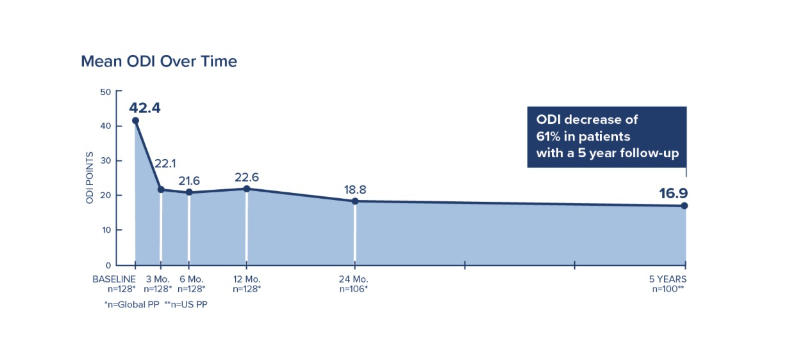
5 Year Data
5 Year Data
Fischgrund et al, 2020

Slide 36
References
Becker, Stephan, et al. “Ablation of the Basivertebral Nerve for Treatment of Back Pain: A Clinical Study.” The Spine Journal, vol. 17, Feb. 2017, pp. 218–23.
Benzel’s Spine Surgery.
Helms, Clyde. “Lumbar Spine: Disc Disease and Stenosis.” Fundamentals of Skeletal Radiology, 5th ed., pp. 211–23.
Intracept®Surgical ProcedureTraining.
Lotz, Jeffrey, and Sigurd Berven. “Pathophysiology of Intervertebral Disc Degeneration and Pain.” Benzel’s Spine Surgery, Fifth, Elsevier, 2022, pp. 296–306.
Fields AJ, Liebenberg EC, Lotz JC. Innervation pathologies in the lumbar vertebral end plate and intervertebral disc. The Spine Journal 2014 (3): 513-521.
Fischgrund, JS, Rhyne A, Macadaeg K, Moore G, Kamrava E, Yeung C, Et al. Long term outcomes following intraosseous basivertebral nerve ablation for treatment of chronic low back pain: 5 year treatment arm results from a prospective Randomized controlled trial double-blind sham-controlled multi center study. Eur Spine J ePub May 25 2020.

Slide 37
Questions?

