Slide 1
Exploring The Benefits of Targeted Drug Delivery Therapy
Rolando Garcia, MS , PAC
WVU Pain Management

Slide 2
TDDS
Objectives
To better understand the benefit of intrathecal pain pump for refractory cancer or non-cancer chronic pain.
Better management of cancer pain with targeted drug delivery system over chronic systemic opioid use.
Better understanding of the indications of a targeted drug delivery system implant.

Slide 3
Targeted Drug Delivery System Implants
Intrathecal drug delivery devices (IDDDs) may be effective for patients with refractory chronic pain.
they may be adopted for non-oncologic pain in patients with compression fractures, spondylolisthesis, spondylosis, back surgery failure syndrome and spinal stenosis.
Oncologic patients can benefit from these treatments in a variable way according to tumor characteristics, prognosis, periprocedural imaging and risk of disease progression.

Slide 4
Targeted Drug Delivery System Implants
Intrathecal drug delivery devices (IDDDs) may be effective for patients with refractory chronic pain.
they may be adopted for non-oncologic pain in patients with compression fractures, spondylolisthesis, spondylosis, back surgery failure syndrome and spinal stenosis.
Oncologic patients can benefit from these treatments in a variable way according to tumor characteristics, prognosis, periprocedural imaging and risk of disease progression.

Slide 5
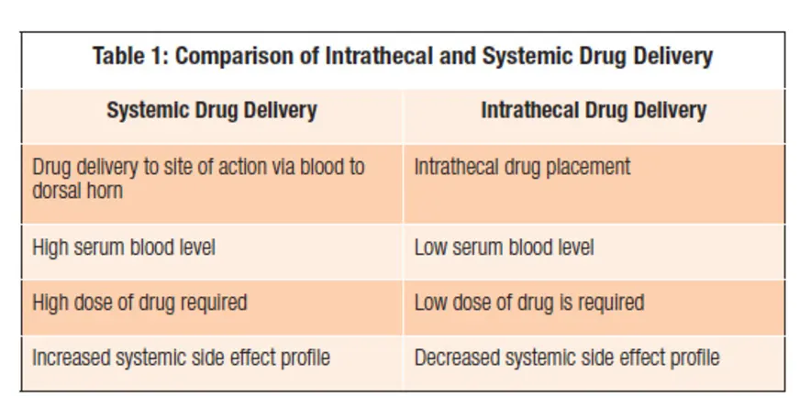

Slide 6
EXPLORing THE BENEFITS OF TARGETED DRUG DELIVERY THERAPY
Patients report a reduction in pain scores after receiving targeted drug delivery.
51% of patients completely eliminated other opioids* at 12 months.
87% of patients rated their quality of life as fair to excellent.
90% of patients would recommend therapy to a family member or friend.

Slide 7
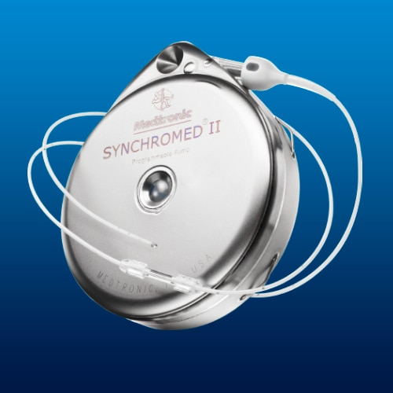
Targeted Drug Delivery Therapy

Slide 8
IDDS

Slide 9
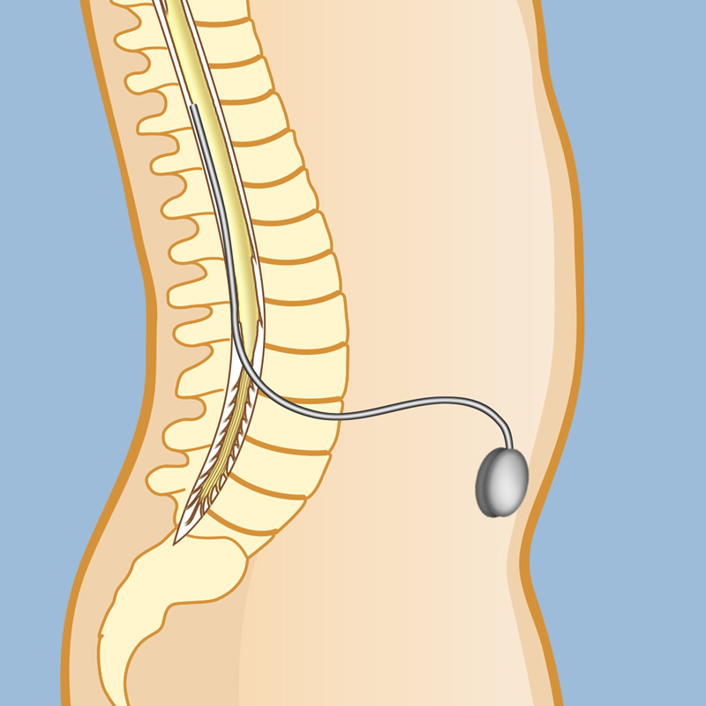

Slide 10
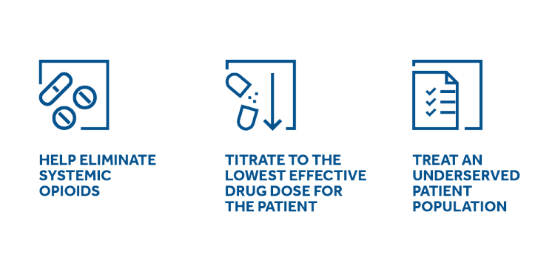
Targeted Drug Delivery Therapy

Slide 11
Patient Selection and Type of Pain Pump Medications:
Type | Characteristics of Good Potential Candidates | Concerns/Contraindications
General | Nociceptive or neuropathic pain | Widespread pain
 | Cancer-related or non-cancer-related etiology | Headaches, facial pain
 | Clear diagnosis, well-localized pain | Inability to place catheter near site of pain origin
 |  | Ischemic heart disease, heart failure, or cerebrovascular disease
 |  | Inadequate caregiver support, transportation to appointments
 |  | Cancer with life expectancy < 3 mo
Morphine | Responsive to systemic opioids | Refractory to systemic opioids
 |  | Substance abuse
 |  | Pulmonary disease
 |  | Obstructive sleep apnea
Ziconotide | Neuropathic pain | History of psychosis
 | Visceral pain
 | Complex regional pain syndrome
 | Concerns related to opioid use

Slide 12
Patient Selection
Refractory chronic pain failing conservative pain management.
Patient failed conservative therapies like oral pain medication, physical therapy, and pain-relief injections such as nerve blocks and epidurals.
Patient is dependent on pain medication and are starting to have strong side effects or addiction.
FBSS/PLLS – failed back surgery syndrome/post lumbar laminectomy syndrome unresponsive and failing other conservative pain management including failure with spinal cord stimulator trial or implants.
Refractory Chronic Cancer Pain.

Slide 13
Patient Selection
Refractory chronic pain failing conservative pain management.
Patient failed conservative therapies like oral pain medication, physical therapy, and pain-relief injections such as nerve blocks and epidurals.
Patient is dependent on pain medication and are starting to have strong side effects or addiction.
FBSS/PLLS – failed back surgery syndrome/post lumbar laminectomy syndrome unresponsive and failing other conservative pain management including failure with spinal cord stimulator trial or implants.
Refractory Chronic Cancer Pain.

Slide 14
The Psychological Evaluation
Helps reveal complex factors that contribute to pain
Establishes a baseline against which to measure improvement
Helps select the right treatment for managing the pain and related symptoms (e.g., fatigue, depression)
May increase the probability of a successful outcome by providing treatments that may resolve psychological risk factors
Identifies and treats psychological co-morbidities prior to therapy
Evaluates patient willingness, understanding, and competency to actively participate in their therapy
Helps assess patient response during spinal cord stimulation screening test
Medicare and some other insurance carriers require
a psychological evaluation for neurostimulation and pain pump therapy.
Pre-authorization may be mandated by some insurers.
© Medtronic Inc. 2015 All Rights Reserved
12

Slide 15
Studies:
Intrathecal Drug Delivery Systems for Cancer Pain: An Analysis of a Prospective, Multicenter Product Surveillance Registry
Stearns, Lisa M. MD*; Abd-Elsayed, Alaa MD, MPH†; Perruchoud, Christophe MD‡; Spencer, Robert MS, MBA§; Hammond, Krisstin BS*; Stromberg, Katherine MS§; Weaver, Todd PhD, MPH§
Author InformationAnesthesia & Analgesia: February 2020 - Volume 130 - Issue 2 - p 289-297
doi: 10.1213/ANE.0000000000004425
(Based on a study of 1403 patients, cancer-related pain can be successfully and safely treated with medication delivery by an implantable pump directly to the spinal cord.)

Slide 16
Case Presentation
A 59-year-old woman with a history of previous discectomy and 2-level fusion at L3–4 and L4–5 presented to a pain clinician with poorly controlled axial and bilateral lower extremity pain.
She had pain that was progressive and predictively worsened when lying supine, standing, and walking.
She had trialed and failed controlled diagnostic facetogenic interventions and epidural steroid injections performed under fluoroscopy.
Her systemic regimen of medication included methadone 10 mg 3 times a day, duloxetine 20 mg once daily, and hydrocodone/acetaminophen 10 mg/325 mg 4 times a day as needed.
She reported that aqua-therapy was helpful while in the pool, and she developed erythema ab igne on her back from extensive exposure to her heating pad.
She reported that in the past she had spinal cord stimulation trialed by 1 provider and implanted by another, with mixed results. The device was subsequently explanted 3 years ago.

Slide 17
Morphine Trial for Pain Pump (Trial done at WVU Hospital, SDS, hosp adm req)
Via Intrathecal injection, like an epidural.
A double blind trial x3.
No oral opiate or pain relievers the morning of trial, patient is to be in pain.
Patient admitted inpatient overnight for observation
Discharge the following morning
May refrain from oral opiates if pain relief persists.

Slide 18
Prialt Trial for Pain Pump (Trial done at the Pain Clinic, no hosp adm)
This medication is a non-opioid pain reliever that is used to treat ongoing pain when other treatments or medications cannot control your pain.
May Treat: Severe chronic pain, Cancer pain, neuropathic from chemo/radiation.
Drug Class: Analgesic - Neuronal (N)-Type Calcium Channel Blockers (NCCBs)
Availability: Prescription Required
mental or mood changes.
Infused into the spinal cord by a special pump.
Because it is non-narcotic, NO WITHDRAWAL SYMPTOMS
Trial is similar to having an epidural injection, but this is infused inside the intrathecal (CSF) space.
Response evaluated in 1 week. If relief lasts for months, will continue intrathecal injection. If it only last weeks, will consider pain pump implant.
Unlike Morphine, Prialt can cover both low back and leg pain and neck and arm pain and even head pain, due to its low molecular wt.

Slide 19
Baclofen Trial for Pain Pump (Trial done at WVU Hospital, SDS, hosp adm req)
Recommended for intractable spasticity unresponsive to oral antispasmodics.
Could be due to any of the following:
Multiple Sclerosis
Cerebral Palsy
Brain injury
Spinal cord injury
SLE (systemic lopus erythematosus) with CNS involvement.

Slide 20
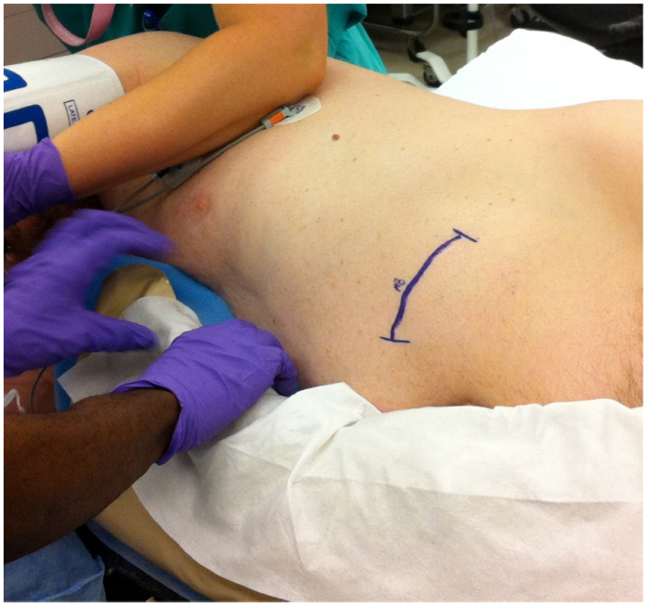
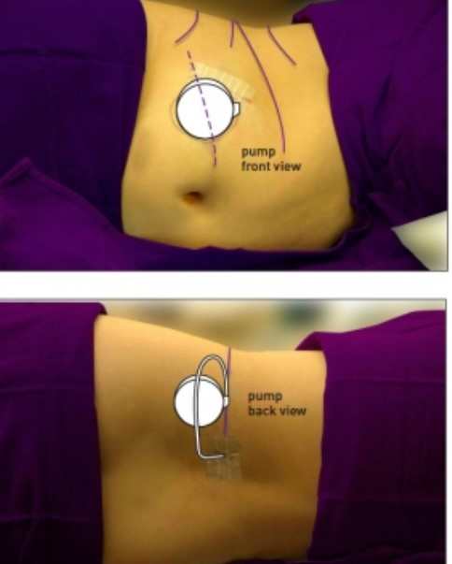
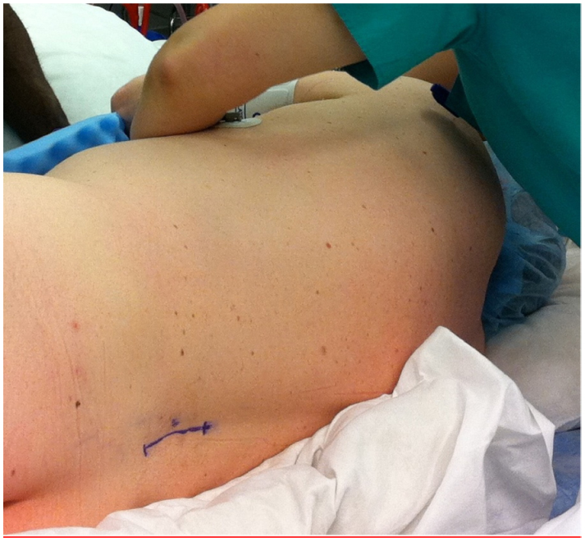
Pain Pump Implant

Slide 21
Reimphasizing the Importance of Good Health and Nutrition BMI: A Concern on Implantable Pain Device
Nutrition
BMI: 35 or lower
Diet
Wt loss
Exercise
Diabetes: Hgb A1C below 7
Metabolic Syndrome
Heart Disease: i. e. CHF, A. Fib
Hgb/HCT
Iron
Protein

Slide 22
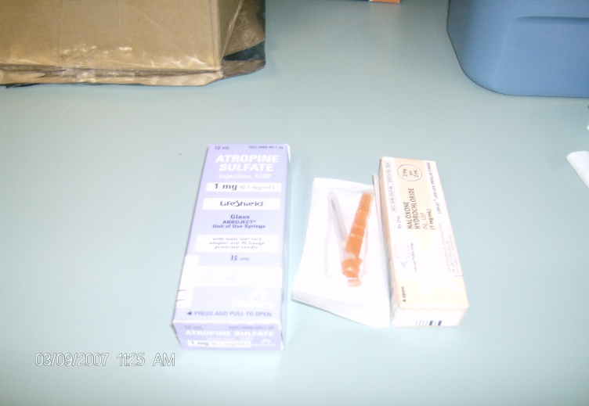
Intrathecal Pump Device
Intrathecal Pump Refill
Equipments
IT pump Refill Kit
Intrathecal narcotic soln
Crash cart –
Atropine, Narcan
Fluoro – for hard to access reservoir port
Programmer

Slide 23
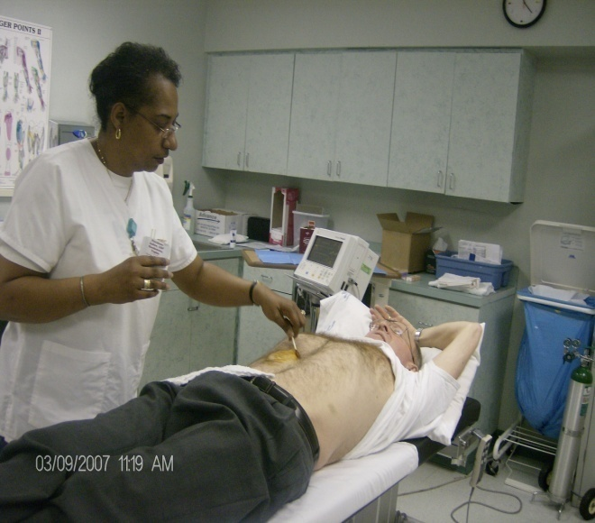
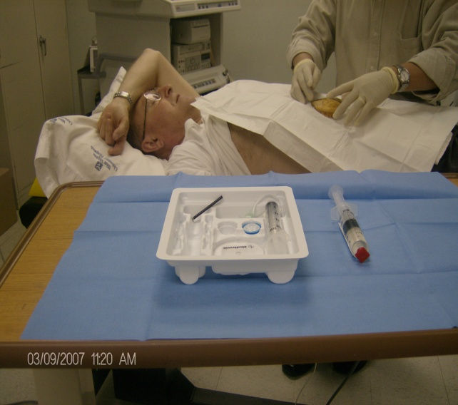
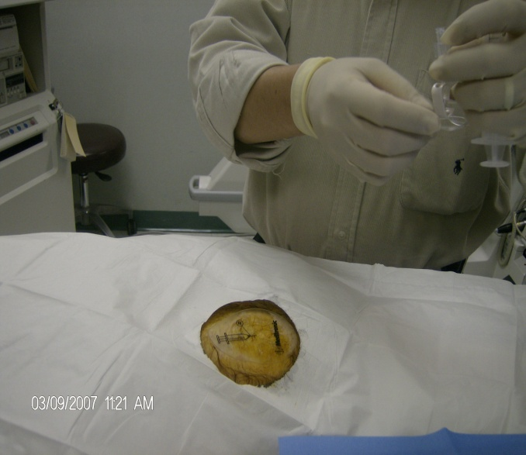
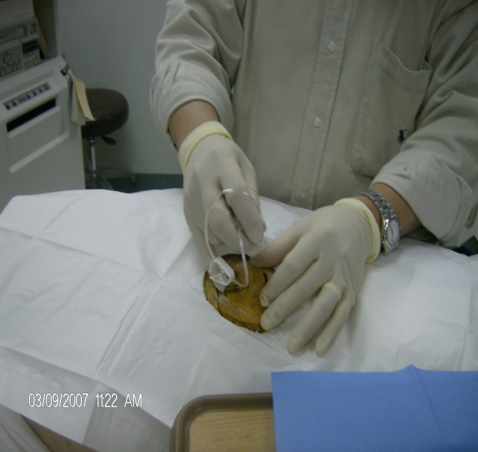
Intrathecal Pump Refill Procedure

Slide 24
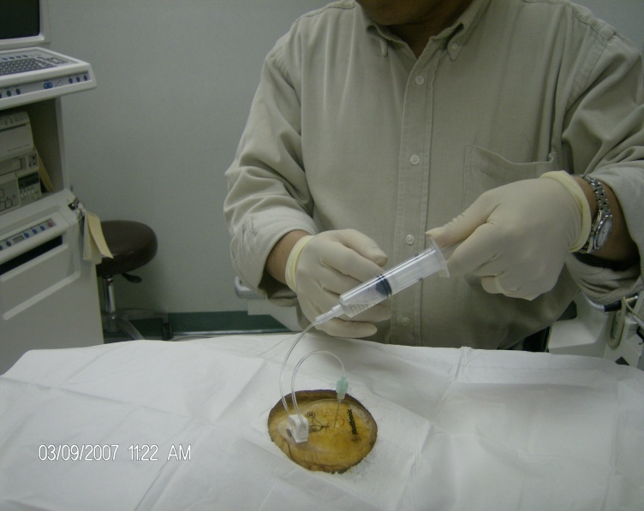
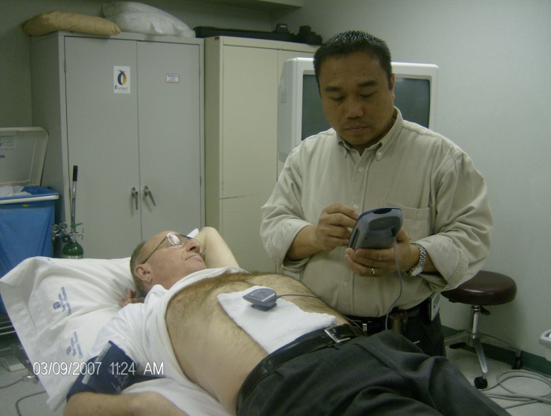
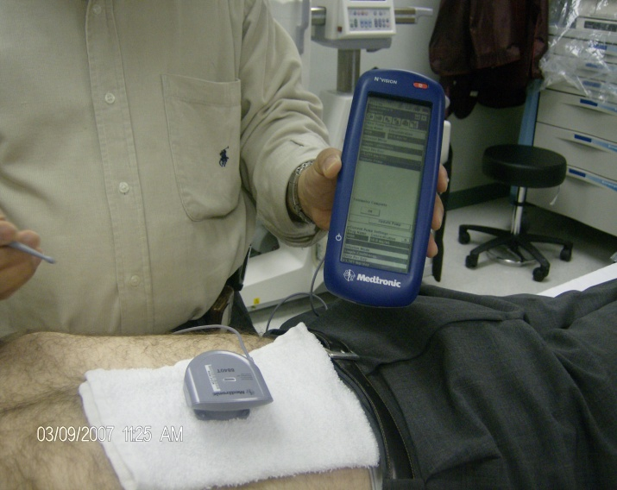
Intrathecal Pump Refill Procedure

Slide 25
Pain Pump Infusion Modes

Slide 26
Simple Continuous Infusion Mode

Slide 27
Flex Dosing Infusion Mode

Slide 28
PTM infusion: Patient Therapy Programmer

Slide 29
References
1. Weiner K. Pain issues: Pain is an epidemic. American Academy of Pain Management. Available from: http://www.aapainmanage.org Accessed: January 26, 2007.
2.. Loeser JD, Butler SH, Chapman CR, Turk DC, editors. Bonica's management of pain. Philadelphia: Lippincott Williams & Wilkins; 2001. [Google Scholar]
3. Smith TJ, Staats PS, Deer T, Stearns LJ, Rauck RL, Boortz-Marx RL, et al. Randomized clinical trial of an implantable drug delivery system compared with comprehensive medical management for refractory cancer pain: impact on pain, drug-related toxicity, and survival. J Clin Oncol. 2002;20:4040–9. [PubMed] [Google Scholar]
4. McDermott AM, Toelle TR, Rowbotham DJ, Schaefer CP, Dukes EM. The burden of neuropathic pain: results from a cross-sectional survey. Eur J Pain. 2006;10:127–35. [PubMed] [Google Scholar]
5. Bier A. Attempts over Cocainisirung of the Ruckenmarkers. Deutsche Zeitschrift für Chirurgie. 1899;51:361–9. [in German] [Google Scholar]
6. Onofrio BM, Yaksh TL, Arnold PG. Continuous low-dose intrathecal morphine administration in the treatment of chronic pain of malignant origin. Mayo Clin Proc. 1981;56:516–20. [PubMed] [Google Scholar]
7. Kitagawa O. On spinal anesthesia with cocaine. Japan Society of Surgery. 1901;3:185–91. [Google Scholar]
8. Pert CB, Snyder SH. Opiate receptor: demonstration in nervous tissue. Science. 1973;179:1011–4. [PubMed] [Google Scholar]
9. Yaksh TL, Rudy TA. Analgesia mediated by a direct spinal action of narcotics. Science. 1976;192:1357–8. [PubMed] [Google Scholar]
10. Atweh SF, Kuhar MJ. Autoradiographic localization of opiate receptors in rat brain. I. Spinal cord and lower medulla. Brain Res. 1977;124:53–67. [PubMed] [Google Scholar]

Slide 30
End

