Slide 1
Center For Integrative
Pain Management
Chiropractic and
Conservative Spine Care
Nicholas R. Marchesani, D.C.

Slide 2
Objectives
Provide a clearer understanding of the patient experience within a chiropractic office
Discuss conservative spine care through a chiropractic lens
Illustrate Chiropractic’s role within spine care

Slide 3

Chiropractic
  Chiropractic is a health care profession that focuses on disorders of the musculoskeletal system and the nervous system, and the effects of these disorders on general health --- American Chiropractic Association

Slide 4

Chiropractors
First contact provider
  Covered under all health insurance plans in WV
  No referral necessary
Diagnosis and Management
  Musculoskeletal disorders
  Primary focus on Spine Related Disorders (SRDs)

Slide 5
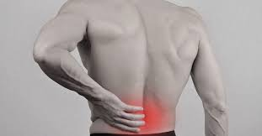
Chiropractic Care
Management
  Conservative approach
  4 main treatment categories
    Joint manipulation/mobilization
    Soft tissue manipulation and other manual therapies
    Therapeutic exercise
    Patient Education

Slide 6
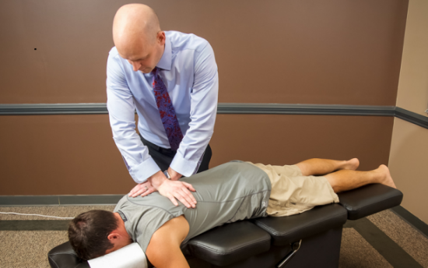
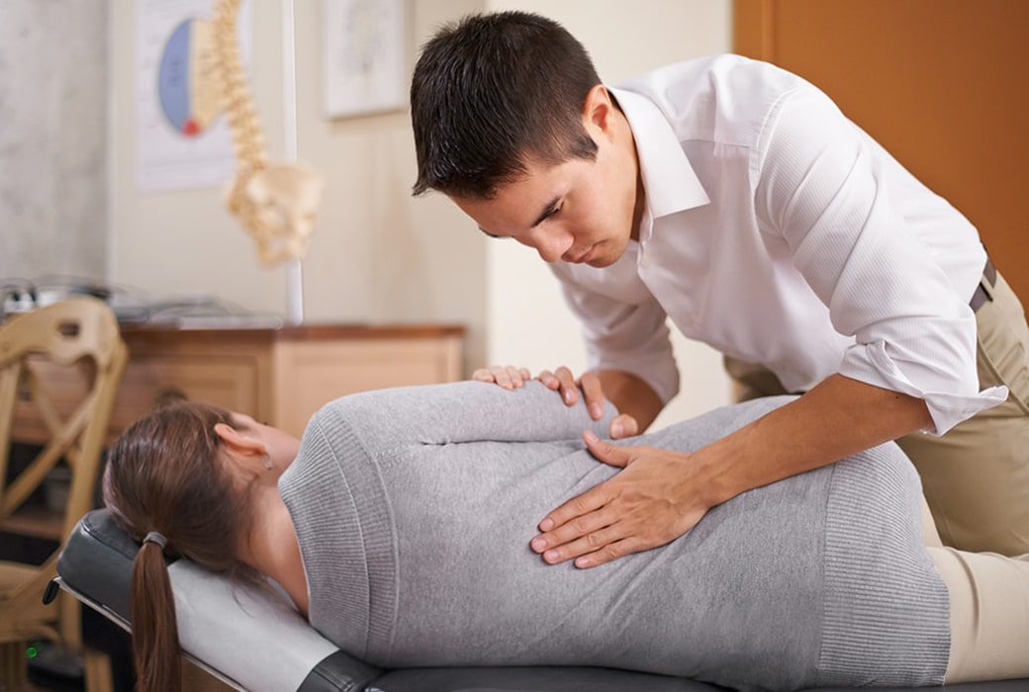
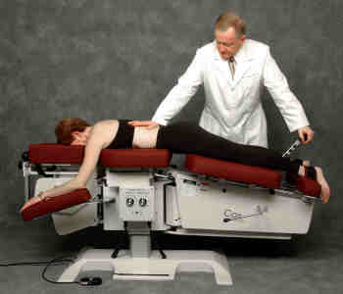
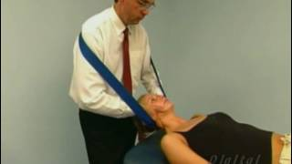
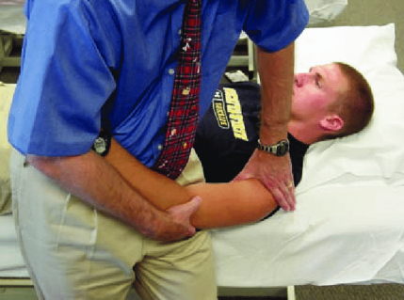
Chiropractic Care
Joint manipulation/mobilization

Slide 7
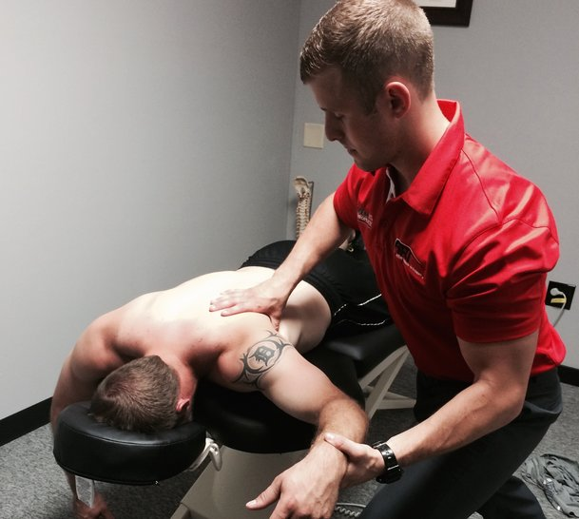

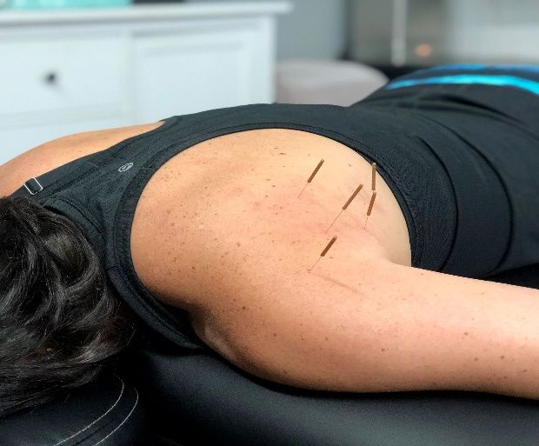

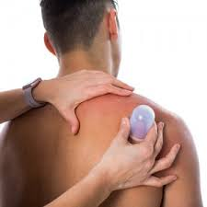
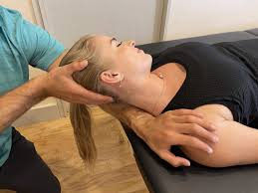
Chiropractic Care
Soft tissue manipulation

Slide 8
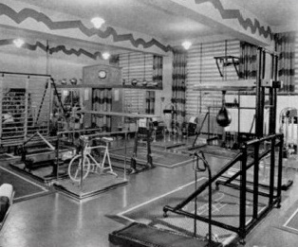
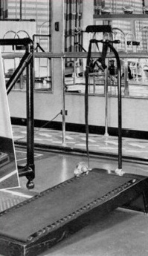
Chiropractic Care
Therapeutic exercise
Palmer Clinic Magazine 1945

Slide 9

Chiropractic Care
Therapeutic exercise
  Rehab approaches and philosophies have changed over time but exercises have remained low tech
  When possible, refrain from rehabilitation exercises that a patient cannot reproduce at home
  If the exercises require costly equipment, only found in a rehab facility, ongoing home care will suffer.
Palmer Clinic Magazine 1945

Slide 10
Chiropractic Care
Patient education
  Possibly the most important category for long term rehabilitative success
  Studies show that the patient who understands their condition better, gets better faster.
  Common topics include but are not limited to:
      Reassurance and Reactivation
        Reassure them there is a high rate of recovery and therapeutic success is not necessarily defined by what was found on imaging
        Encourage reactivation into social and physical aspects of their lives
      Hurt ≠ Harm
      An understanding of the patient’s specific pain triggers
        Flexion, extension, slump, sustained vs repetitive postures, etc.
      Improvement of ADL specific postures
      General spine hygiene
        Mobility, stability, proper breathing patterns, core efficiency, etc.
      Concept of spine conditions being “managed” not “cured”
        High rate of recurrence
        #1 predictor of LBP is a previous episode of LBP

Slide 11

Chiropractic Care
Choice of treatment methods and dosage
  The key to success is matching the right treatment to the right patient at the right time
  Determined through the evaluation process
    3 fundamental questions
      1) Are there any Red Flags or is this pain of non-spine origin?
      2) Can we determine the likely pain generator?
      3) Are there any functional or psychosocial factors present that are contributing to the persistence of this pain?

Slide 12
Evaluation and Management
Red flags or pain of non-spine origin
    Back pain may be the initial symptom for certain visceral disorders or potentially serious illnesses
General conditions being evaluated or screened
Cancer | Cauda equine syndrome
Infection | Gastrointestinal disease
Benign tumor | Genitourinary disease
Fracture | Spondyloarthropathy
Aortic aneurysm
-Adopted from Murphy’s Clinical Reasoning in Spine Pain

Slide 13
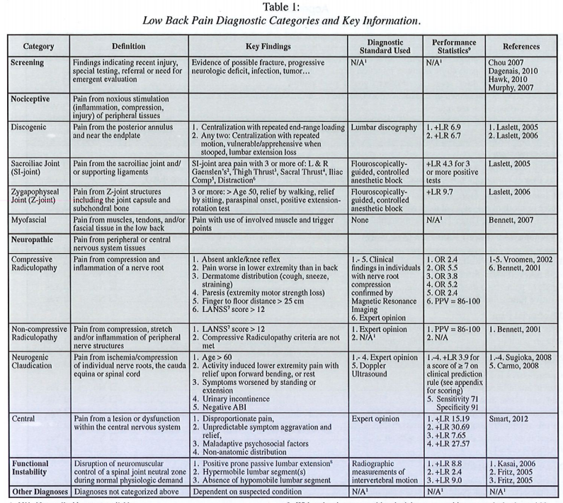
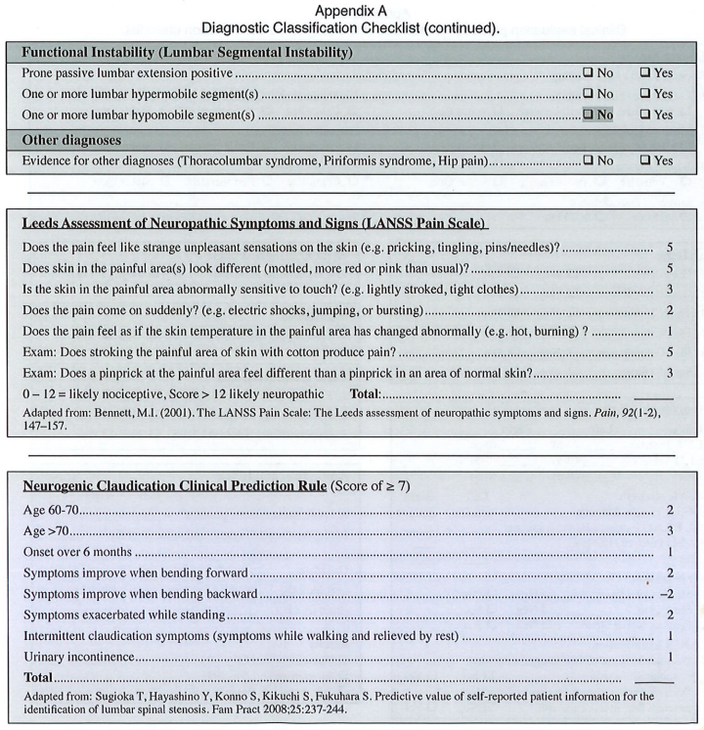
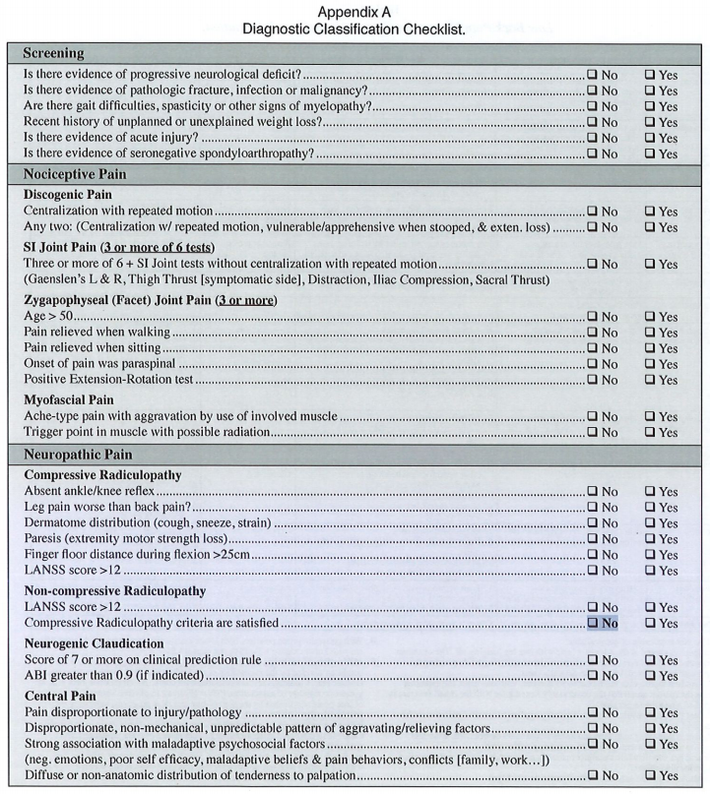
Evaluation and Management
Pain generator
  Cannot determine with 100% certainty but diagnostic criteria exists suggesting potential structures that may be involved.
-Vining 2013

Slide 14
Evaluation and Management
-Vining 2013

Slide 15
Evaluation and Management
-Vining 2013

Slide 16
Evaluation and Management
-Vining 2013

Slide 17
Evaluation and Management
Reasons for persistence of the pain
  What has happened with this person as a whole that would cause the pain experience to develop and persist?
Somatic/neurophysiological factors | Psychosocial factors
Dynamic Instability | Fear
Passive Instability | Catastrophizing
Central sensitivity | Passive coping
 | Poor self-efficacy
 | Depression
 | Perceived injustice
 | Hypervigilance
 | Cognitive fusion
 | Anxiety
-Adopted from Murphy’s Clinical Reasoning in Spine Pain

Slide 18
Evaluation → Treatment Plan
E&M
Treatment options
Is this a mechanical problem related to the spine?
What structures are involved?
What factors are contributing to the persistence of this pain?
Joint specific
Soft tissue specific
Exercise interventions
Patient education
→

Slide 19
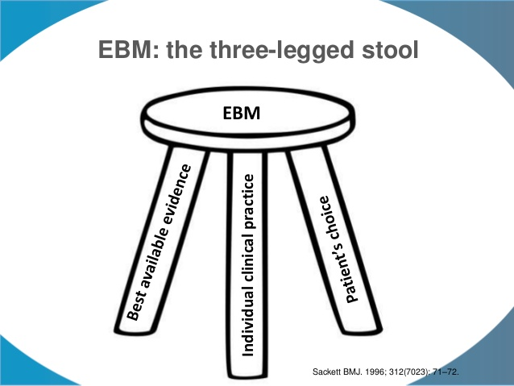
Evidence Based Care

Slide 20
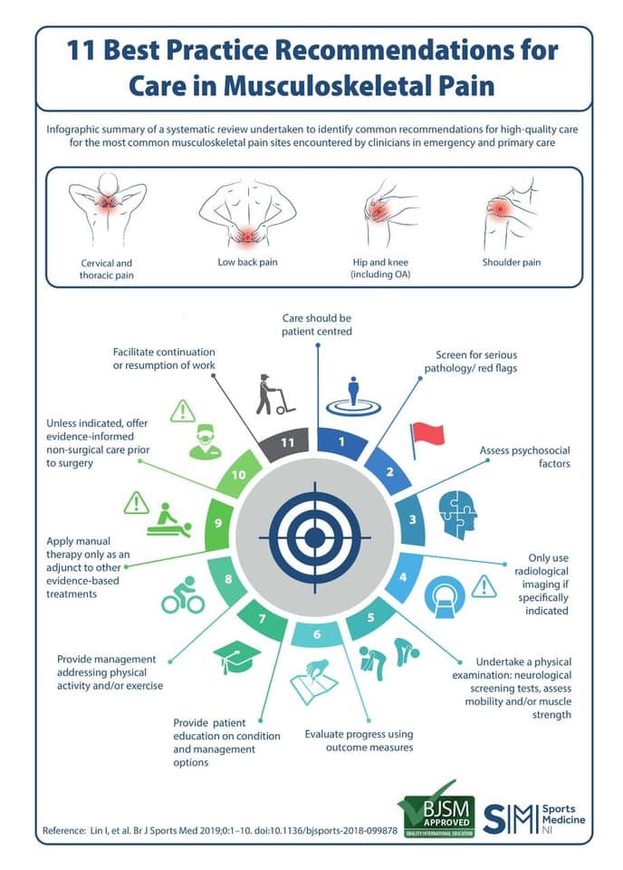
Evidence Based Care

Slide 21
Low Back Pain
#1 cause of years lived with disability worldwide
Disability has increased by > 50% in the last 25 years
US: LBP accounts for more lost work days than any other occupational MSK condition
Hartvigsen, et al., Lancet –June 2018

Slide 22
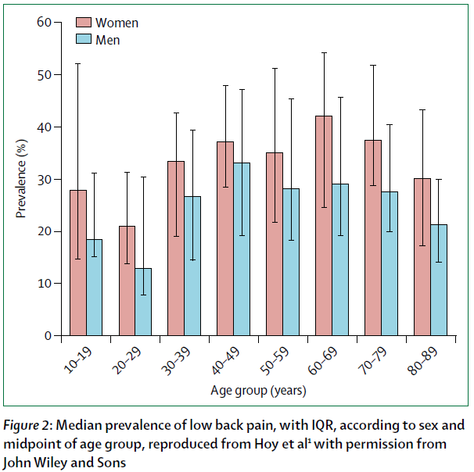
Spine Related Pain
Very Common
Hartvigsen, et al., Lancet –June 2018

Slide 23
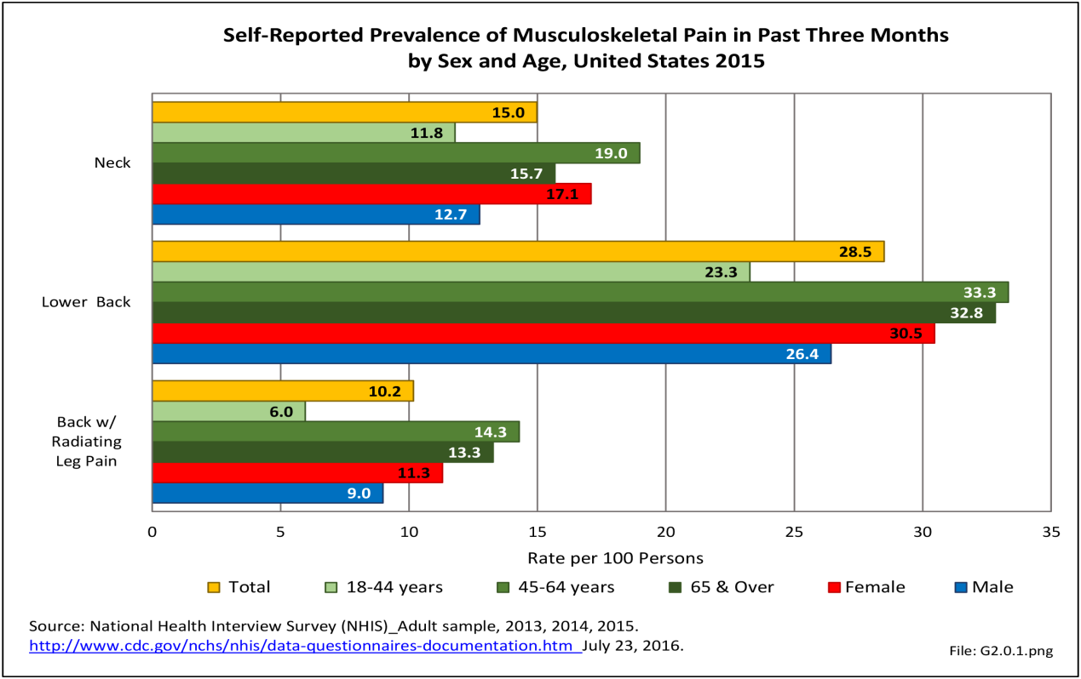
Spine Related Pain
CDC data
  28.5% prevalence of LBP in last 3 months
  10.2% with radiating leg pain
http://www.boneandjointburden.org

Slide 24
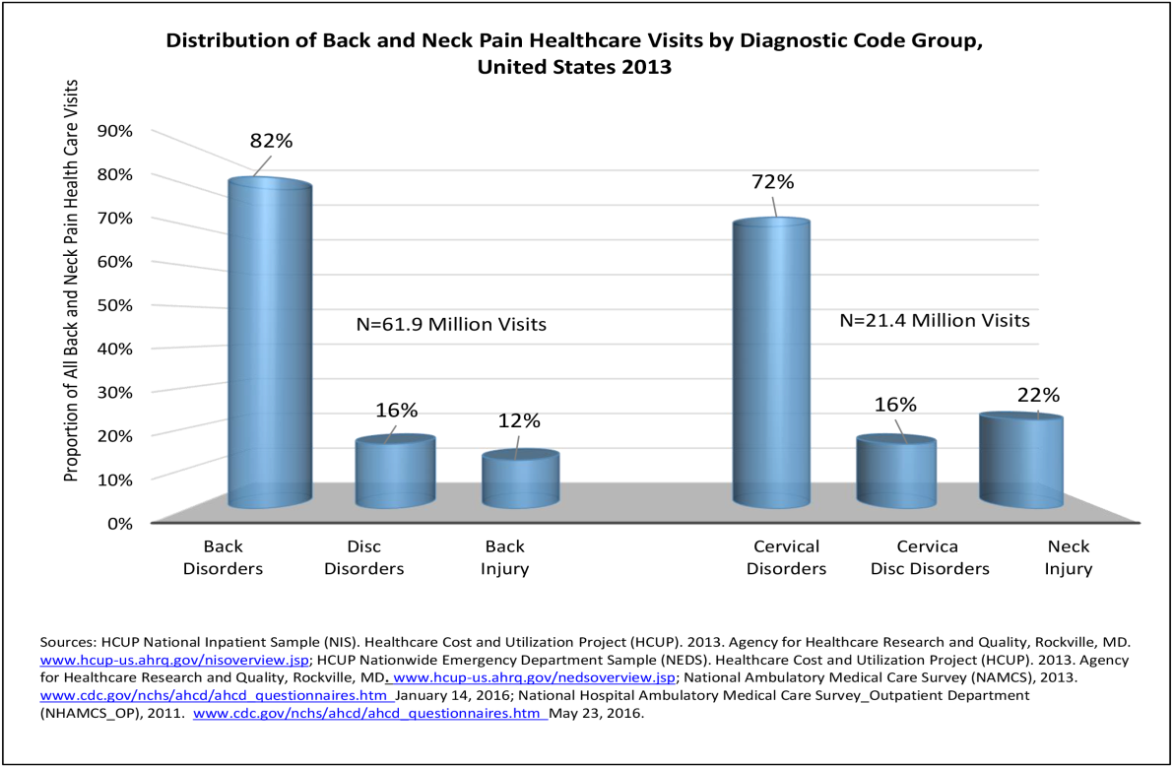
Spine Related Pain
CDC data
  2013
    Back disorders-61.9 million visits
    Cervical disorders-21.4 million visits
http://www.boneandjointburden.org

Slide 25
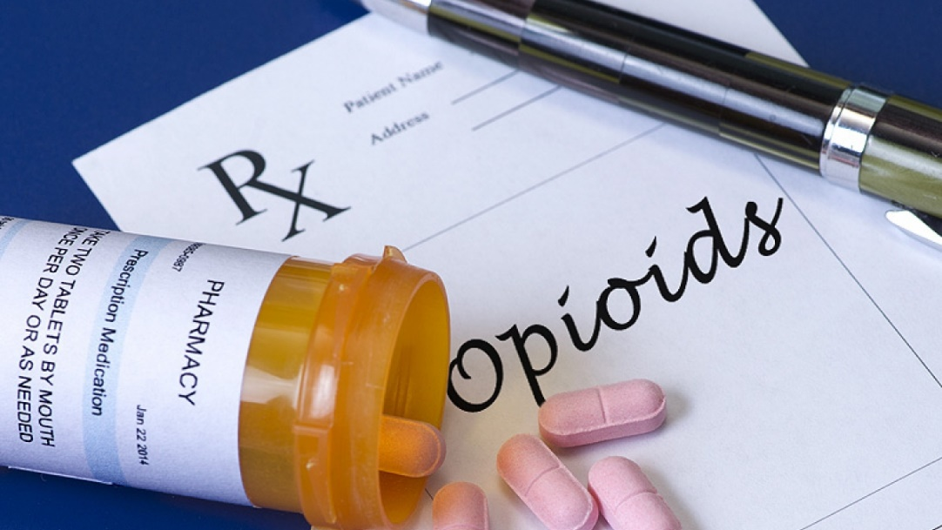
Opioids
~ 50% of all opioid users have spine pain -Busse J, et al. JAMA 2018
~ 40% began using because of spine pain –Ivanova Jl, et al. Spine J. 2011

Slide 26
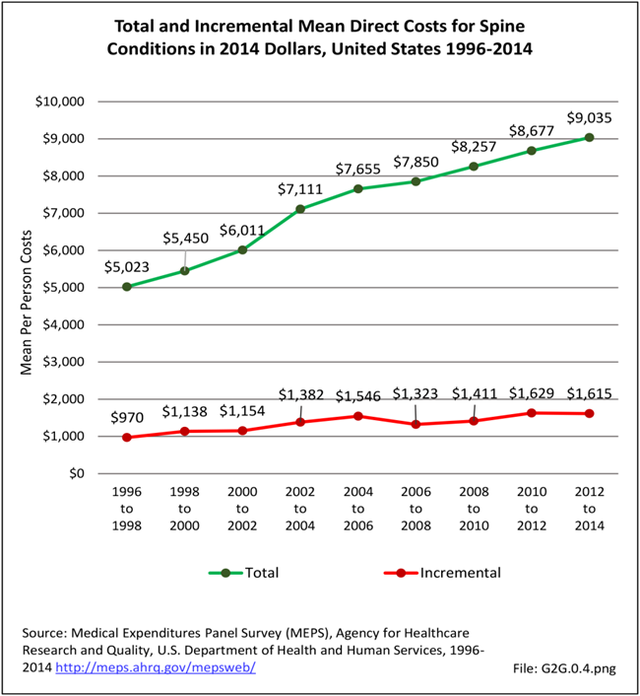
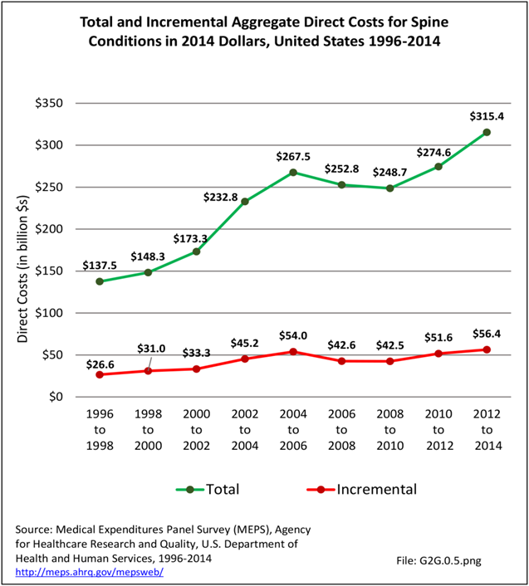
Spine Related Pain
Rising Costs

Slide 27
Spine Related Pain
Rising Costs
  Between 1997 and 2006, expenditures for SRDs rose 82% (adjusted for inflation)
  Yet the number of patients pursuing treatment for SRDs rose only 25%
Martin BI, et al. Trends in health care expenditures, utilization, and health status among US adults with spine problems, 1997-2006. Spine 2009; 34(19):2077-84

Slide 28
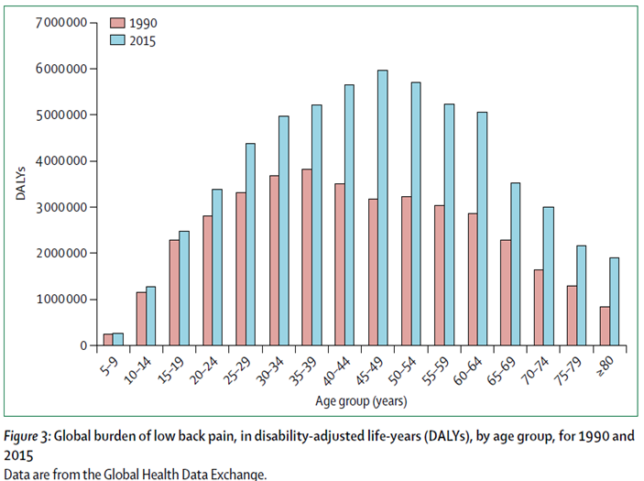
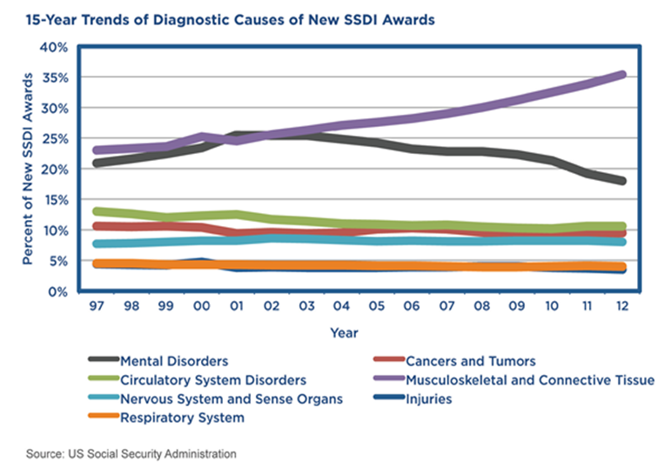
Spine Related Pain
Rising Disability

Slide 29


Rising Costs,
Rising Disability

Slide 30

Rising Costs,
Rising Disability
Outcomes
Value =
Costs

Slide 31

Solution?

Slide 32

Solution?

Slide 33

Solution?
The Lancet Low Back Pain Series – 2018
  “Despite multiple clinical guidelines providing similar recommendations for managing LBP, a substantial gap between evidence and practice exists”
Clinical Practice Guidelines
Practice

Slide 34

Evidence Gap
Guidelines: Recommend education and advice to keep active and keep working
  Practice: Many clinicians and patients advocate rest and absence from work

Slide 35

Evidence Gap
Guidelines: Recommend that first line care should be non-pharmacological
  Practice: A study in US showed that only about half of people with chronic low back pain are prescribed exercise

Slide 36
Evidence Gap
Clinical Practice Guidelines
Practice

Slide 37
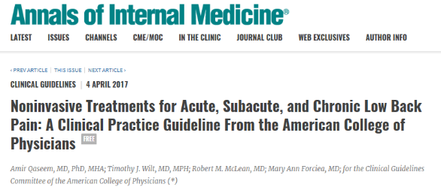
American College of Physicians – April 2017
Recommendation 1
Acute/Subacute Low Back Pain
    “…clinicians and patients should select non pharmacologic treatment with…”
      Heat
      Massage
      Acupuncture
      Spinal Manipulation
    “If pharmacologic treatment is desired…”
      NSAIDs
      Skeletal muscle relaxants

Slide 38

American College of Physicians – April 2017
Recommendation 2
Chronic Low Back Pain
    “…clinicians and patients should initially select non pharmacologic treatment with…”
      Various forms of exercise
          Motor control, multidisciplinary rehab, tai chi, yoga
      Acupuncture
      Behavioral medicine
          CBT, mindfulness, progressive relaxation, EMG biofeedback, operant therapy
      Low level laser
      Spinal manipulation

Slide 39
American College of Physicians – April 2017
Recommendation 3
Chronic Low Back Pain
    “In patients with cLBP that have had an inadequate response to non pharmacologic therapy…”
      First line therapy: NSAIDs
      Second line therapy: tramadol or duloxetine
      Clinicians should only consider opioids as an option in patients who have failed the aforementioned treatments and only if the potential benefits out-weigh the risks for individual patients and after a discussion of known risks and realistic benefits with patients

Slide 40

Implementation
Guidelines without effective strategies to implement their recommendations have little to no effect on clinical practice. – Foster, N et al. Lancet 2018

Slide 41
Implementation
Optum Health
  1st contact provider choice has enormous effect on receiving care consistent with the guidelines
      When patients saw a DC or PT first...
        > 88% received manual therapies/manipulation
        > 72% received exercise therapy
        Less utilization of opioids
        Less utilization of imaging within the first 30 days
  Guideline consistent care resulted in reduced total episode costs.

Slide 42
Implementation
Optum Health
  As result, they are implementing strategies to push patients to the more conservative and guideline consistent choices of Chiropractic and PT
    Currently: PCP (30.4%), Specialists (38.3%), DC/PT (31.3%)
    Goals: Increase DC/PT 1st contact from 31.3% to >50%
        Increase conservative care referrals from PCPs and Specialists from 2% to >10%
    Projections: Net decrease in annual medical expenditures of $230 million
            Reduction in opioid prescribing for LBP by 25-26%
    Strategies: Eliminating initial co pays for patients choosing DC/PT first
            Hotline and web portal for education/decision support
            Direct scheduling to in network providers

Slide 43
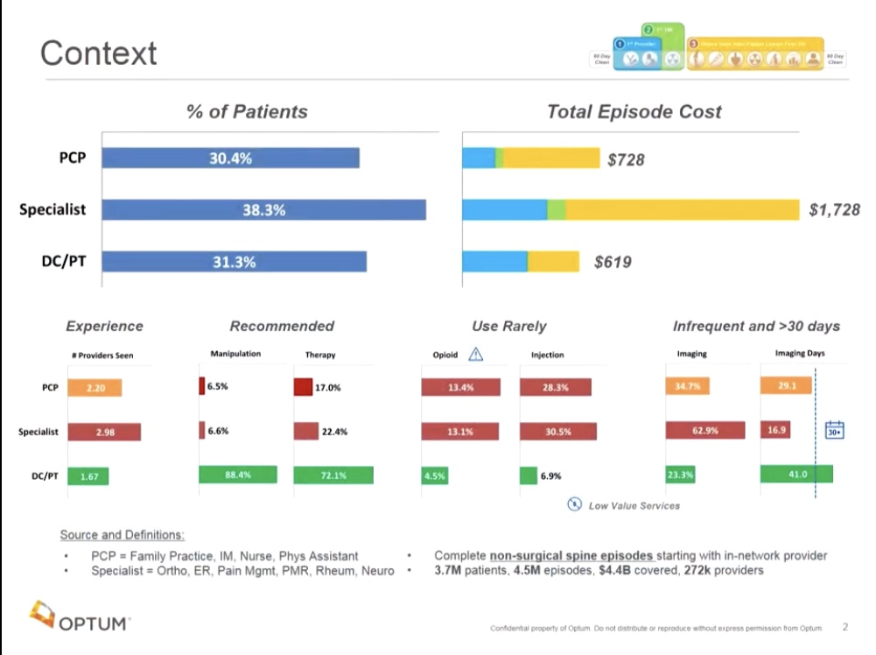
Optum Health
- David Elton, Optum

Slide 44
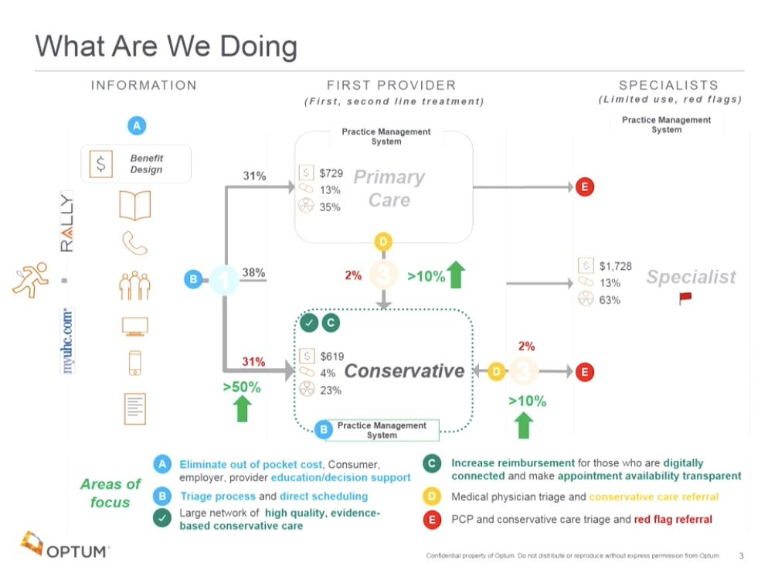
Optum Health
- David Elton, Optum

Slide 45

PEIA
After exposure to the Optum data, PEIA changed benefit policy
  Eliminating initial co-payments for the first 2 chiropractic visits for the treatment of back pain

Slide 46
RAC LBP Program (ISAEC)
RAC Low Back Pain Program (formerly known as ISAEC)
    Rapid Access Clinics for LBP
    Led by specially trained chiropractors and physical therapists
Developed to “help improve the quality, access, and appropriateness of low back care”.
Fully covered by the Ontario Health Insurance Plan (OHIP)
    Due to the cost savings seen in early pilot programs

Slide 47
WVU CIPM
Fast Track Spine Care
  Goal: improve early access to guideline consistent conservative spine care
  Streamlined referral process for patients with acute or subacute back pain
  Appointment within 72 hours
  Referral Order within EPIC - WVU Medicine’s EHR
  Direct scheduling now available through MyChart
      No referral necessary

Slide 48
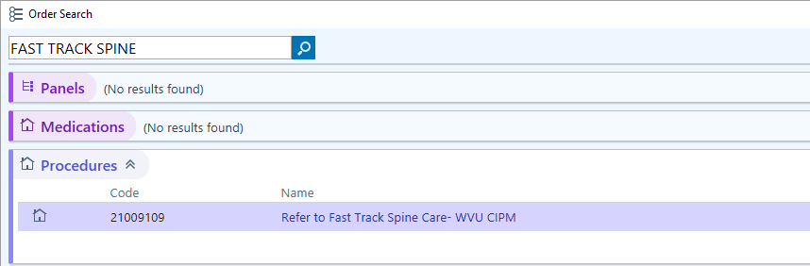
Fast Track Spine Care
To access
  Search “FAST TRACK SPINE”
  Outside WVU Medicine
    Call the WVU Call Center 1-855-WVU-CARE (855-988-2273)
    nicholas.marchesani@wvumedicine.org

Slide 49
Objectives
Provide a clearer understanding of the patient experience within a chiropractic office
Discuss conservative spine care through a chiropractic lens
Illustrate Chiropractic’s role within spine care

Slide 50
Thank You
Center For Integrative
Pain Management
Nicholas Marchesani, DC
nicholas.marchesani@wvumedicine.org

Slide 51
References
Murphy, D.R. (2013) Clinical Reasoning in Spine Pain. Vol 1 CRISP Education and Research, LLC.
Vining R, Potocki E, Seidman M, Morgenthal AP. An evidence-based diagnostic classification system for low back pain. J Can Chiropr Assoc. 2013;57(3):189-204.
Sackett DL, Rosenberg WM, Gray JA, Haynes RB, Richardson WS. Evidence based medicine: what it is and what it isn't. BMJ. 1996;312(7023):71-72. doi:10.1136/bmj.312.7023.71
Lin I, Rankin A, Wiles L, et al Infographic. 11 best practice recommendations for care in musculoskeletal pain British Journal of Sports Medicine 2019;53:1250.
Hartvigsen, Jan & Hancock, Mark & Kongsted, Alice & Louw, Quinette & Ferreira, Manuela & Genevay, Stephane & Hoy, Damian & Karppinen, Jaro & Pransky, Glenn & Sieper, Joachim & Smeets, Rob & Underwood, Martin & Buchbinder, Rachelle & Cherkin, Dan & E Foster, Nadine & Maher, Chris & Tulder, Maurits & R Anema, Johannes & Chou, Roger & Woolf, Anthony. (2018). What low back pain is and why we need to pay attention. The Lancet. 391. number 10137, p2295-2388, e21
US Bone & Joint Initiative. The Burden of Musculoskeletal Diseases in the United States, 2014-2019. http://www.boneandjointburden.org/about/rights
Martin BI, et al. Trends in health care expenditures, utilization, and health status among US adults with spine problems, 1997-2006. Spine 2009; 34(19):2077-84
Busse, Jason W et al. “Opioids for Chronic Noncancer Pain: A Systematic Review and Meta-analysis.” JAMA vol. 320,23 (2018): 2448-2460. doi:10.1001/jama.2018.18472
Ivanova Jl, et al. Real-world practice patterns, healthcare utilization, and costs in patients with low back pain: the long road to guideline-concordant care. Spine J. 2011; 11(7) :622-32
Qaseem A, Wilt TJ, McLean RM, Forciea MA, for the Clinical Guidelines Committee of the American College of Physicians. Noninvasive Treatments for Acute, Subacute, and Chronic Low Back Pain: A Clinical Practice Guideline From the American College of Physicians. Ann Intern Med. [Epub ahead of print 14 February 2017]166:514–530. doi: 10.7326/M16-2367
Foster NE, Anema JR, Cherkin D, et al., Prevention and treatment of low back pain: evidence, challenges, and promising directions. Lancet. 2018

