Slide 1
Medical Acupuncture
Kendra Unger MD, FAAMA
President, American Academy of Medical Acupuncture
Associate Professor, Department of Family Medicine

Slide 2
Objectives
Define
Define Medical Acupuncture.
Describe
Describe the acupuncture point.
Verbalize
Verbalize the concept of the acupuncture channel.
Discuss
Discuss how medical acupuncture works.
Recognize
Recognize conditions treated by acupuncture.
Explore
Explore the different types of acupuncture.
I have no commercial conflicts to disclose.

Slide 3
Acupuncture in Family Medicine
Kendra Unger MD, FAAMA
Jason Oreskovich DO, FAAMA
Notes:
We are always learning from each other and from our patients. We are also always teaching medical students and residents.

Slide 4
The Acupuncture Point
Helms J. Acupuncture Energetics: A Clinical Approach for Physicians. textbook. Theme Publishers. 1995 Image used with permission from Dr. Helms
(1)

Slide 5
(1)
Helms J. Acupuncture Energetics: A Clinical Approach for Physicians. textbook. Theme Publishers. 1995 Image used with permission from Dr. Helms

Slide 6
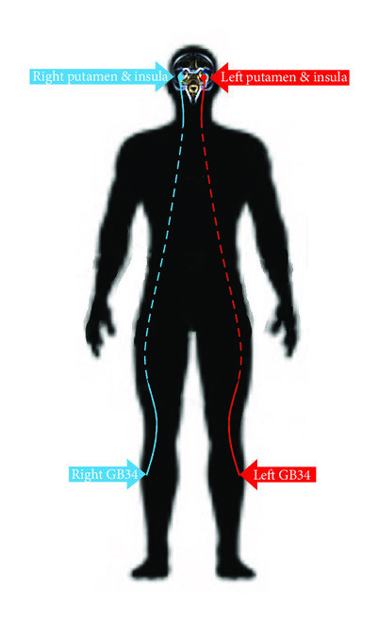
(4)

Slide 8
Helms J. Acupuncture Energetics: A Clinical Approach for Physicians. textbook. Theme Publishers. 1995 Image used with permission from Dr. Helms
(1)

Slide 9
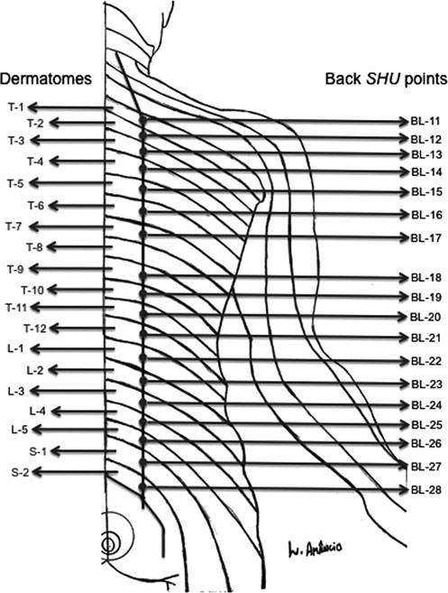

Slide 10
Research
(2)
McDonald J, Janz S. The Acupuncture Evidence Project: A Comparative Literature Review. Australia: Australian Acupuncture & Chinese Medicine Association Limited;2016. Image used with permission from Dr. McDonald.

Slide 11
(2)
McDonald J, Janz S. The Acupuncture Evidence Project: A Comparative Literature Review. Australia: Australian Acupuncture & Chinese Medicine Association Limited;2016. Image used with permission from Dr. McDonald.

Slide 12
McDonald J, Janz S. The Acupuncture Evidence Project: A Comparative Literature Review. Australia: Australian Acupuncture & Chinese Medicine Association Limited;2016. Image used with permission from Dr. McDonald.
(2)

Slide 13
McDonald J, Janz S. The Acupuncture Evidence Project: A Comparative Literature Review. Australia: Australian Acupuncture & Chinese Medicine Association Limited;2016. Image used with permission from Dr. McDonald.
(2)

Slide 14
McDonald J, Janz S. The Acupuncture Evidence Project: A Comparative Literature Review. Australia: Australian Acupuncture & Chinese Medicine Association Limited;2016. Image used with permission from Dr. McDonald.
(2)

Slide 15
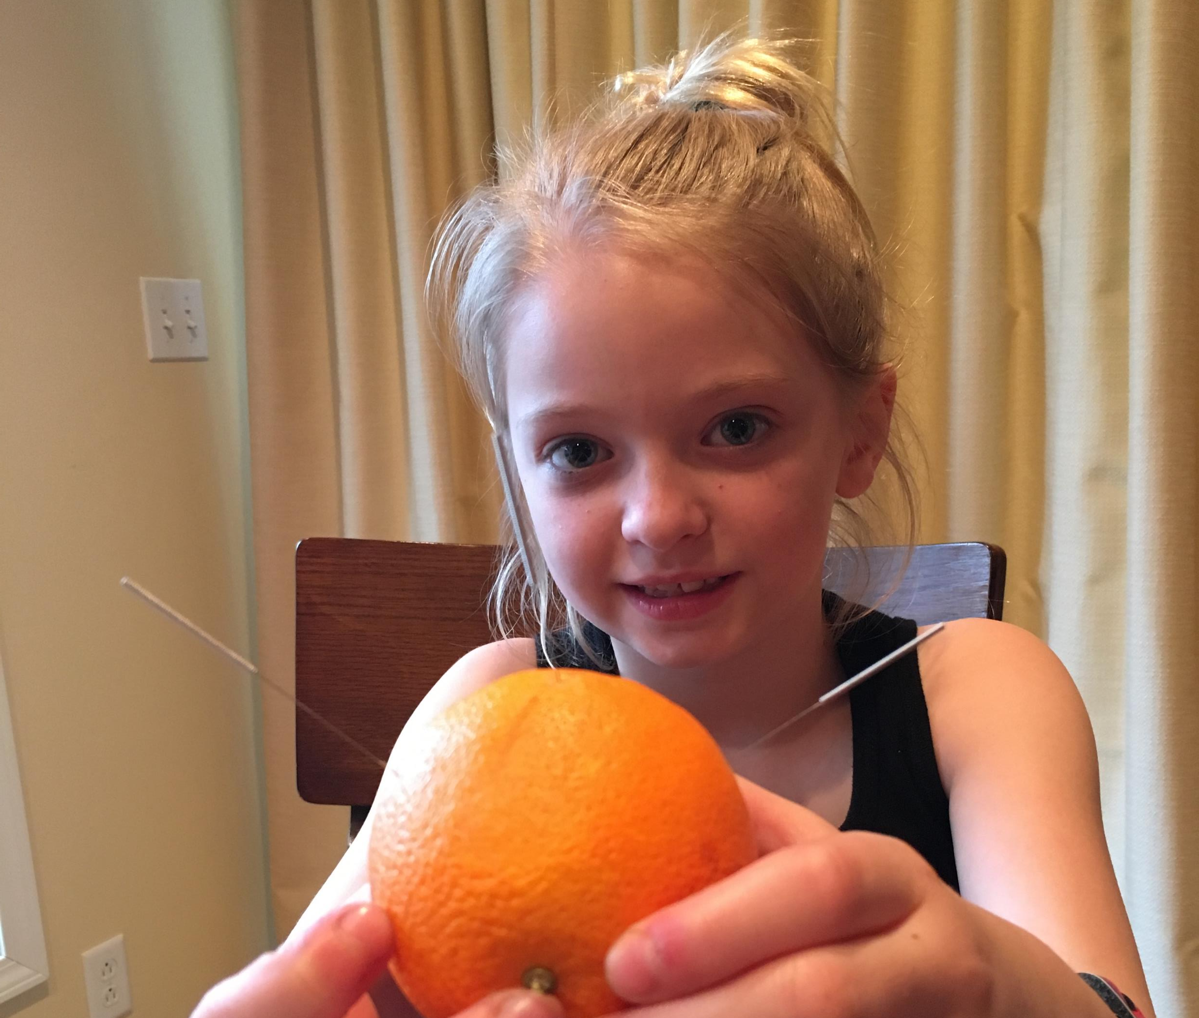
Types of Acupuncture
Neuro-anatomical
French Energetics
Five Phases/Five Elements (TCM)
Scalp
Auricular
Several more

Slide 16
Percutaneous Electrical Nerve Stimulation
Central module 2-4 Hz
Dermatomes, myotomes and autonomics
Peripheral module 15,30 or 90 Hz
Sclerotomes and autonomics

Slide 17
(Helms Medical Institute ISBN: 978-1-57250-710-4)

Slide 19
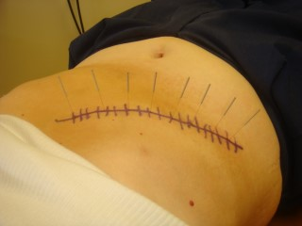
Scars

Slide 21
French Energetics
SP-6/KI-3 (-)
LU-7 (+) 4Hz

Slide 23
KI-3(-), KI-10 (+) LR-3
LI-11(-), ST-25 (+) MH-6

Slide 24
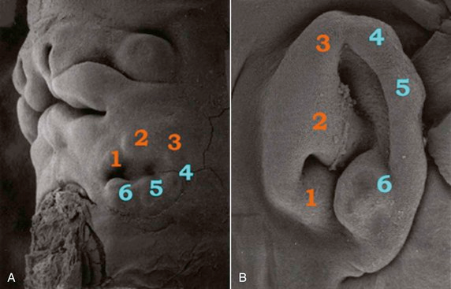
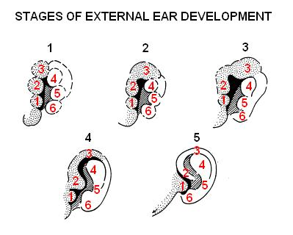
Auricular Acupuncture
One of few anatomical structures which is composed of tissue from each type of embryological tissue. This accounts for the somatotopic functions related to that auricular area.
(3)

Slide 25
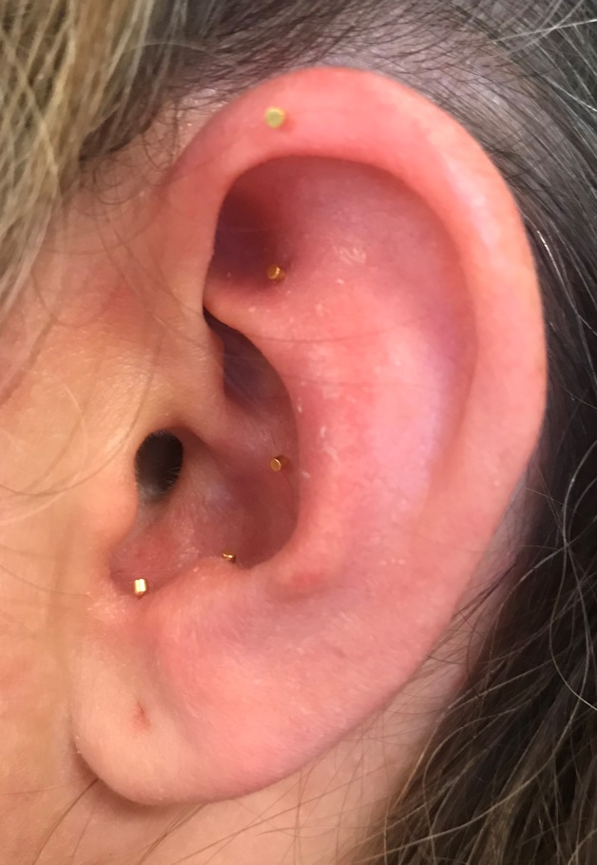
Battlefield Acupnture
3. Omega 2
5. Shen Men
4. Point Zero
2. Thalamus
1. Cingulate Gyrus

Slide 26
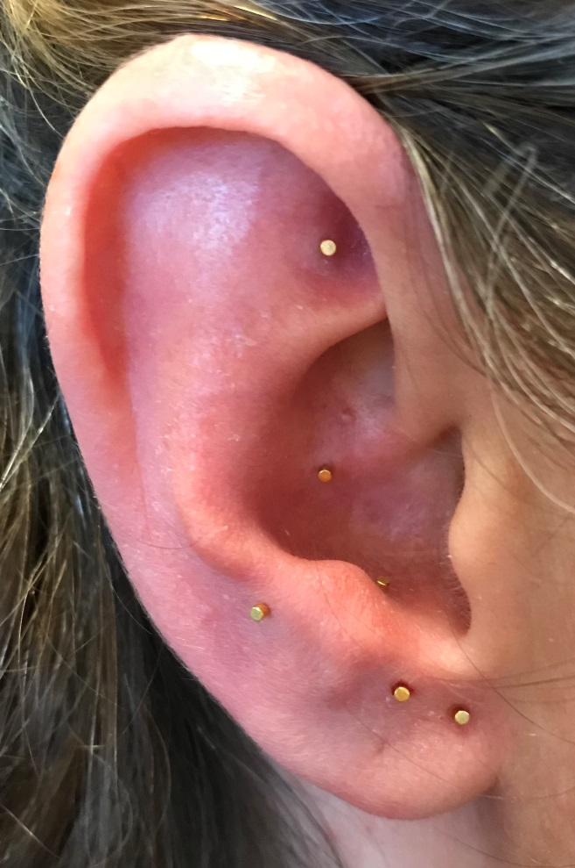
Acute Trauma Protocol
6. Shen Men
5. Point Zero
1. Hypothalamus
3. Hippocampus
2. Amygdala
4. Master Cerebral

Slide 27
Cupping and Gua Sha
Can be used alone or to augment acupuncture therapy
Stimulates blood flow
Alleviates tension patterns in the muscles and fascia
Improves circulation and relieves pain
(6)

Slide 28
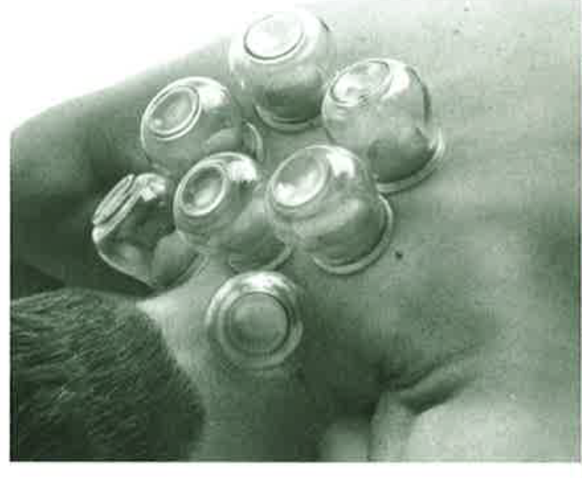
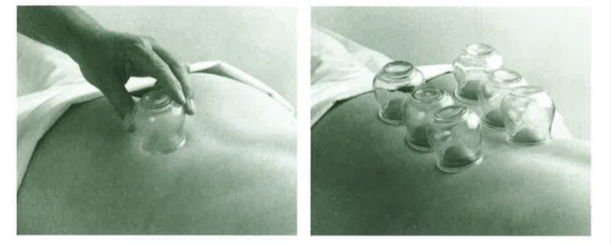
Cupping
Helms J. Acupuncture Energetics: A Clinical Approach for Physicians. textbook. Theme Publishers. 1995 Image used with permission from Dr. Helms
(1)

Slide 29
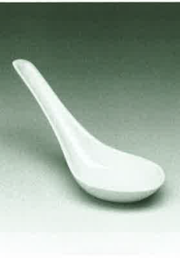
Gua Sha

Slide 30
Trigger Point Deactivation with Dry Needling
Exam is very important
Needle without medication or injection
Taught band of skeletal muscle
(6)

Slide 31
AAMA Position Statement
The American Academy of Medical Acupuncture, the premier North American organization of physician acupuncturists (MDs and DOs), is committed to safeguarding public health and safety by advocating for proper training of all persons who practice acupuncture. It is imperative that legal authorities and medical bodies maintain strict standards of education and training before any health care professional inserts a needle into a patient.

Slide 33
References
Helms J. Acupuncture Energetics: A Clinical Approach for Physicians. textbook. Theme Publishers. 1995.
McDonald J, Janz S. The Acupuncture Evidence Project: A Comparative Literature Review. Australia: Australian Acupuncture & Chinese Medicine Association Limited;2016.
Olsen T. Auriculotherapy Manual: Chinese and Western Systems of Ear Acupuncture. 2nd Edition. Los Angeles, CA: Heath Care Alternatives, INC;1996.
Yeo S, vandenNoort, Bosch, Lim. Ipsilateral Putamen and Insula Activation by both Left and Rights GB34 Acupunture Stimulation: An fMRI Study on healthy Participants. Evidence-Based Complementary and Alternative Medicine. Volume 2016, Article ID 4173185, 9 pages

