Slide 1
Emotional Eating as a Maladaptive Coping Strategy for Pain
Amanda Pratt RD, LD

Slide 2
Disclosure
I have NO financial disclosure or conflicts of interest with the presented material in this presentation.

Slide 3
Objectives:
Identify emotional eating
Investigate cause of emotional eating
Understand relationship between chronic pain and emotional eating
Learn new treatment methods using focused on mindfulness
Suggest tips for dealing with emotional eating to patients

Slide 4
Defining Emotional Eating

Slide 5
Considering obesity and eating disorders as a spectrum
Two major maladaptive eating styles have been delineated:
  Restrained eating – deliberate and persistent food restriction
  Disinhibited eating which is further divided into:
    Emotional eating – overeating in response to internal cues (i.e. emotions)
    External eating – overeating in response to external cues (i.e. seeing food that looks delicious
    A growing body of evidence suggests that the distinctions between emotional and external eating are not as clear as previously assumed. In fact they may represent a general concept of concerned and/or uncontrolled eating, characterized by low perceived self-control and high motivation to eat.
Today we will focus on disinhibited eating or emotional eating as general concept when used as a maladaptive coping strategy for chronic pain.

Slide 6
What is emotional eating?
Psychologist Susan Albers defines emotional eating as “eating to escape, numb, change, or amplify our feelings.”
First, be aware that occasional emotional eating is a perfectly normal response to strong feelings.
Second, emotional eating is very common.
  “Research shows that about 75% of all of our eating is emotionally driven,” Dr. Albers notes. “We eat not because we’re hungry, but because we’re bored, stressed or anxious.”

Slide 7
Why do we emotionally eat?
During periods of stress our body starts producing a hormone called cortisol when you start feeling alarmed or upset. “Cortisol makes us crave sugary, fatty or salty foods,” says Dr. Albers. Increased calorie consumption can be viewed as a rational response to pain. These calories used to be necessary to fuel our fight or flight response.
However, food is now available 24/7 in large parts of the world. So when we’re feeling stressed, it is very easy to reach for food to combat those feelings.
Society and culture also portrays food as something ideal if you need a mood boost or pick-me-up.
Reinforcement or associative learning (i.e. operant conditioning) which includes both positive reinforcement (receipt of a reward) and negative reinforcement (removal of a noxious stimulus).
Notes:
Continual exposure to such cues can alter our eating behavior in the short-term by triggering non-homeostatic eating (i.e. eating for reasons other than hunger) or encouraging restriction despite physiological hunger. Remember occasional episodes of over- or undereating show be considered normal over time these cues may tap into our natural reward-based learning processes to cultivate habits of non-homeostatic eating. Unsurprisingly we have discovered links between maladpative eating behaviors and emotional duress including depression, anxiety, and psychological stress.

Slide 8
Relationship between emotional eating and chronic pain

Slide 9
Veterans Initiative for Eating and Weight
Studies show that rates of chronic pain and excess weight are higher among veterans who report suffering from conditions like low back pain and osteoarthritis.
In a new study, Dr. Robin Masheb and her team of researchers in Psychiatry at Yale School of Medicine surveyed 126 veterans who were referred to an orientation session for MOVE, 16-week weight management program offered at the VA.
Results showed that 42.5% of veterans screened overate in response to physical pain at least once in the 30 days prior to being surveyed.
While 14.2% of veterans reported eating in response to physical pain at least once a day.
Researchers theorized that overeating in response to pain may be a specific type of "mal-adaptive pain-related coping that increases risk for obesity and developing eating disorders.

Slide 10
'Discomfort eating': An investigation into the use of food as a coping strategy for the management of chronic pain
Animal and human studies have demonstrated that eating high-sugar nutrient-dense foods confers analgesic effects.
This study aimed to determine whether chronic pain intensity predicts pain-inducted comfort eating, elevated BMI and to establish whether BMI predicts chronic pain interference.
This study utilized a cross-sectional online survey design and a sample of 151 adults with chronic pain.
Over 75% of this sample group reported engaging in pain-induced comfort eating. However, pain intensity was not a significant predictor.
As assumed pain-induced comfort eating significantly predicted increased BMI and in turn BMI significantly predicted greater chronic pain interference.

Slide 11
The More Pain I Have, the More I want to Eat": Obesity in the Context of Chronic Pain
A total of 30 patients were recruited from primary care clinics at a large VA hospital.
Eligible patients had BMI >25, weekly pain at an intensity of >4 for the previous 3 months, and current diagnosis of a medical complaint associated with persistent pain.
Several key themes emerged from focus group and individual interview discussions. Discussions focused on:
  Depression as magnifying the comorbid physical symptoms and complicating treatment for comorbid obesity and pain
  Hedonic hunger triggered by physical pain and associated with depression and shame from eating in the absence of hunger
  Emotional or "binge" eating in response to pain
  Altered dietary choices in response to pain
  Low self-efficacy for physical activity due to pain

Slide 12
Eating the Pain Away: The use of food as a coping mechanism in older adults experiencing chronic pain
This study examined whether older adults experiencing chronic pain report higher instances of emotional eating in comparison to a population of older adults not experiencing chronic pain.
Data stemmed from the Midlife in the United States study was analyzed to investigate whether individuals used food as a coping mechanism for chronic pain symptoms.
Results of the Independent Samples T-Test indicated that participants were found to be engaging in emotional eating when experiencing chronic pain symptoms, as hypothesized. Participants in the has chronic pain condition reported relying on food as a coping mechanism more (M= 3.66, SD= 1.87) than participants in the does not have chronic pain condition (M= 3.42, SD= 1.71); t(1370)= 2.71, p= .007, d= 0.13.
Results suggest that older adults experiencing chronic pain report utilizing food as a coping mechanism more than older adults that do not experience chronic pain. Investigating alternative coping mechanisms for chronic pain would be beneficial to diminish the harmful health effects of emotional eating.

Slide 13
Mechanism of Reward-Related Eating
Behaviors learned via positive and negative reinforcement are reinforced by their consequences (rewards).
Once our brains grasp the connection between a behavior and a reward we create a powerful emotional memory the increases the probability of performing reward-yielding behavior in the future.
Put simply, if we eat a highly palatable food, we feel good, and lay down a memory that helps us remember under what circumstance we ate it, where we obtained it, what we liked about it, and so on. This memory reminds us to perform the same behavior the next time we are in a similar situation (positive reinforcement).
Likewise, if we eat something that serves to reduce our sadness or anxiety, we may lay down a memory to eat certain foods to reduce particular affective states (negative reinforcement).

Slide 14
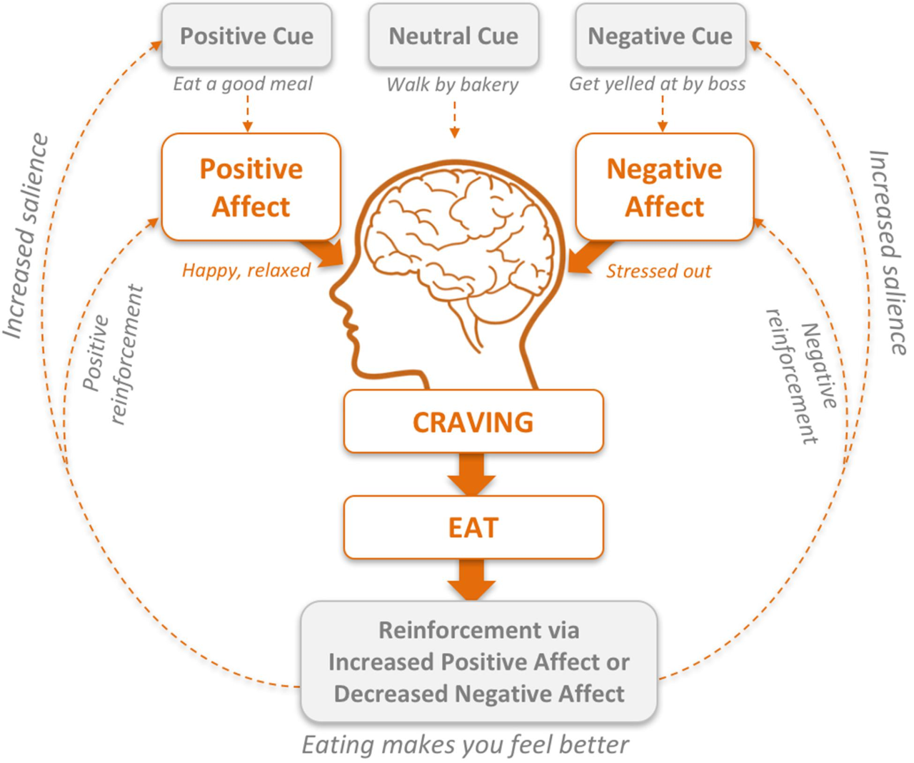
The habit loop. Development of habitual reward-based eating via positive and negative reinforcement.

Slide 15
Causes of emotional eating
Diet choice
There is evidence to suggest that repeatedly consuming highly processed foods (e.g., processed foods high in combinations of sugar and fat, salt and fat, or all three) can alter the brain’s reward circuitry. Such foods stimulates dopamine release along the same associative learning pathway as substances of abuse, and in some studies, this release surpasses that associated with cocaine use.
Although the concept of “food addiction” remains controversial, sugar and refined-carbohydrate consumption may lead to similar neuroadaptations as drugs of abuse, including craving and withdrawal.
Repeatedly overconsuming sugar-laden food can condition individuals to expect pleasurable responses not only upon consuming a highly palatable food, but also when observing stimuli that one associates with the food (e.g., seeing a picture of ice cream). Such stimuli can activate learned associations that trigger non-homeostatic eating.

Slide 16
Causes of emotional eating
Food enjoyment
  Pain has been shown to enhance the enjoyment of sweet foods.
  After undergoing cold-pressor test healthy volunteers reported greater pleasure from eating chocolate.
  This increased food enjoyment after pain offets maybe related to a feeling of relief and unlikely to occur in patients who suffer from persistent pain.
  Eating and drinking is not associated with pleasure but also the feeling of relief.

Slide 17
Causes of emotional eating
Inability to distinguish between physical and emotional hunger
These positively and negatively reinforced learning pathways provide a useful explanatory model for why, how, and when people set up habits based on the rewarding experiences of eating and/or restricting, rather than true physical hunger.
The more we engage in these habit loops by experiencing stress (trigger), eating palatable foods or restricting our eating (behavior), and receiving temporary relief (feeling better, being distracted from negative affect, moving toward a goal, avoiding feelings of guilt for having broken one’s dieting “rules” etc.), the further obscured our ability to recognize the difference between homeostatic and non-homeostatic hunger becomes.

Slide 18
Causes of emotional eating
Psychological meaning given to pain
  The experience of pain and suffering is closely tied to justice.
  Perceived injustice (i.e. Why should I suffer more than others?) is associated with problematic pain outcomes, such as prolonged disability and mental illness.
  In experimental studies, pain perceived as being unfair significantly increased how many chocolates participants chose to eat.
  In contrast, pain that seemed to be justified did not affect indulgence levels.
  Some have argued that unfair pain can induce feelings of entitlement and thereby increase indulgence in "guilty pleasures." It can be described as a feeling of "deserving" more hyper-satieting food because I am in pain.
  These patients may be responding to signals that are not directly related to hunger but instead to reestablishing a sense of psychological equilibrium and personal justice.

Slide 19
Causes of emotional eating
Cravings
Craving is a central downstream component linking both positive and negative emotions to eating. Food cravings are most commonly defined as intense desires or longings to eat a specific food.
Food cravings fit into a food reward framework as a psychological state of wanting which is distinct from liking, or the pleasure one derives from eating a particular food. Psychological (rather than physical) deprivation is the more likely primary driver of food cravings.
Theoretical frameworks posit that cues to eat, be they cognitive, emotional, or physiological, can trigger seemingly spontaneous thoughts of images. These thoughts or images then motivate further movement toward the desired food.
Studies show that food cravings predict non-homeostatic eating and binge-eating, and are associated with weight-preoccupation.

Slide 20
Current treatment
Willpower based dieting

Slide 21
Willpower based dieting
The standard clinic approach to weight-loss is dietary restriction.
However, data has repeatedly demonstrated that traditional diet programs yield variable short-term results and minimal differences in the long-term.

Slide 22
Proposed new treatment method
Mindfulness

Slide 23
Step 1: Awareness – We Cannot Change What We Cannot See
First they must become aware of habitual eating behaviors and their triggers.
Because reward-related eating can become ingrained early in life, many individuals report that they do not notice that they are out of touch with their hunger and satiety signals.
Therefore awareness often helps people eat then they are physiologically hungry and not reinforce reward-related eating.

Slide 24
Step 2: Evaluating Outcomes – Clearly Seeing the True ‘Rewards’ of Our Habits
Second there must be a clear recognition of the actual results (rewards) that one is receiving from the behavior.
Specifically these are the direct physical sensations and emotional effects of eating beyond satiety or when triggered in the absence of hunger.
Create an accurate assessment of everything that results from an episode of reward-related eating, rather than selectively paying attention to only certain aspects of the experience.
Non-judgmental awareness of the entire experience provides an opportunity to “add up” all of the elements resulting in a more accurate calculation of the sum total of the reward.
Outcome evaluation begins a process of disenchantment with habitual behaviors, as a thorough assessment of the rewards reveals that they are not as rewarding as once perceived

Slide 25
Step 3: Unforced Freedom of Choice – Supporting Intuitive Self-care
Third developing the ability to make unforced, embodied choices about food.
An awareness of the links between behavior and outcome cultivates a heightened ability to "intuitive" choices that supports self-care.
One should be able to consciously or unconsciously compare the relative rewards from these previous actions to guide current behavior.
The goal is for patients to move away from "shame and blame" thinking that comes with cognitively based dieting and into more self-compassionate ways of being.
This is critical as many individuals spin out into cycles of shame and blame when check their weight which ironically often triggers "eating to cope" habit loops.

Slide 26
Summing up Mindfulness
Mindfulness may constitute a different form of self-regulation than the self-control that comes with cognitive or deliberate effort – one that is fostered by an “effortless awareness”
While attempting to use cognitive control to resist, fight, or distract oneself from the experience of craving precludes changing a problematic habit loop, an unforced, curiosity-based observation of its elements and their time-course may decrease the likelihood of falling back on previously learned behaviors (including self-judgment).
Smoking Cessation tactics like RAIN (Recognize the craving, Allow it to exist, Investigate what it feels like in the body, Note the associated physical sensations from moment-to-moment) gives pragmatic tools for observing and even co-existing with cravings rather than using cognitively based suppression or avoidance techniques.

Slide 27
Practical advice for patients

Slide 28
How to recognize emotional eating
Sudden, urgent cravings
Craving only certain foods
Overeating
Shame or guilt

Slide 29
How to stop emotional eating
Get down to the root cause
  Short-term issues
    Bad day at work
    Fight with a family member
  Long-term issues
    Chronic stress like caring for a sick loved one
    Long term anger stemming from past trauma
    Depression
    Chronic pain
Notes:
Patients may say their pain is the root cause of their emotional eating and this may be true. But just because their pain is chronic doesn’t mean their maladaptive coping habits have to also be chronic. If a patient is depressed than it is the depression that needs treated to help the emotional eating.

Slide 30
How to stop emotional eating
2. Ask why you’re eating
  Pause and ask yourself “Am I really hungry?”
    Consider your hunger on a scale of 1 to 5, with 1 being not hungry at all and 5 being you are so hungry you would eat the food you hate most in the world.
    If your hunger ranks as a 3-4 grab a healthy balanced snack within 15 minutes or balanced meal within 30 minutes if it is close to a meal time.
    If your hunger is a 1-2 try an alternative activity that soothes you like going for a walk or listening to music.

Slide 31
How to stop emotional eating
Swap out your worst snacks
  Be mindful of what you’re eating. Certain foods are more likely to trigger emotional eating.

Slide 32
How to stop emotional eating
Choose foods that fight stress
  Foods high in vitamin D like fortified milk, eggs, mushrooms and salmon can improve mood.
  Foods high in vitamin C like oranges can boost immunity. Plus the smell of citrus is a stress reliever.

Slide 33
How to stop emotional eating
Make emergency packages
  If you are prone to stress-related snacking, prepare for it.
  Pre-portion your snacks and set yourself up for success.
    Grabbing snacks directly from the package is a recipe for binge eating and overindulgence.
  Take healthy snacks with you on the go so you are not at the mercy of a gas station or convenience store.
    There are healthy options available in these places but you will have to choose them over the more plentiful and appealing unhealthy snacks.

Slide 34
How to stop emotional eating
Don’t let yourself get too hungry
  Avoid skipping meals
  Eat protein rich foods which will help you stay full for longer

Slide 35
Final thoughts
If we understand that pain overeating exists and learn how to best address it specifically and not just the scale number we can adapt our interventions for weight loss and weight management.

Slide 36
Resources
Emotional Eating: What It Is and Tips to Manage It – Cleveland Clinic
Masheb RM, Douglas ME, Kutz AM, Marsh AG, Driscoll M. Pain and emotional eating: further investigation of the Yale Emotional Overeating Questionnaire in weight loss seeking patients. J Behav Med. 2020;43(3):479-486. doi:10.1007/s10865-020-00143-4
O'Loughlin I, Newton-John TRO. 'Dis-comfort eating': An investigation into the use of food as a coping strategy for the management of chronic pain. Appetite. 2019;140:288-297. doi:10.1016/j.appet.2019.05.027
Brewer JA, Ruf A, Beccia AL, et al. Can Mindfulness Address Maladaptive Eating Behaviors? Why Traditional Diet Plans Fail and How New Mechanistic Insights May Lead to Novel Interventions. Front Psychol. 2018;9:1418. Published 2018 Sep 10. doi:10.3389/fpsyg.2018.01418
Leknes, S.a; Bastian, B.b How does pain affect eating and food pleasure?, Pain: April 2014 - Volume 155 - Issue 4 - p 652-653. doi: 10.1016/j.pain.2014.01.001
5 Strategies to Help You Stop Emotional Eating – Cleveland Clinic

