Slide 1
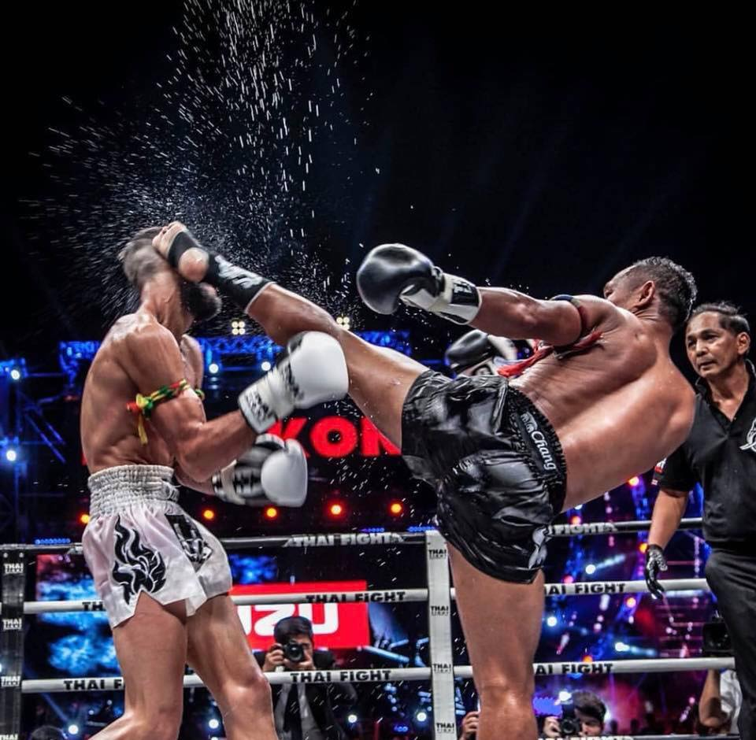
Knock out the Nerves, Knock out the Pain:
Nerve Ablations in Chronic Pain

Slide 2
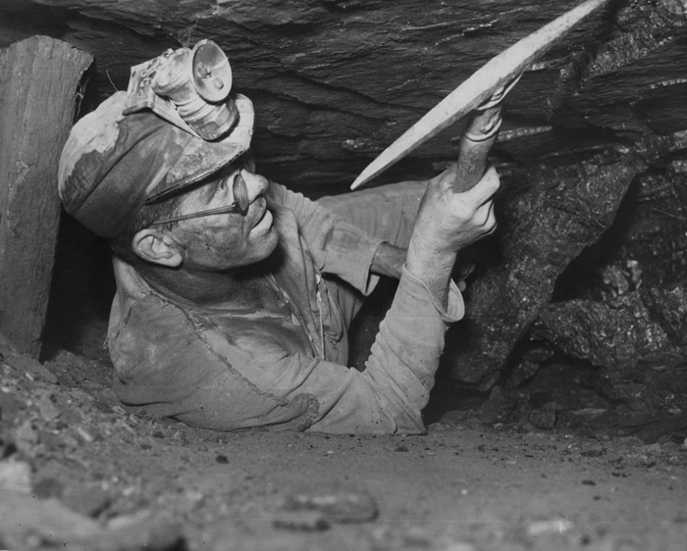
Case 1: Captain West Virginia
60yo coal miner with axial back pain
Localizes to just above the belt line
Slowly worsening over the last 20 years
Worse after a long day in the mines

Slide 3
Case 1: Treatment
3 weeks of PT and high dose fish oil helped mobility, but the pain is still pretty rough
Opioids?
“That crap killed my neighbors dirtbag kid. I’ll flush ‘em as soon as I get home.”
NSAIDS?
Precluded by impaired renal function

Slide 4
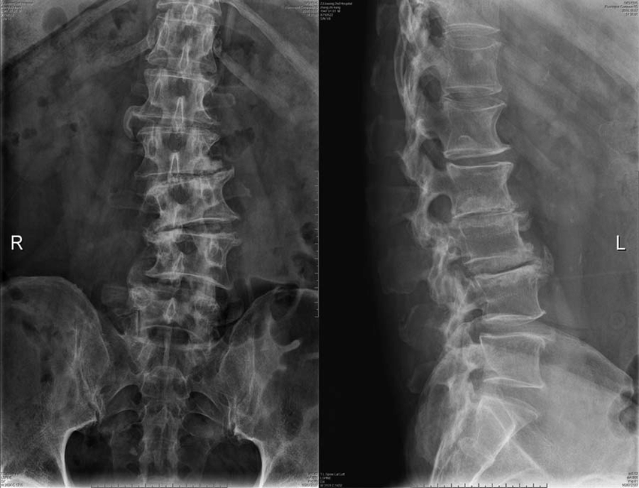
Lumbar Spondylosis and the Degenerative Aging Cascade
Old man back arthritis
Non-radiating, axial back pain
Worse with rising from flexion
Worse with prolonged activity
No gait changes
No change with valsalva

Slide 5
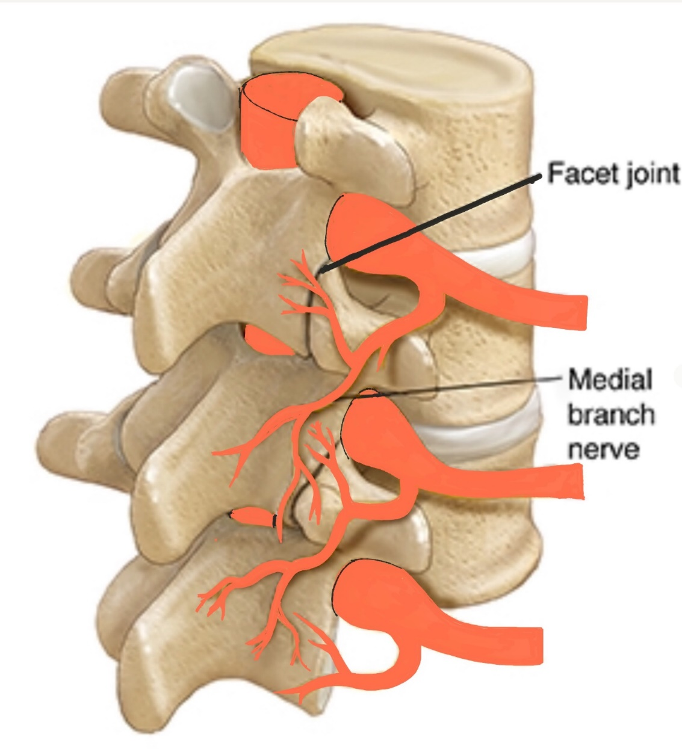
Anatomy

Slide 6
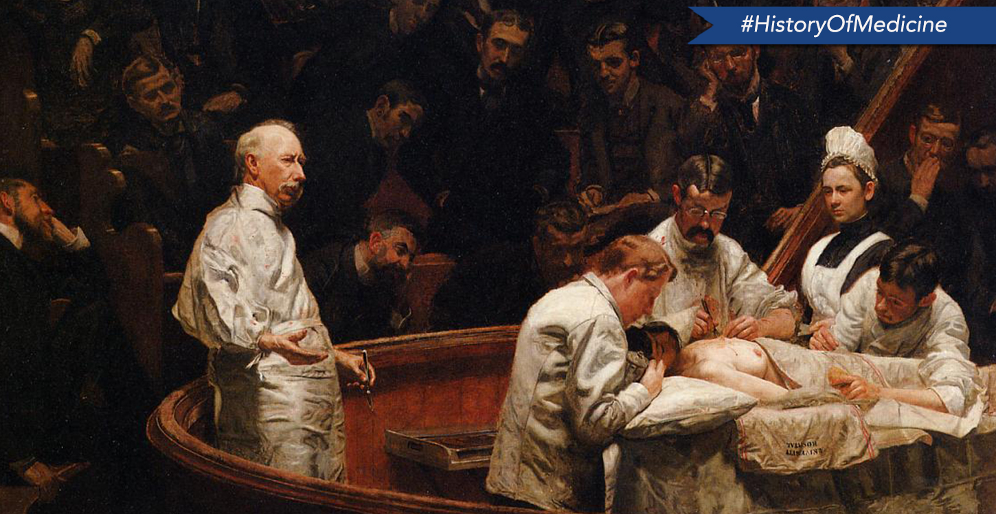
History

Slide 7
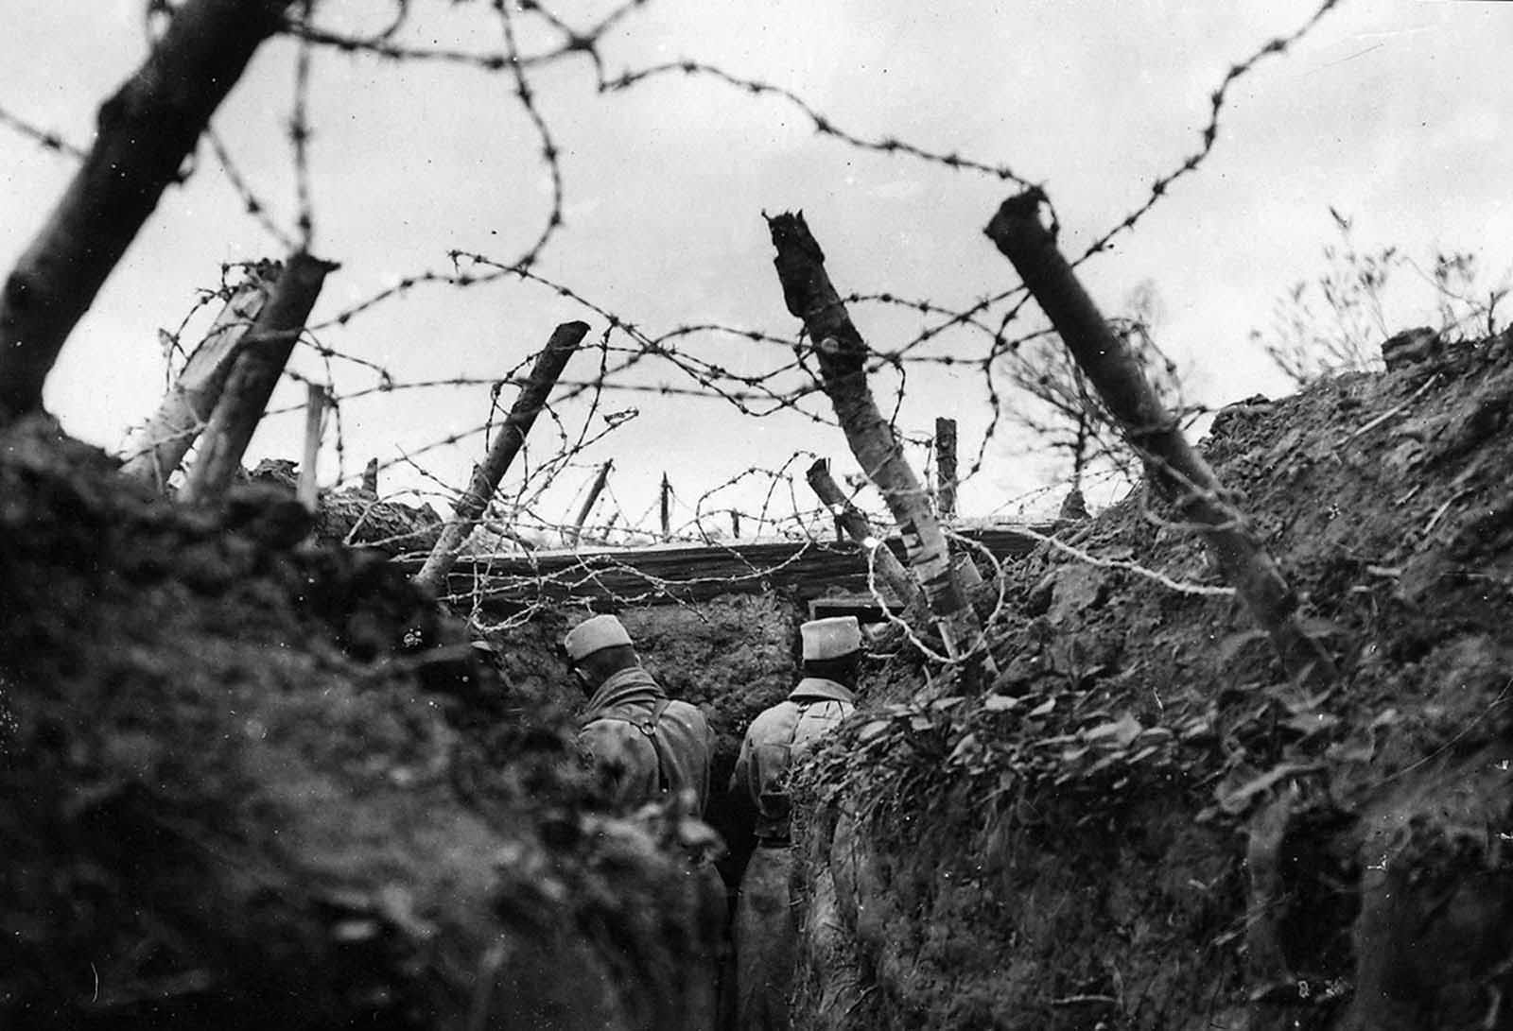
Dr. Vincent Nesfield
Treated “Trench Back” and “Railway Spine”
Fine, long, curved ophthalmic scalpel
Lost license for about 19 years for “Vit-alexin” quackery
Treated a famous journalist who made a “miraculous” recovery

Slide 8
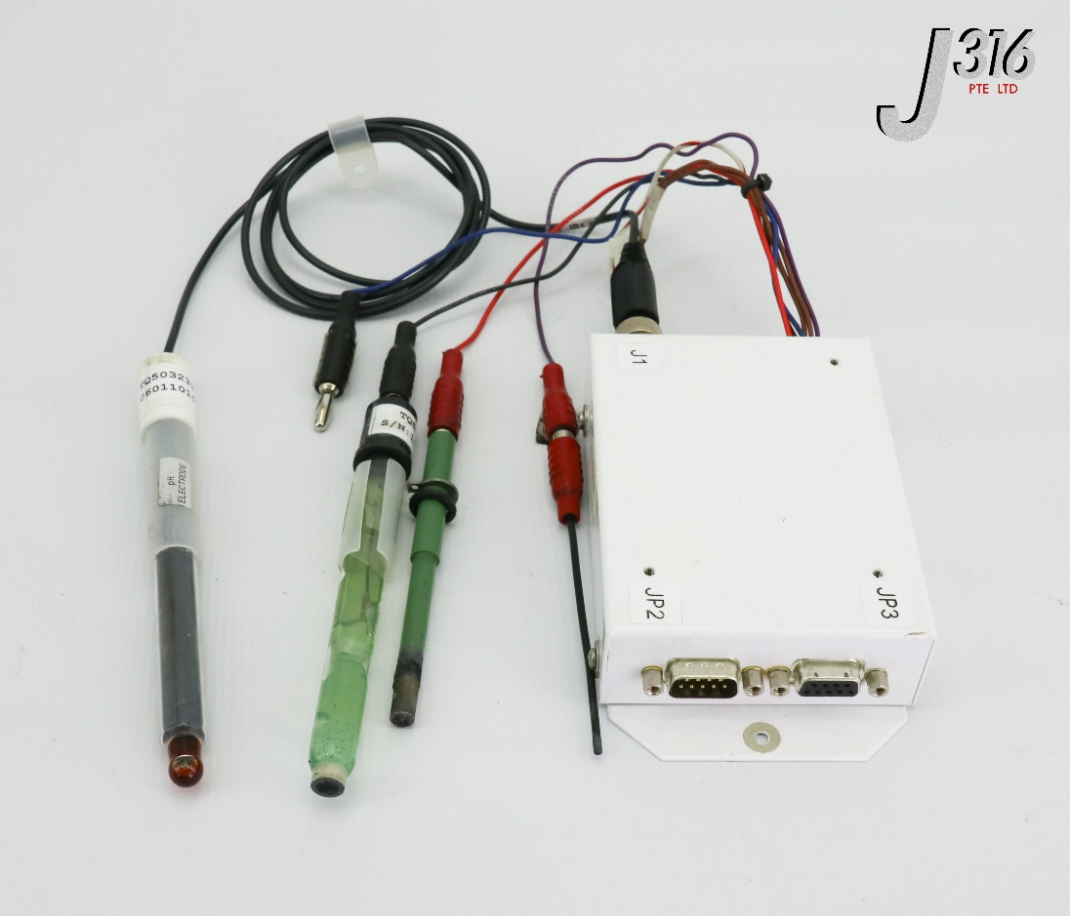
Dr. C. Norman Shealy
1973
Placed 14 gauge needles near the facet
Passed thermistor electrode through the needle
Lateral X-ray to make sure he was far enough from the nerve root
Reported 90% success rate (“good” or “very good”) on 140 patients with virgin backs

Slide 9
Dr. Nikolai Bogduk
1980
Dissections revealed Shealy’s procedure was actually lesioning the lumbar medial branch
Percutaneous lumbar medial branch neurotomy introduced in 1980
Developed 2 block paradigm

Slide 10
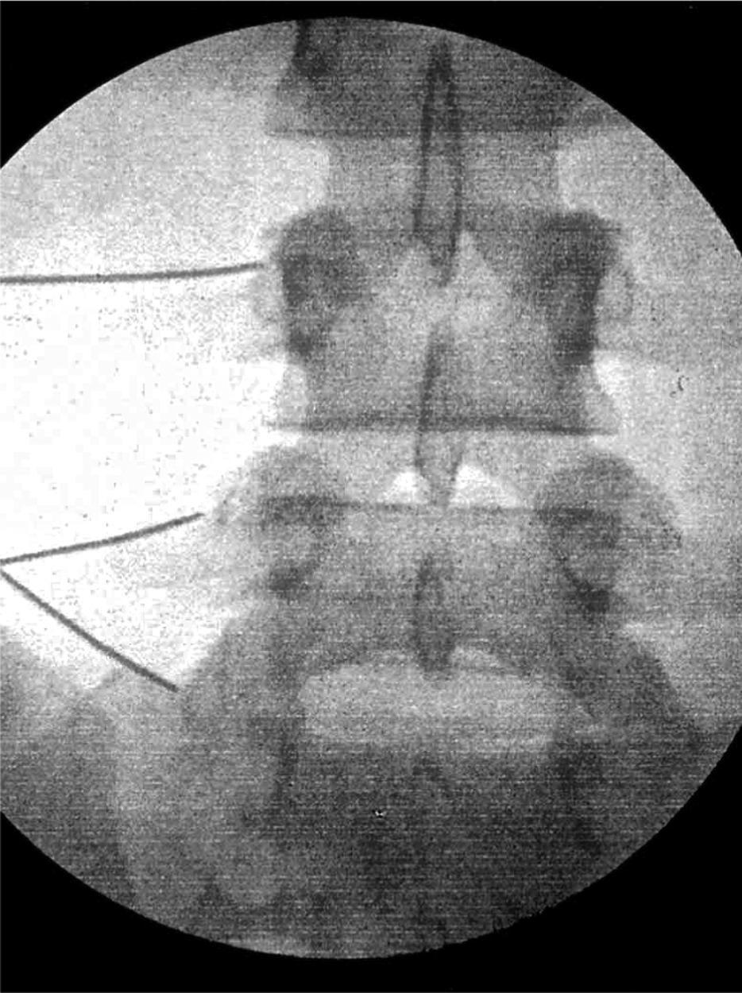
Fluoroscopy/Technique
Lumbar medial branch block
turn off feeling to the facet joint briefly and see how they feel
2 blocks to qualify
Lumbar medial branch ablation
Test to confirm needle position
Anesthetize the area
Heat up the needle tip to kill the nerve

Slide 11
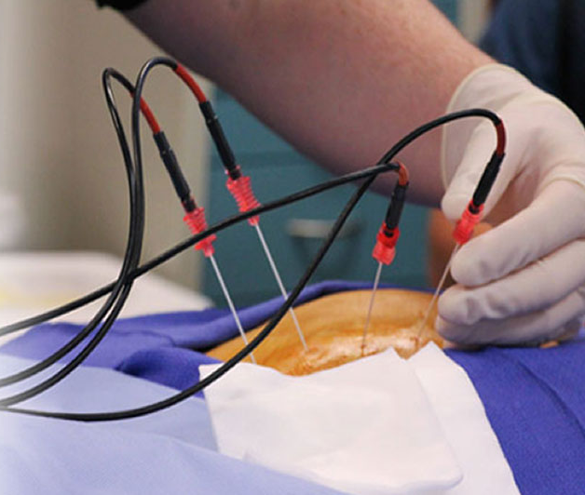
Fluoroscopy/Technique
Lumbar medial branch block
turn off feeling to the facet joint briefly and see how they feel
2 blocks to qualify
Lumbar medial branch ablation
Test to confirm needle position
Anesthetize the area
Heat up the needle tip to kill the nerve

Slide 12
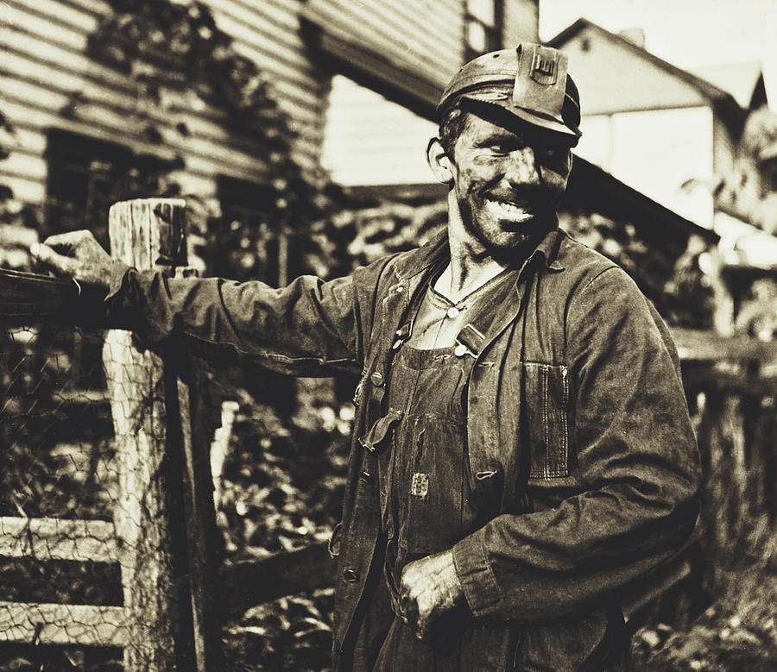
The efficacy of conventional RFA denervation in patients with chronic low back pain originating from the facet joints: a meta-analysis of RCTs
Lee, Chung, Kim
Meta-analysis of RCTs comparing epidurals or sham injections to RFA in facet pain
Seven trials with 454 patients
Statistically significant improvement in pain scores even out to a year

Slide 13
Outcomes
We generally see 6+ months of pain relief and functional improvement
Occasional bruising, and rare neuritis
Can repeat the RFA at 6 months without repeating the diagnostic blocks

Slide 14
Case 2: Torque Wrench Tommy
65yo auto mechanic with non-radiating neck pain
15 years of slowly worsening neck pain
“Cracks and pops”
No arm/hand symptoms

Slide 15
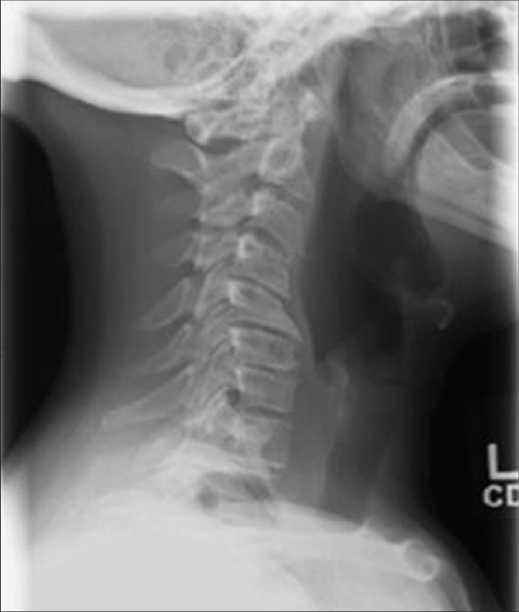
Case 2: Treatment
4 weeks of PT provided 10-20% improvement
Fish oil “helping a little”
NSAIDs
“Those things tear my guts up.”
Opioids
“I got a little crazy on the pills a few years back.”

Slide 16
Cervical Spondylosis
Old man neck arthritis
Stiff and sore
Clicking, popping, grinding
Worsens with activity (ask about checking blind spot)
Hand/arm symptoms suggest this isn’t the only problem

Slide 17
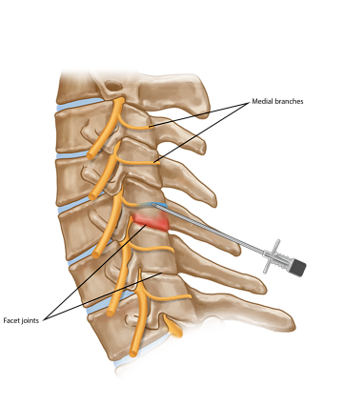
Anatomy

Slide 18
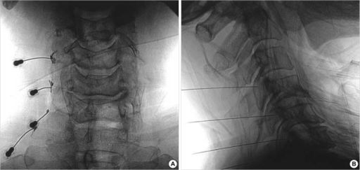
Fluoroscopy/Technique
2 blocks to assess efficacy
Ablate if the blocks are briefly effective

Slide 19
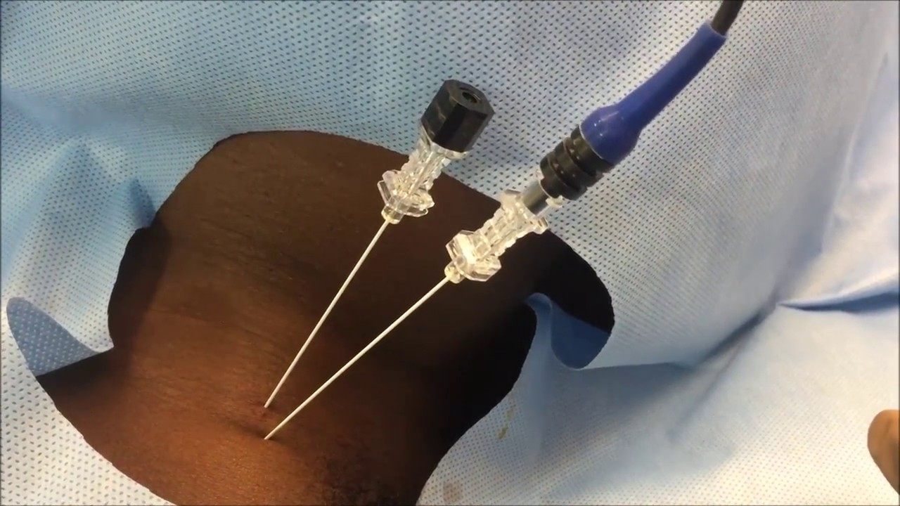
Fluoroscopy/Technique
2 blocks to assess efficacy
Ablate if the blocks are briefly effective
Test sensory
Test motor
Anesthetize
Lesion

Slide 20
Percutaneous radiofrequency neurotomy for chronic cervical zygapophyseal-joint pain
Lord, Barnsley, Wallis, McDonald, Bogduk
24 patients with facet pain after whiplash injury
All had successful diagnostic blocks
Half treated with RFA at 80C and half with just needles and meds
7 in the control group and one in the placebo group pain free at 27 weeks
2 in the treatment group got relief after additional levels lesioned

Slide 21
Cervical and Lumbar Facet Joint Denervation Summary
Start with conservative measures
Ablate if 2 diagnostic blocks are effective
Ablation procedure takes 20 minutes per side with a 15 minute recovery
Relief lasts about 6 months and can be repeated as needed

Slide 22
What About the Peripheral Joints?
Which nerves can be knocked out without compromising function?

Slide 23
Case 3: Donna from the Diner
55yo waitress with knee pain
Worsens with activity
“cracking and popping”
“I can barely get through a shift.”

Slide 24
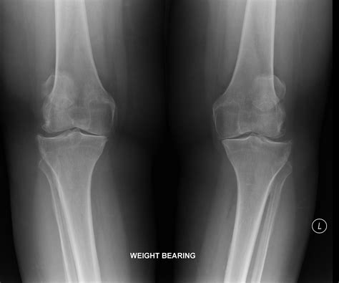
Case 3: Treatment
PT
“I’m stronger, but it still hurts.”
Bracing
“I’m just not shaped right for those things.”
Weight Loss
“I’m trying. I’d be more active if my knees didn’t hurt so bad.”
NSAIDs
Precluded by diabetic nephropathy

Slide 25
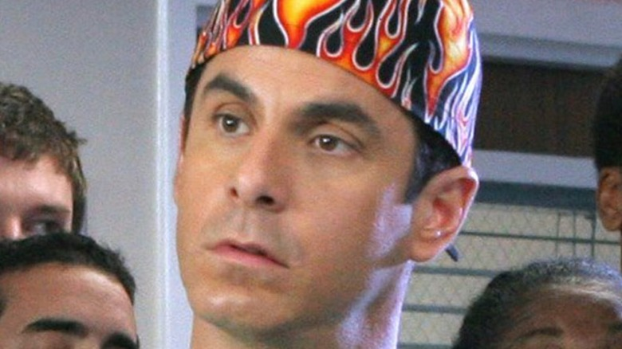
Case 3: Treatment
Opioids
“Those things make me feel goofy.”
Lidoderm patches
“Helps a little”
Steroid Injection
“Worked great for 3 weeks”
Ortho
Ms. Donna is not a good surgical candidate 2/2 obesity, diabetes, CAD… “Bone Doctor No Fix. Big Sad.”

Slide 26
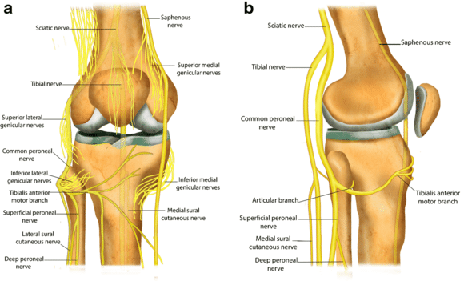
Anatomy

Slide 27
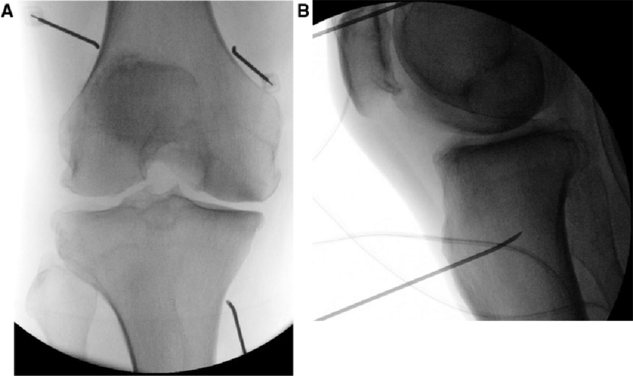
Fluoroscopy/Technique
Diagnostic block x2
Superior lateral
Superior medial
Inferior medial

Slide 28
Fluoroscopy/Technique
Ablate if the patient receives substantial short lived relief with the diagnostic block
Ablation typically provides about 6 months of relief

Slide 29
Efficacy and safety of RFA for treatment of knee osteoarthritis: a meta-analysis of RCTs
Zhang, Wang, He, Du
Nine studies between 2010 and 2020 included
802 patients with 404 receiving the intervention
Pain scores improved at 4, 12, and 24 weeks
WOMAC scores improved at 4, 12, and 24 weeks (5 pain items, 2 stiffness items, and 17 physical function items)
Authors conclude moderate quality of evidence

Slide 30
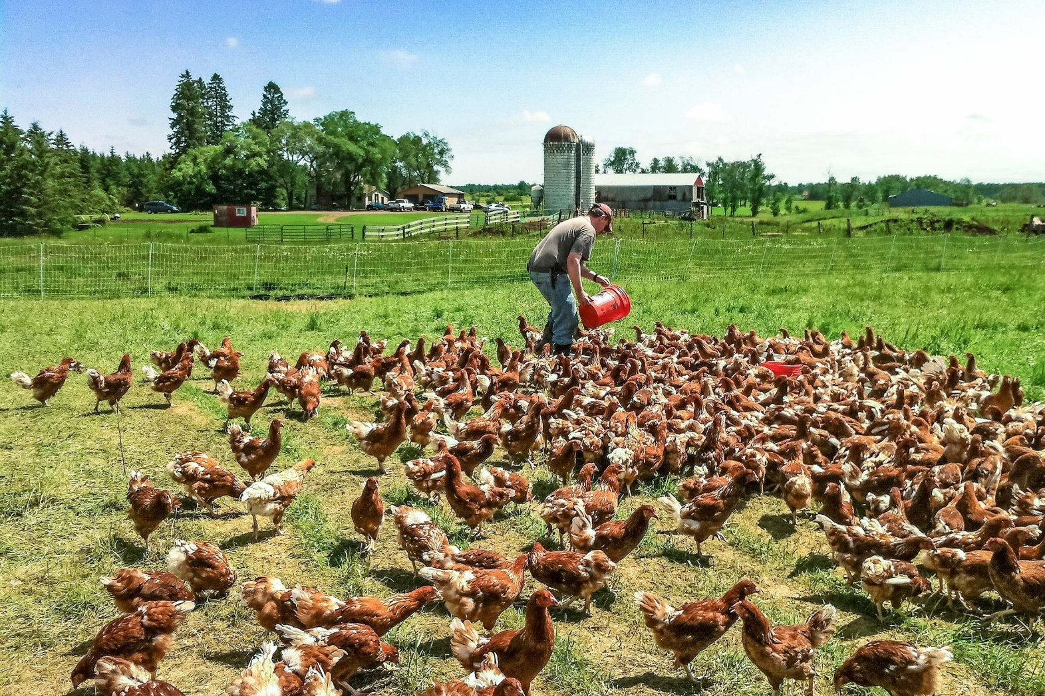
Case 4: Robby the Rooster
40yo chicken farmer
Right low back and buttock pain worsening over the 10 years
Began after ATV “mishap” that left him with a leg length discrepancy
“This is a real pain in the butt doc…”

Slide 31
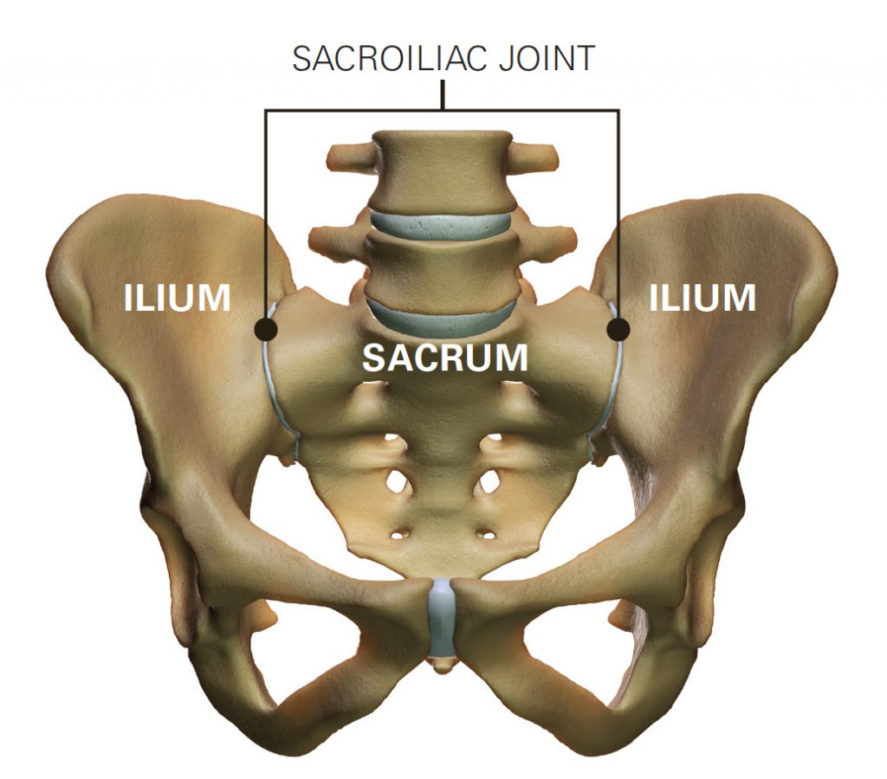
Case 4 Treatment
PT
“Didn’t help. They just put me on that bike for an hour.”
NSAIDs
“My doc says I shouldn’t be on those long term.”
Opioids
“My wife said I was talking to our lamp. No way.”
SI Joint Injection with Steroid
“I felt like a new man for 3 days after each of them, but I can’t get a shot every week.”

Slide 32
SI Joint Anatomy
Net of nerves lateral to the sacral foramina

Slide 33
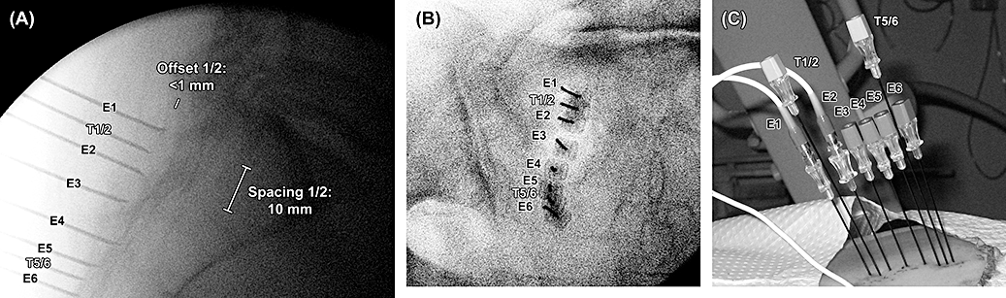
Fluoroscopy/Treatment: Bipolar Lesioning

Slide 34
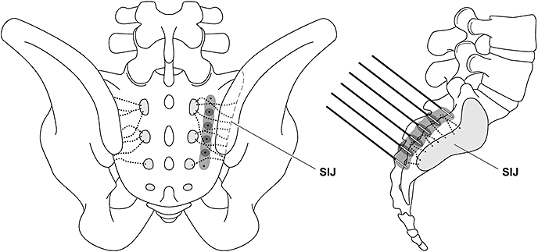
Fluoroscopy/Treatment: Bipolar Lesioning

Slide 35
The role of RFA for sacroiliac joint pain: a meta-analysis
Aydin, Gharibo, Mehnert, Stitik
10 studies (1 RCT, 4 prospective observational, 5 retrospective)
92/160 patients had >50% relief at 3 months
79/158 had >50% relief at 6 months
Lots of heterogeneity in qualifying patients and in the ablation technique

Slide 36
Other Peripheral Joints: The New Hotness

Slide 37
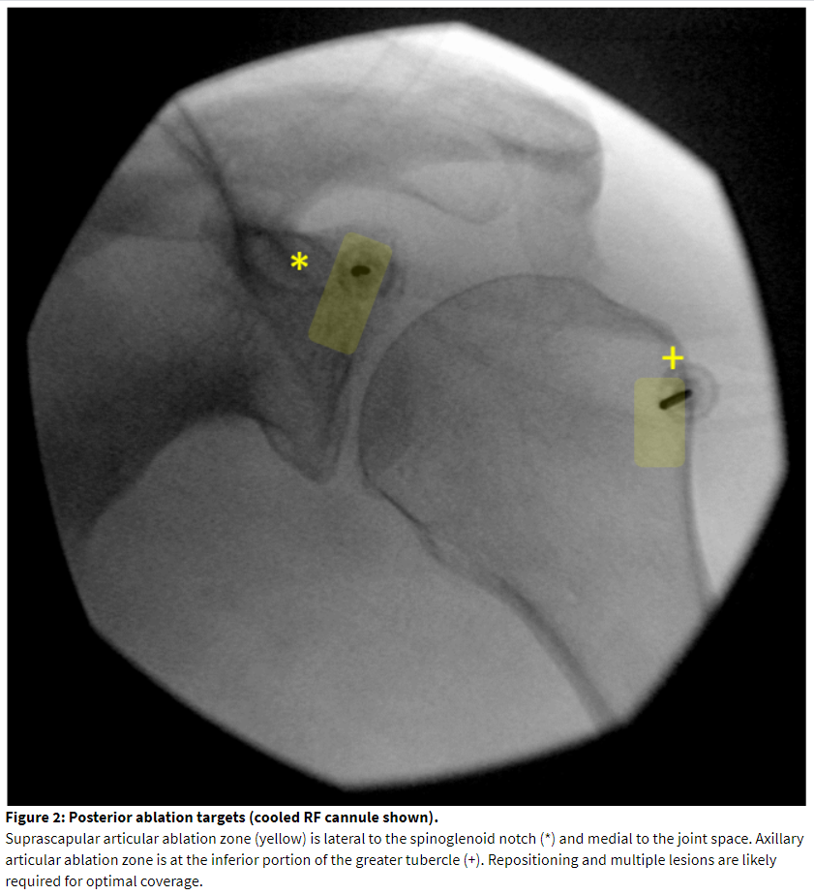
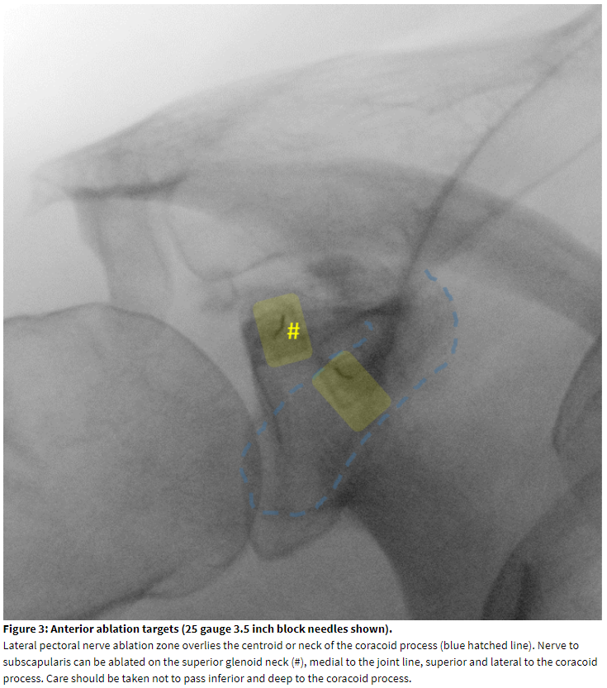
Shoulder

Slide 38
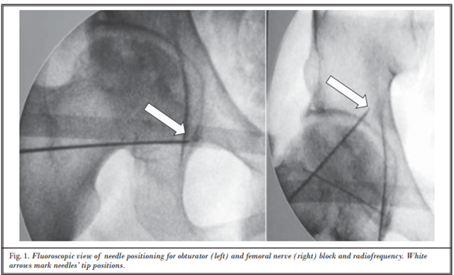
Hip

Slide 39
Hit Me Up with Questions
jpratt@hsc.wvu.edu

