Slide 1
Spinal Cord Neuromodulation:
Diabetic Peripheral Neuropathy and Ischemic Pain
Skyler McCoy, MD and Brian Wolf, MD

Slide 2
Disclosures
We have no actual or potential conflict of interest in relation to this program/presentation.

Slide 3
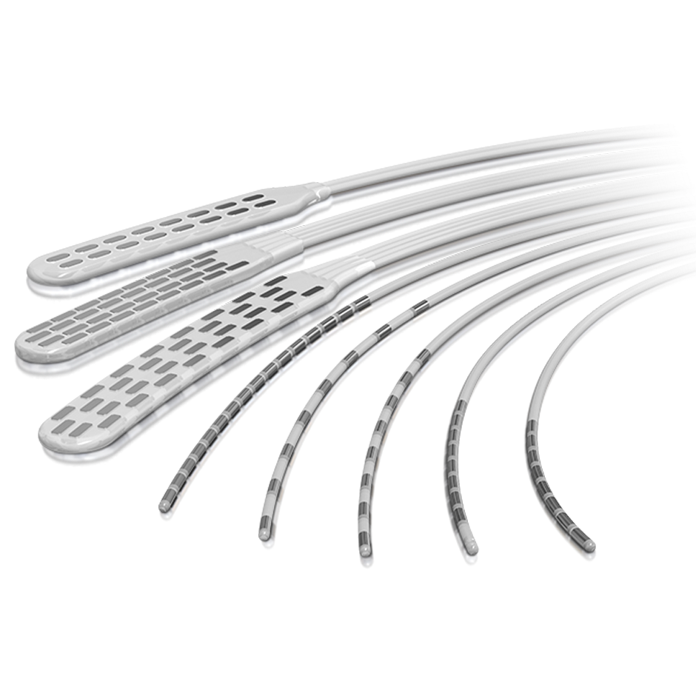
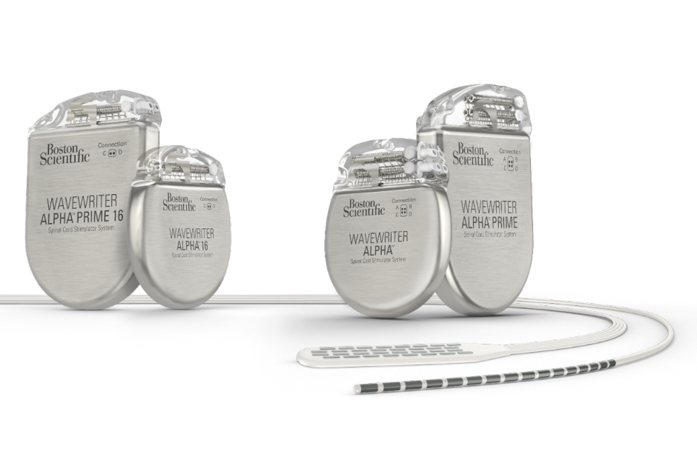
What is Spinal Cord Stimulation?
Neuromodulation – the alteration of nerve activity through targeted delivery of a stimulus, such as electrical stimulation or chemical agents
Leads
Pulse Generators

Slide 4
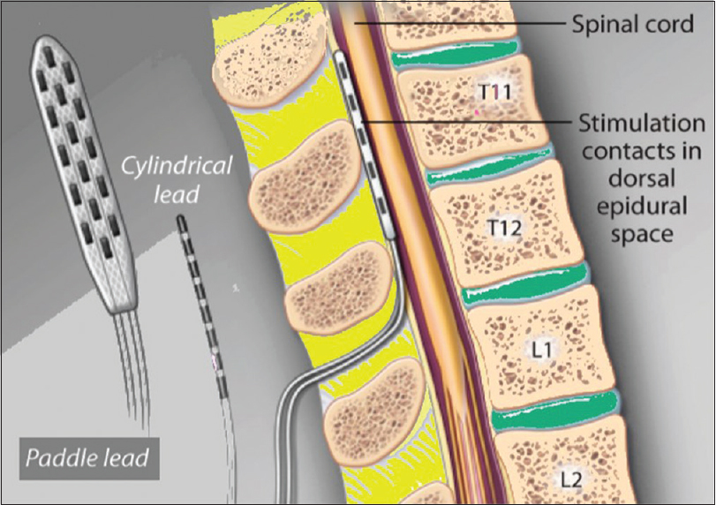
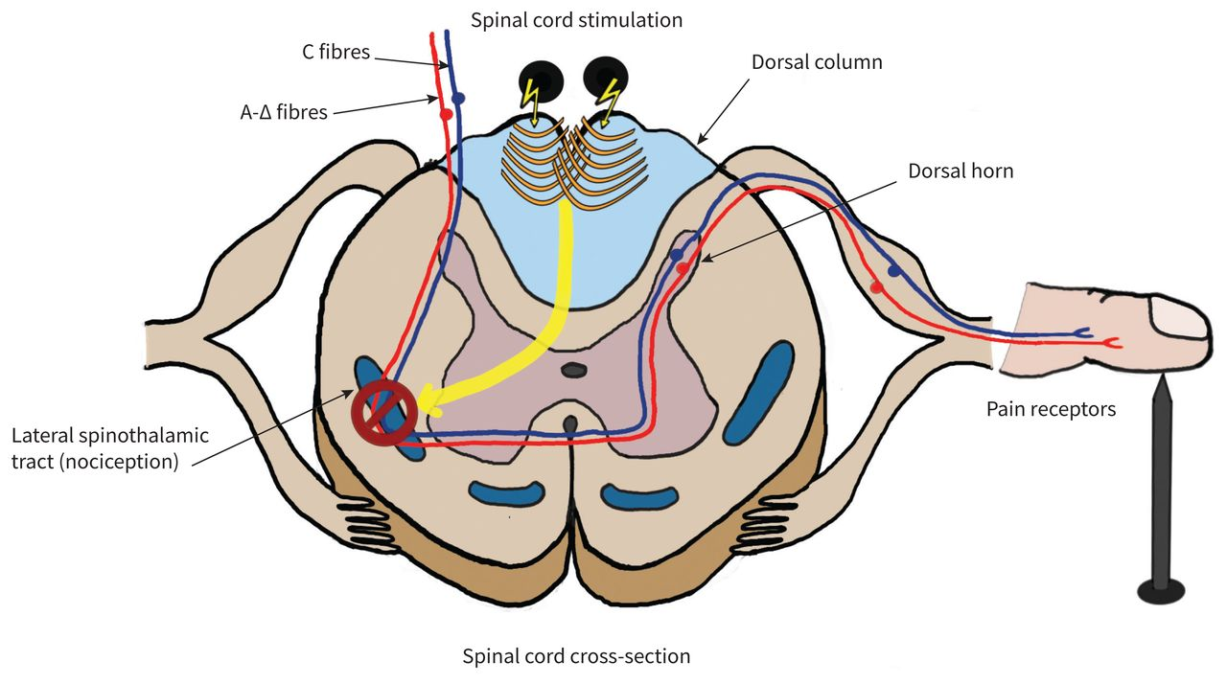
What is Spinal Cord Stimulation?
Gate theory of Pain
  Melzack and Wall in 1965
In 1967 Norman Shealy implanted a monopolar SCS intrathecally near the dorsal column.

Slide 5
The Evolution of Spinal Cord Stimulation
Technical advances
  IPG size, battery life, Rechargeable, MRI compatibility
Understanding Multiple mechanisms of action
  Supraspinal pathway activation, Sympatholytic Effect, Glial cell activation
  Neurochemical changes, Targeting pathways other than Dorsal Columns
Stimulation waveforms
  Tonic stimulation
  Non-paresthesia modes – High frequency and burst stimulation
Estimated 50,000 SCS were placed in 2017

Slide 6
Spinal Cord Stimulation Indications
CRPS
Intractable Back Pain
Leg or Arm Pain
Failed back surgery or Post laminectomy syndrome
Refractory Angina
DM Neuropathy
PVD
Notes:
Intractable low back pain secondary to DDD, epidural fibrous, arachnoiditis
Leg or arm pain secondary to herniated discs or any other cause of radicular sx’s

Slide 7
Before Trial
Initial Consult with Pain Specialist
MRI of Lumbar, Thoracic, or Cervical
Behavior medicine
  Psychology evaluation
SCS education class

Slide 8
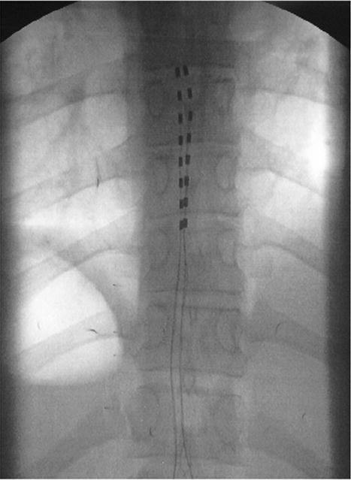
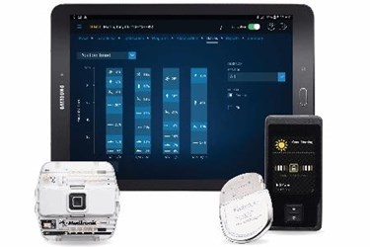
Trial
Notes:
Done at the clinic.
Patient is prone and liberal amount of local is used to place the percutaneous leads epidurally. These leads are placed via 14g Tuohy needles
Sx’s will dictate placement of the leads. Cervical for arm and then normally T8-10 for back and leg pain
During the trial period the patient's pain and function are assessed throughout the trail. There are varying definitions of a successful trial; the Neuromodulation Appropriateness Consensus Committee recommends a patient experience greater or equal to 50% pain relief during the trial. Objective measurements of activities of daily living, sleep, and walking tolerance may also be recorded

Slide 9
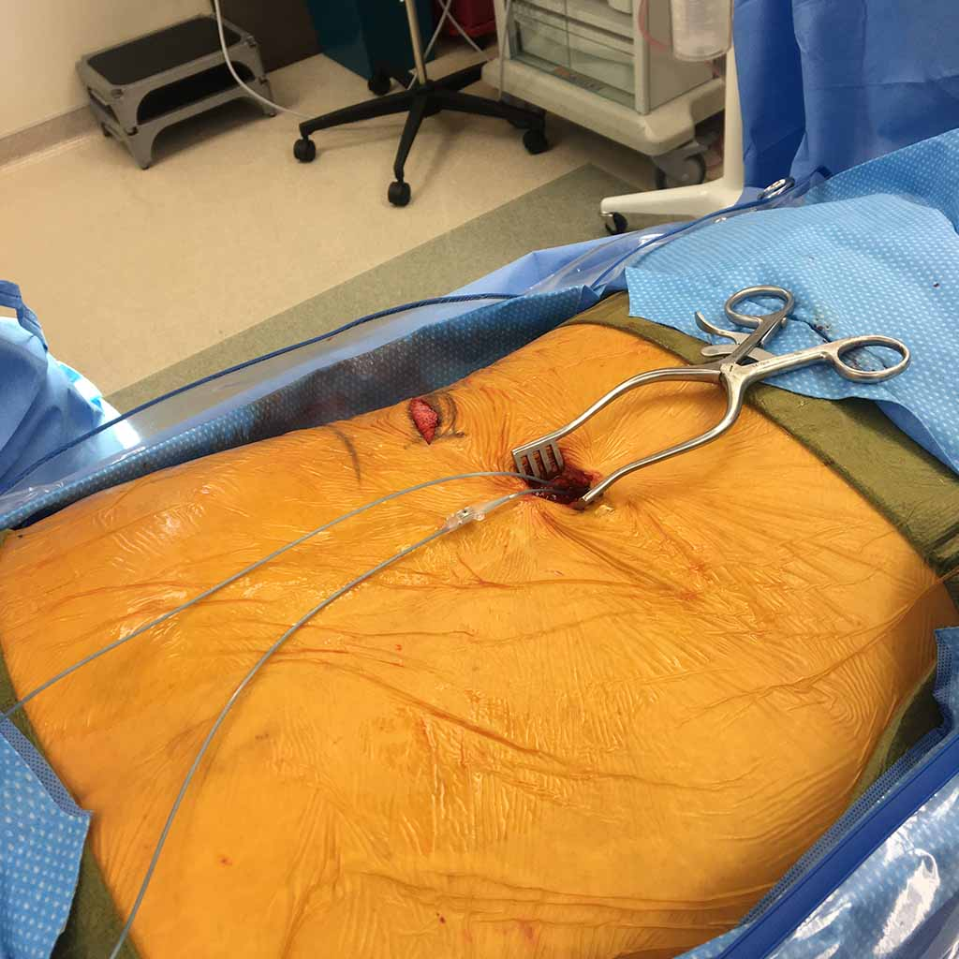
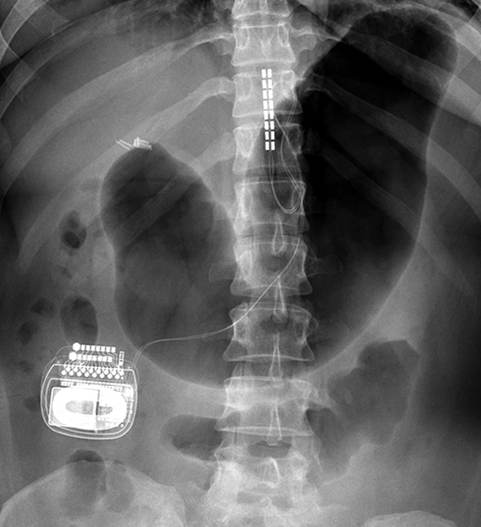
SCS implant
Notes:
Small incision
Done under sedation
Done at ruby day surgery

Slide 10

Contraindications and Complications
Complications
  Device related complications – more common
    Lead migration 10-25%
    Lead malfunction 0-10%
  Biologic complications
    Pain over incision site 1-12%
    Infection - 4-10%
    Serious neurological injury – 0.3%
Contraindications
  Inability to control device
  Major ongoing psychiatric disorder
  Unacceptable surgical risk

Slide 11
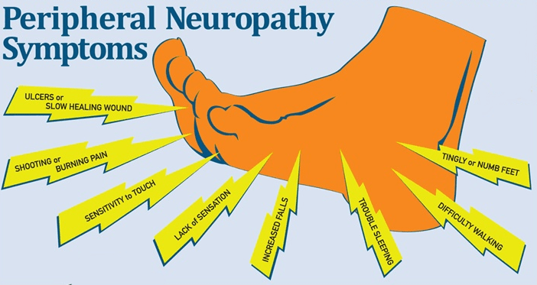
SCS for Diabetic Peripheral Neuropathy
Pharmacotherapy NNT
  Amitriptyline - 5.1
  Gabapentin - 5.9
  Pregabalin - 7.8
  Duloxetine - 5.0
SCS used to successfully treat CRPS for decades

Slide 12
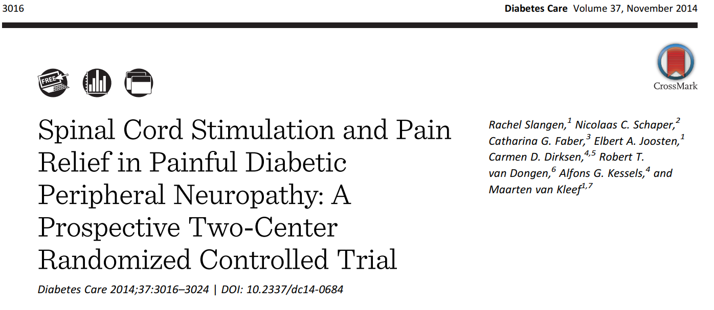
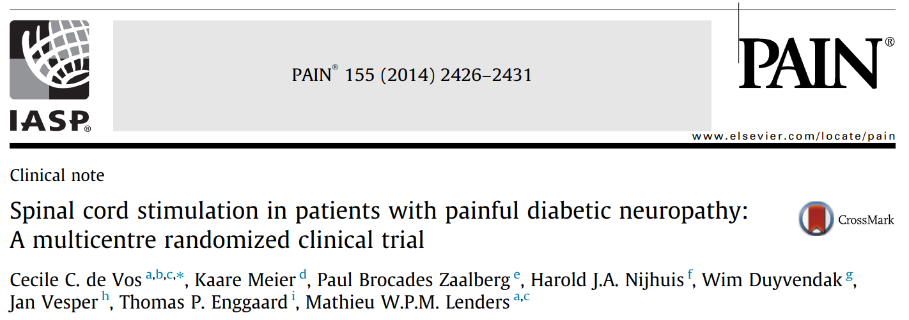
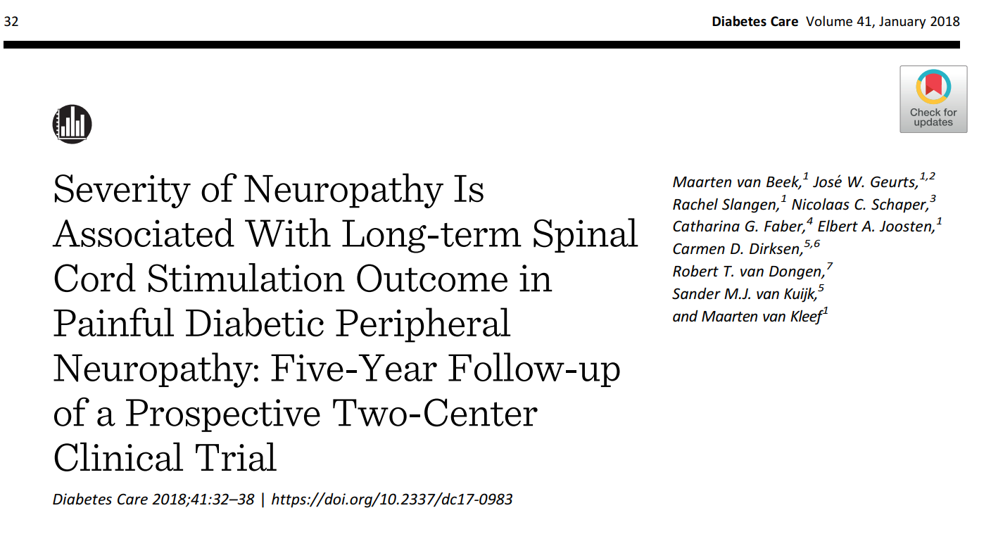
Clinical Evidence
Two multicenter randomized control trials done in 2014
Both with peer-reviewed publications and inclusion in systematic reviews with meta-analyses
5 year follow up data

Slide 13
The Patients
Slangen, et al. Diabetes Care
Inclusion criteria
  NRS at least 5/10
  Over 12 months of pain
  Insufficient pain relief or unacceptable side effects with best medical treatment (BMT)
Exclusion criteria
  Unstable HbA1c
  Active foot ulceration
  Upper limb pain >2/10 NRS
  Contraindications to SCS
de Vos, et al. PAIN
Inclusion criteria
  VAS at least 50 mm
  Over 12 months of pain
  Referral to trial based on all conventional treatments failing
Exclusion criteria
  Atherosclerotic lesions
  Upper limb pain intensity >20 mm
  Contraindications to SCS

Slide 14
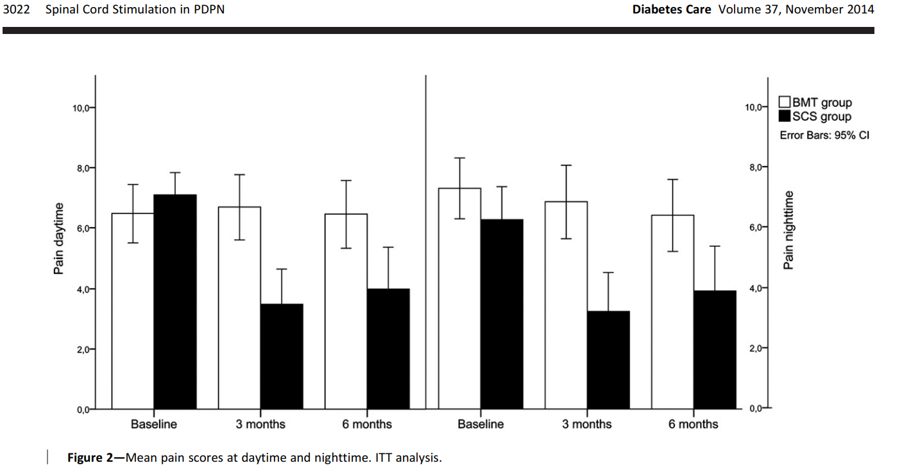
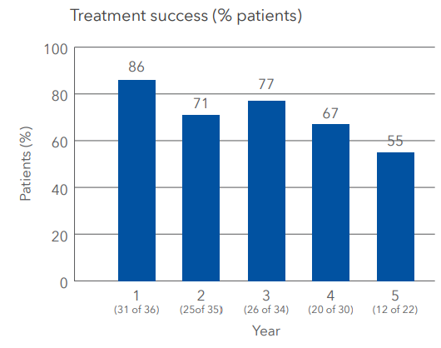
The Results: Slangen, et al. Diabetes Care and van Beek M, et al. Diabetes Care
Daytime NRS decreased by 3.1 compared to no change (p <0.001)
Nighttime NRS decreased by 2.4 points compared to 0.9 points (p < 0.003)
5 year follow up on 2 prospective RCTs
Treatment success is at least 50% pain relief or at least "much improved" on the PGIC scale

Slide 15
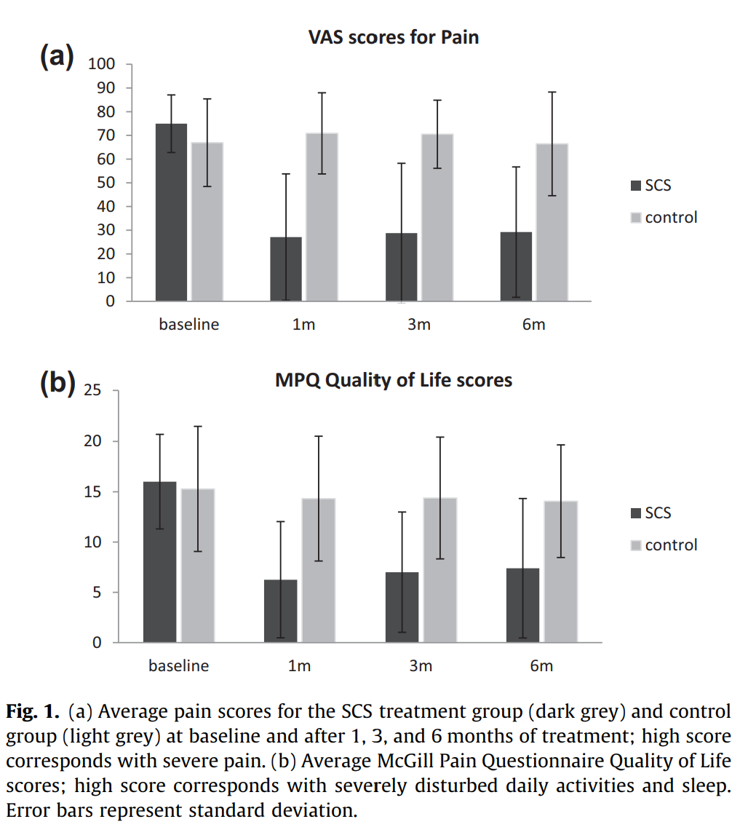
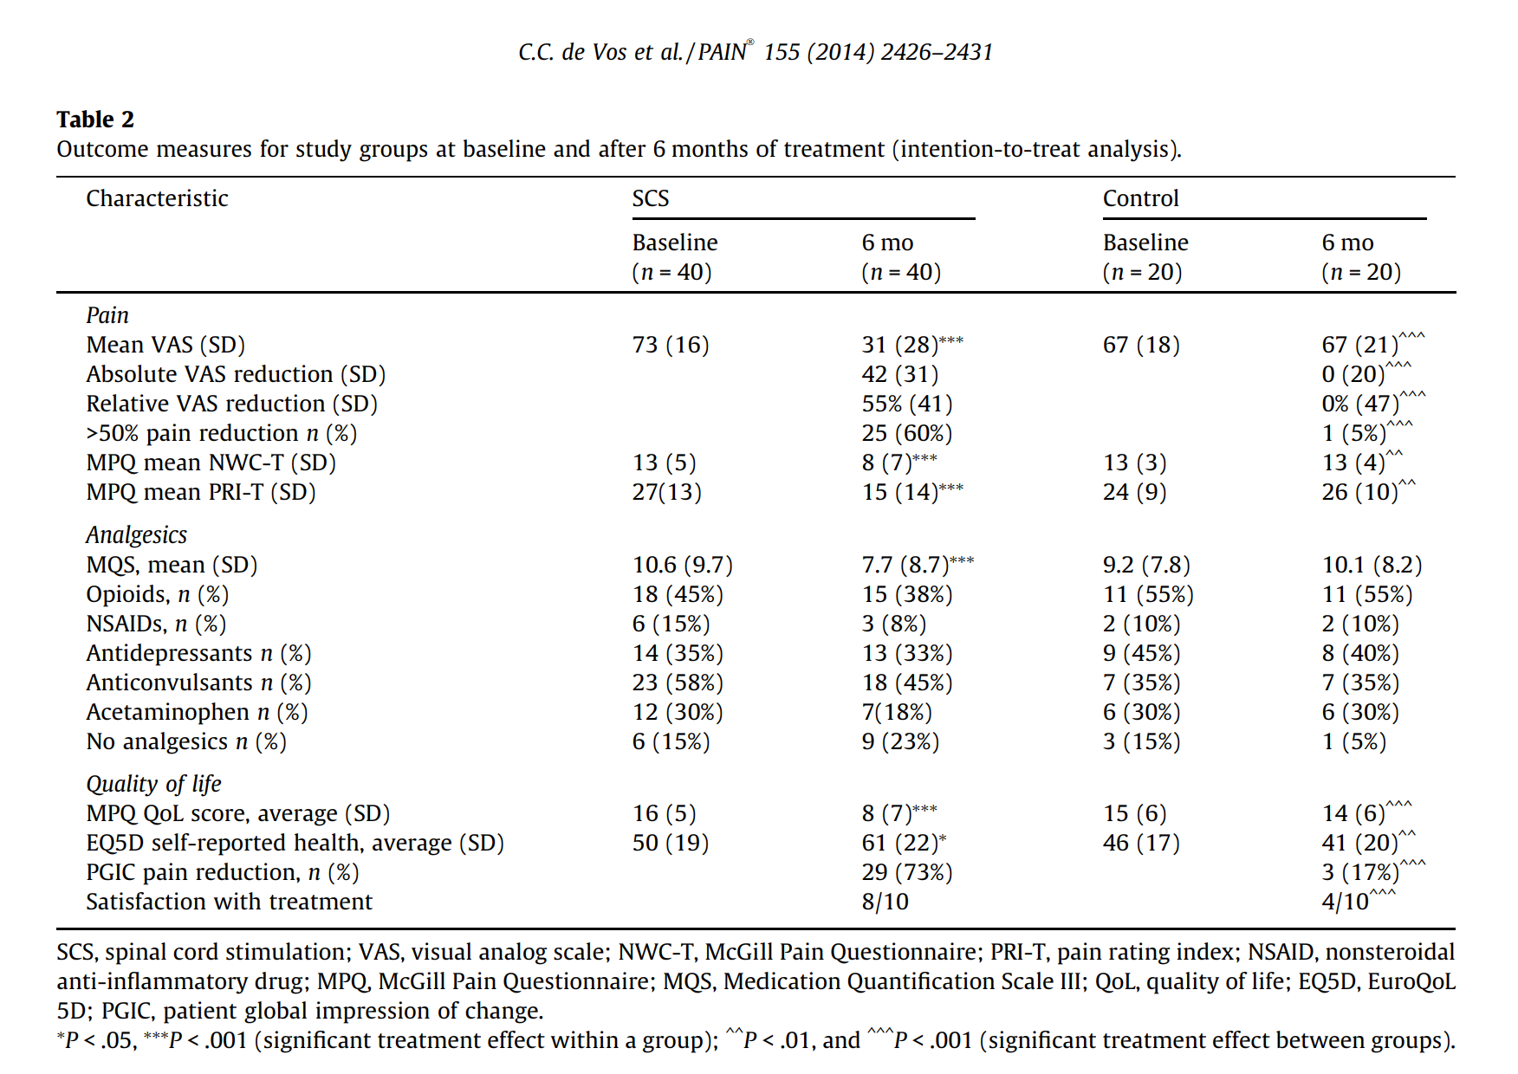
The Results: de Vos et al. PAIN

Slide 16
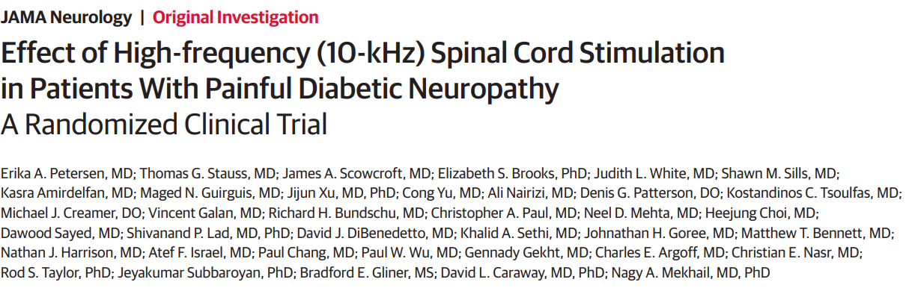
Petersen, et al. JAMA (2021)
Inclusion criteria
  Lower limb pain at least 50 mm
  Over 12 months of pain
  Pain refractory to gabapentin or pregabalin and at least 1 other class analgesic
Exclusion criteria
  HbA1c >10%
  BMI > 45
  Daily MME >120
  Upper limb pain >30 mm
  Contraindications to SCS

Slide 17
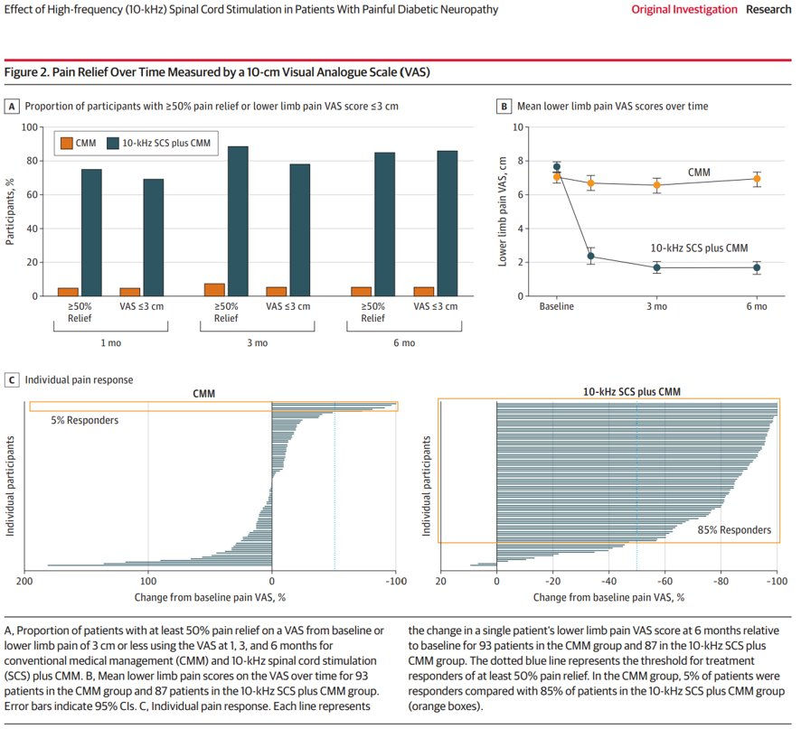
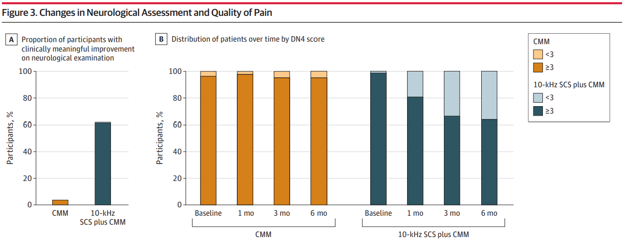
The Results: Petersen, et al. JAMA
Investigators documented improvement in neurological exam in 62% of the SCS group at 6 months
DN4 score decreased with SCS from an average of 6.5 to 3.5
FDA approval for the use of spinal cord stimulation to treat painful diabetic peripheral neuropathy

Slide 18
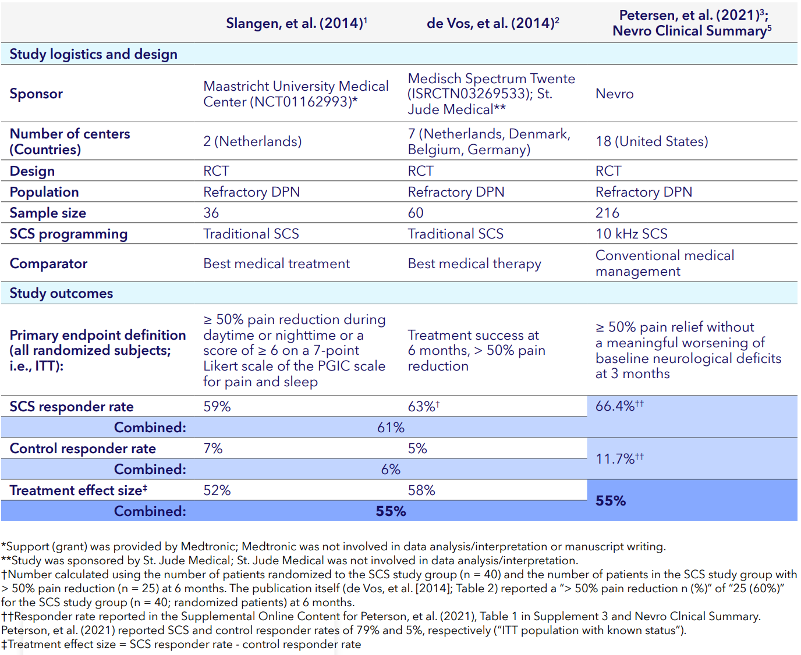
Clinical evidence on SCS for painful DPN
Compendium by Medtronic

Slide 19
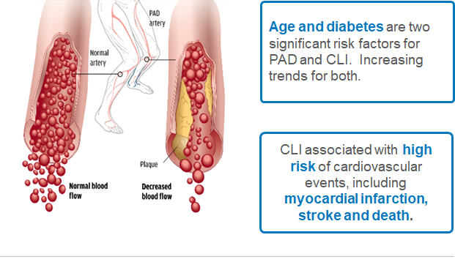
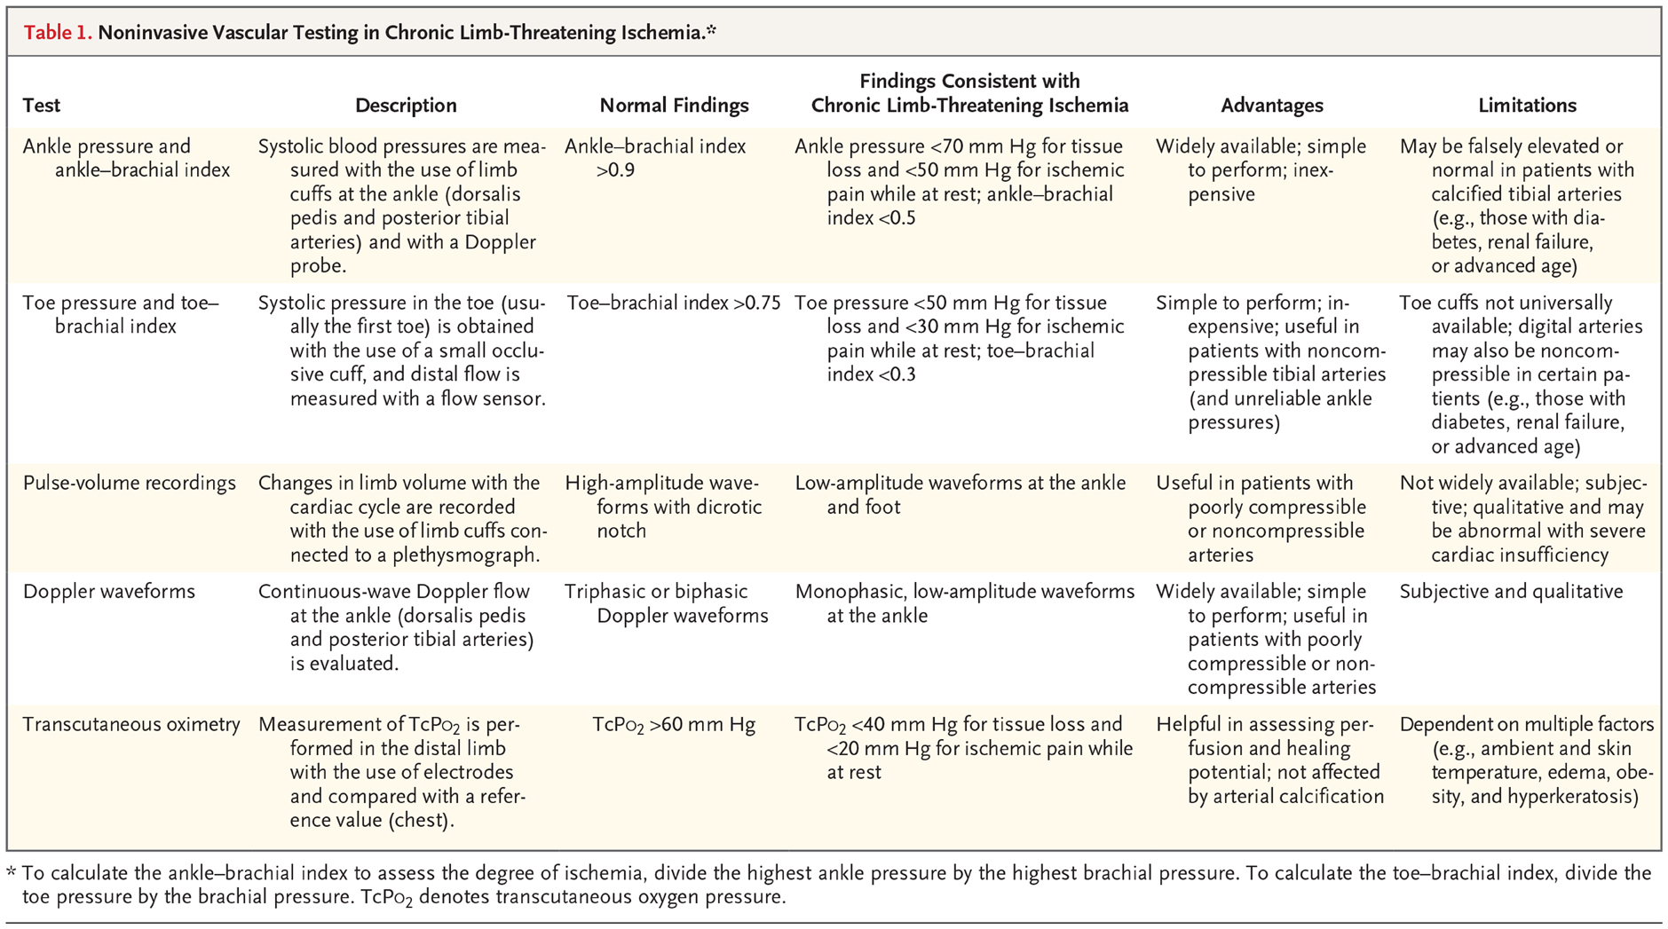

Chronic-Critical Limb Ischemia
Notes:
The term critical limb ischemia refers to a condition characterized by chronic ischemic at-rest pain, ulcers, or gangrene in one or both legs attributable to objectively proven arterial occlusive disease. Critical limb ischemia implies chronicity and is to be distinguished from acute limb ischemia
Mortality rate 25% with in one year of diagnosis over 50% at 5 years
30% amputation rate by 1 year

Slide 20
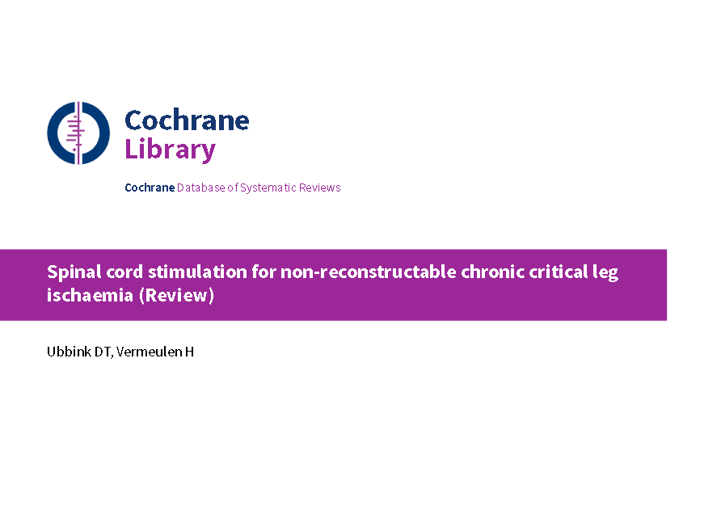
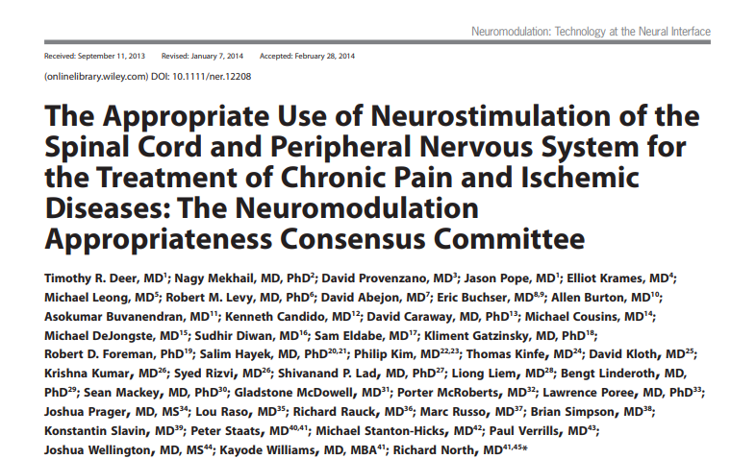
Clinical Evidence
Cochrane review on the use of SCS for non-reconstruct able CCLI that was published in 2005 and updated in 2013.
The review included six control trials
Totaling 450 patients
Comparing SCS with conservative treatment to conservative treatment alone.

Slide 21
Results
Limb salvage at 12 months was significantly higher in the SCS groups with a number needed to treat of 9
In the SCS groups significant pain relief was more prominent and less analgesics were used
More patients improved to Fontaine stage II in the SCS groups compared to the conservative only groups (NNT=3)
No significant effect on ulcer healing was observed
The patients receiving conservative treatment alone had a higher incidence of G.I. bleeding, dizziness, and nausea
Notes:
This classification system grades the clinical presentation of patients to four stages. The system is solely based on clinical symptoms, without other diagnostic tests, and is typically used for clinical research and not routinely used in patient care.
Stage II - Mild claudication pain in limb
Stage IIA Claudication at a distance > 200 m
Stage IIB Claudication at a distance < 200 m
Stage III Rest pain, mostly in the feet
Stage IV Necrosis and/or gangrene of the limb

Slide 22
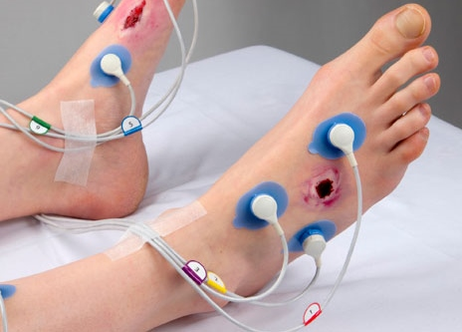
Improved Patient Selection
Transcutaneous Oxygen (tcpO2)
50-70 mmHg – Normal
10-30 mmHg
Notes:
Tcp02 - non-invasive method to quantify skin oxygenation
a predictive factor for spontaneous healing when pressure is above 30 mmHg
an unfavorable course when pressure is less than 10 mmHg

Slide 23
SCS for CCLI
Mechanism of action
  One of these proposed possibilities is that SCS causes release of Nitric oxide (NO) within the vascular system
  Modulation of the sympathetic nervous system has also been postulated as a possible mechanism
Cost effectiveness
  SCS + CMM is more expensive
  SCS + CMM therapy more than doubled the quality-adjusted life year (QALY) for those patients
Notes:
When placing the SCS into the posterior epidural space it stimulates mainly C fibers and A delta fibers of the dorsal columns of the spinal cord. This stimulation causing a biochemical cascade which eventually leads to NO being released. (Deogaonkar) NO is an important mediator in vascular disease as it causes vasodilatation and a decrease in vascular resistance (Ismaeel).
This modulation causes vasodilation and is achieved via prostaglandin release.

Slide 24
Conclusions
Spinal Cord stimulation can be a helpful modality in non-operable or failed operative vascular disease for treating pain, improving healing of skin ulcerations and possible limb salvage
  The earlier referral is important since TcPO2 <20 mmHG result in poorer outcomes
Spinal cord stimulation is highly effective for the management of painful diabetic neuropathy refractory to medical management
  As high as 86% treatment success

Slide 25
Medical References
Slangen R, Schaper NC, Faber CG, et al. Spinal cord stimulation and pain relief in painful diabetic peripheral neuropathy: a prospective two-center randomized controlled trial. Diabetes care. 2014;37(11):3016-3024.
van Beek M, Slangen R, Schaper NC, et al. Sustained Treatment Effect of Spinal Cord Stimulation in Painful Diabetic Peripheral Neuropathy: 24-Month Follow-up of a Prospective Two-Center Randomized Controlled Trial. Diabetes care. 2015;38(9):e132-134.
van Beek M, Geurts JW, Slangen R, et al. Severity of Neuropathy Is Associated With Long-term Spinal Cord Stimulation Outcome in Painful Diabetic Peripheral Neuropathy: Five-Year Follow-up of a Prospective Two-Center Clinical Trial. Diabetes care. 2018;41(1):32-38.
Pluijms WA, Slangen R, Bakkers M, et al. Pain relief and quality-of-life improvement after spinal cord stimulation in painful diabetic polyneuropathy: a pilot study. Br J Anaesth. 2012 Oct;109(4):623-9.
de Vos CC, Meier K, Zaalberg PB, et al. Spinal cord stimulation in patients with painful diabetic neuropathy: a multicentre randomized clinical trial. Pain. 2014;155(11):2426-2431.
Duarte RV, Andronis L, Lenders MW, de Vos CC. Quality of life increases in patients with painful diabetic neuropathy following treatment with spinal cord stimulation. Qual Life Res. 2016;25(7):1771-1777.
Duarte RV, Nevitt S, Maden M, et al. Spinal cord stimulation for the management of painful diabetic neuropathy: a systematic review and meta-analysis of individual patient and aggregate data. Pain. 2021;162(11):2635-2643.
Raghu ALB, Parker T, Aziz TZ, et al. Invasive Electrical Neuromodulation for the Treatment of Painful Diabetic Neuropathy: Systematic Review and Meta-Analysis. Neuromodulation : journal of the International Neuromodulation Society. 2021;24(1):13-21.
Medtronic. Medtronic Pain Therapy Clinical Summary M221494A016 Rev B 2022-01-31. 2022
Nevro. Nevro Clinical Summary 12057 Rev D, 2021. In: https://nevro.com/English/us/providers/product-manuals/default. Aspx.
Petersen EA, Stauss TG, Scowcroft JA, et al. Effect of High-frequency (10-kHz) Spinal Cord Stimulation in Patients With Painful Diabetic Neuropathy: A Randomized Clinical Trial. JAMA Neurol. 2021;78(6):687–698. doi:10.1001/jamaneurol.2021.0538
Got I. La pression transcutanée D'oxygène (TcPO2): intèrêts et limites [Transcutaneous oxygen pressure (TcPO2): advantages and limitations]. Diabetes Metab. 1998 Sep;24(4):379-84. French. PMID: 9805653.
Deer TR, Mekhail N, Provenzano D, Pope J, Krames E, Leong M, Levy RM, Abejon D, Buchser E, Burton A, Buvanendran A, Candido K, Caraway D, Cousins M, DeJongste M, Diwan S, Eldabe S, Gatzinsky K, Foreman RD, Hayek S, Kim P, Kinfe T, Kloth D, Kumar K, Rizvi S, Lad SP, Liem L, Linderoth B, Mackey S, McDowell G, McRoberts P, Poree L, Prager J, Raso L, Rauck R, Russo M, Simpson B, Slavin K, Staats P, Stanton-Hicks M, Verrills P, Wellington J, Williams K, North R; Neuromodulation Appropriateness Consensus Committee. The appropriate use of neurostimulation of the spinal cord and peripheral nervous system for the treatment of chronic pain and ischemic diseases: the Neuromodulation Appropriateness Consensus Committee. Neuromodulation. 2014 Aug;17(6):515-50; discussion 550. doi: 10.1111/ner.12208. PMID: 25112889.
Ubbink DT, Vermeulen H. Spinal cord stimulation for non-reconstructable chronic critical leg ischaemia. Cochrane Database Syst Rev. 2013 Feb 28

Slide 26
Medical References
Ranjan M, Kumar P, Konrad P, Rezai AR. Finding Optimal Neuromodulation for Chronic Pain: Waves, Bursts, and Beyond. Neurol India [serial online] 2020 [cited 2022 May 16];68, Suppl S2:218-23. Available from: https://www.neurologyindia.com/text.asp?2020/68/8/218/302465
Shealy CN MJ, Reswick JB. Electrical inhibition of pain by stimulation of the dorsal columns: Preliminary clinical report. Anesth Analg 1967;46:489-91
Illustration by Jean Chan. Spinal cord stimulation: a nonopioid alternative for chronic pain management. Aaron Hong, Vishal Varshney, Gregory M.T. Hare and C. David Mazer CMAJ October 19, 2020 192 (42) E1264-E1267; DOI: https://doi.org/10.1503/cmaj.200229
Wifen PJ, Derry S, Bell RF, Rice AS, Tölle TR, Phillips T, et al. Gabapentin for chronic neuropathic pain in adults. Cochrane Database Syst Rev. 2017;6:CD007938.
Finnerup NB, Attal N, Haroutounian S, McNicol E, Baron R, Dworkin RH, et al. Pharmacotherapy for neuropathic pain in adults: a systematic review and meta-analysis. Lancet Neurol. 2015;14(2):162–73
Derry S, Bell RF, Straube S, Wifen PJ, Aldington D, Moore RA. Pregabalin for neuropathic pain in adults. Cochrane Database Syst Rev. 2019;1:CD007076.
Brunton S, Wang F, Edwards SB, Crucitti AS, Ossanna MJ, Walker DJ, et al. Profle of adverse events with duloxetine treatment: a pooled analysis of placebo-controlled studies. Drug Saf. 2010;33(5):393–407
Eldabe S, Buchser E, Duarte RV. Complications of Spinal Cord Stimulation and Peripheral Nerve Stimulation Techniques: A Review of the Literature. Pain Med. 2016 Feb;17(2):325-36. doi: 10.1093/pm/pnv025. PMID: 26814260.
Oakley J, Prager J. Spinal cord stimulation: mechanisms of action. Spine. 2002;27(22):2574-2583
Spinal Cord Stimulation. Available at: http://www.aans.org/Patients/Neurosurgical-Conditions-and-Treatments/Spinal-Cord-Stimulation (accessed 9/18/2017). estimate
Ranjan M, Kumar P, Konrad P, Rezai AR. Finding Optimal Neuromodulation for Chronic Pain: Waves, Bursts, and Beyond. Neurol India [serial online] 2020 [cited 2022 May 16];68, Suppl S2:218-23. Available from: https://www.neurologyindia.com/text.asp?2020/68/8/218/302465
Shealy CN MJ, Reswick JB. Electrical inhibition of pain by stimulation of the dorsal columns: Preliminary clinical report. Anesth Analg 1967;46:489-91

Slide 27
References Images
IPG WaveWriter Alpha SCS Solution Overview - Boston Scientific https://news.bostonscientific.com/2020-09-30-Boston-Scientific-Launches-WaveWriter-Alpha-TM-Spinal-Cord-Stimulator-Systems-In-Europe
Electrodes: https://neupsykey.com/spinal-cord-stimulation-as-a-treatment-of-failed-back-surgery-syndrome/
“Diabetic Peripheral Neuropathy: What is it? Why do I have it? Anything else to try?” by Dr. Catherine Christenson Family Nurse Practitioner. October 21, 2021. https://strivephysmed.com/2021/10/diabetic-peripheral-neuropathy/
Illustration by Jean Chan. Spinal cord stimulation: a nonopioid alternative for chronic pain management. Aaron Hong, Vishal Varshney, Gregory M.T. Hare and C. David Mazer CMAJ October 19, 2020 192 (42) E1264-E1267; DOI: https://doi.org/10.1503/cmaj.200229
Trial https://www.meddeviceonline.com/doc/medtronic-announces-fda-approval-launch-generation-stimulator-chronic-management-0001
CLI https://hemostemix.com/platform/critical-limb-ischemia/
CLI https://resident360.nejm.org/clinical-pearls/chronic-critical-limb-ischemia

